Slide 1


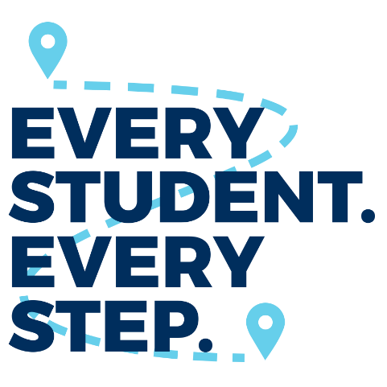






Slide 2
Introduction
Notes:
In everything we do, we believe in helping others achieve success. From a student wanting to go to college to a counselor helping a student make big life decisions to an administrator enabling data-driven change in a school, we believe in helping each of these people achieve education and workplace success. My guess is that you also believe in helping others, and that’s why you’re here today.

Slide 3
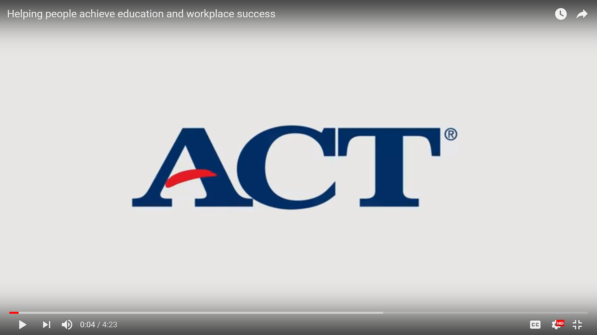
ACT Corporate Video
https://www.youtube.com/watch?v=MaxtEk_Cmpw

Slide 4

Hello, my name is…
Your Name
Your Title
Your School
What you are most interested
in learning today
Notes:
Have the attendees introduce themselves. If there are too many people, have them raise hands to show how many are Counselors, Teachers, etc.

Slide 5

Agenda
What do we expect our students to learn?
How will we know they are learning?
How will we respond if they don’t learn it?
How will we respond if they already know it?
Look for this icon. FREE RESOURCES are available for you to use at www.act.org/ccrw-toolkit.
#ACTCCRW
Notes:
What do we expect our students to learn?
We’ll review the educational framework, standards, and benchmarks that ACT research has determined are predictors for college and career success. You’ll also hear how social and emotional skills can be measured and improved from Kate Walton, Principal Research Scientist at ACT and Associate Professor of Psychology at St. John’s University.
How will we know they are learning?
We’ll go through an exercise to audit your current assessments and begin the process of creating a comprehensive assessment plan. This exercise will help you focus on the overall purpose of your assessment system as well as eliminate redundancies, limit their impact on instructional time, and align data from grade 3 through high school. We’ll even show you how a couple of schools have successfully put this into practice.
We’ll review updates to ACT products and how each one fits into your comprehensive assessment plan.
ACT electronic reporting
Introduce ACT Academy
Tessera Update
How will we respond if they don’t learn it?
What can you do to help students catch up? We’ll go through tools and resources you can use to build and enhance your intervention strategies – like the new ACT Academy. We’ll share how a few schools use these tools.
How will we respond if they already know it?
When your students are on the right track, what do you do? They still need college and career planning advice. Again, we’ll cover tools and resources you can use to bolster your expertise to help students find more scholarships and plan for their future.
Wrap-up

Slide 6
Every student of every race, gender, creed, country, and socioeconomic level deserves the opportunity to achieve their dreams.

Slide 7
What do we expect our students to learn?
PAGE 5
Notes:
Answering what we expect students to learn and when we expect them to learn it has been the subject of extensive research, the foundation of our curriculum, and the reason for assessments for decades. So today we’re not going to review everything we expect students to learn. What we’re going to talk about are the resources and tools we use to make sense of everything we expect students to learn.

Slide 8
Holistic Framework
Core academic skills that are mapped to learning progressions from K–career
Cross-cutting capabilities, such as critical thinking, collaborative problem solving, and information and technology skills
Behavioral skills related to success in education and the workforce
Education and career navigation skills related to exploration, planning, and decision making
Notes:
We know now that what we expect students to learn goes beyond core academics. In fact, a growing body of research has shown the importance of nonacademic factors for predicting outcomes such as retention, persistence, and engagement in college, as well as graduation from college. In response, ACT developed the Holistic Framework to help define this new standard for preparing and measuring student readiness for college and careers.
Video https://www.youtube.com/watch?v=WCFglzNStII
ACT is now mapping it’s current products and developing new products that align to the Holistic Framework.

Slide 9
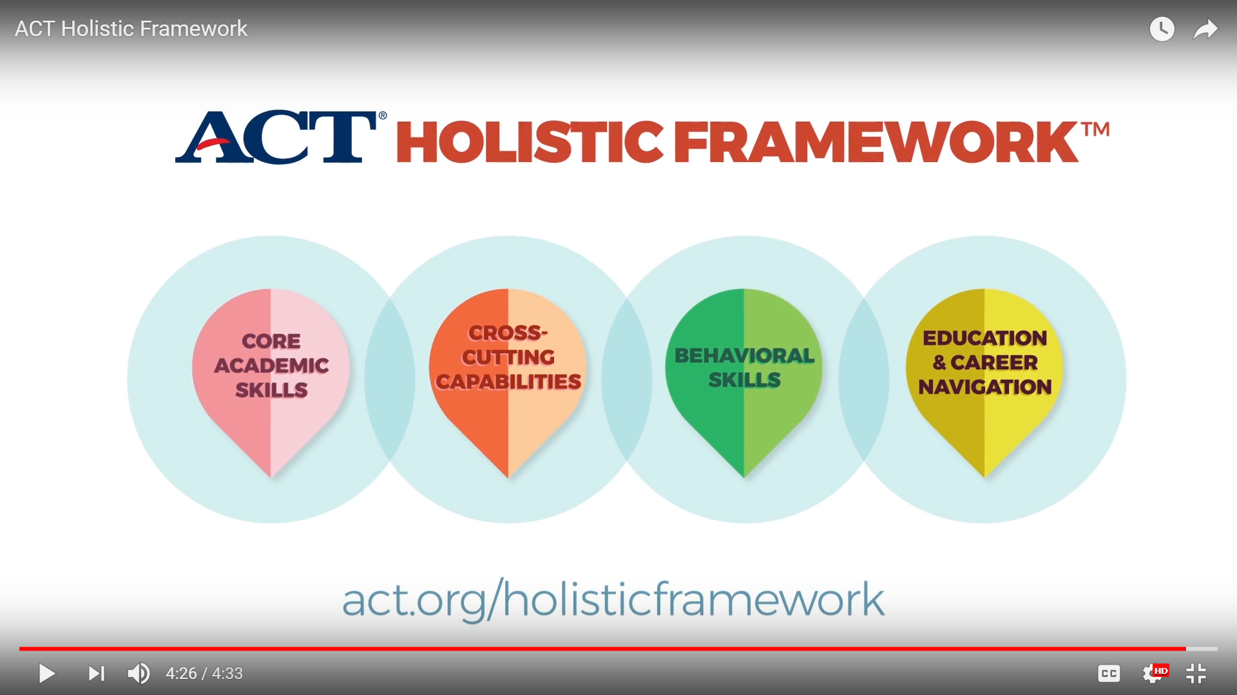

Slide 10

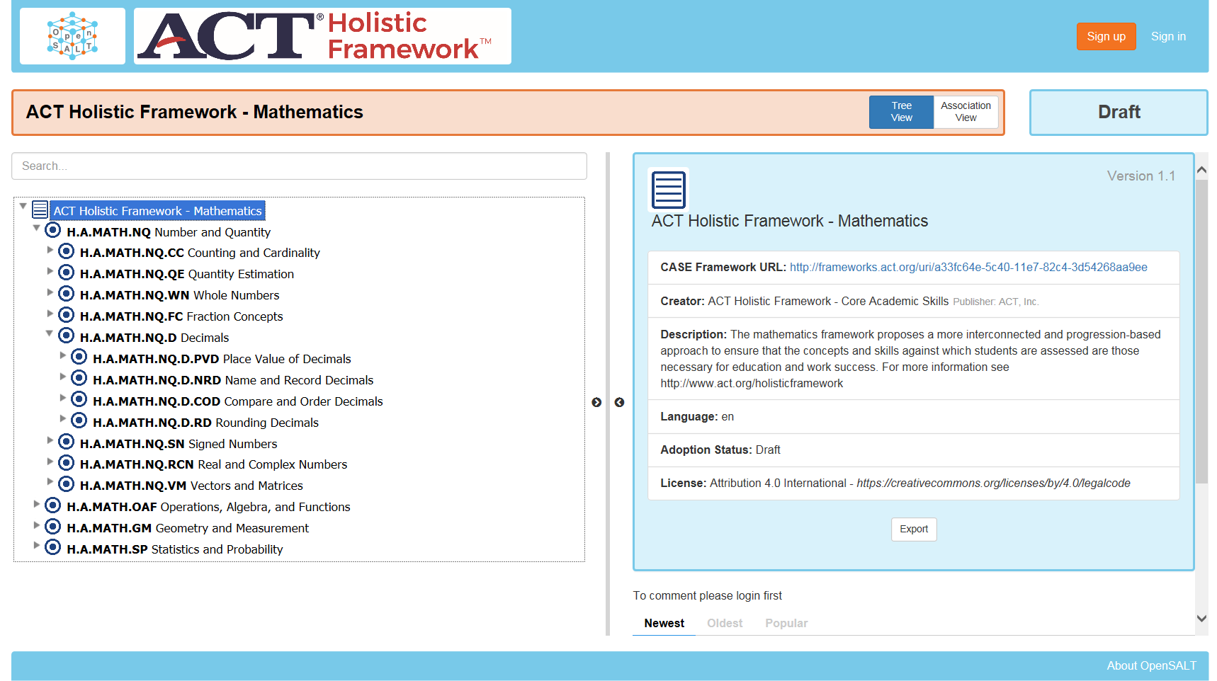
OpenSALT
frameworks.act.org
Notes:
We want you to help us evaluate the framework by joining a free, open-source online platform called OpenSALT (Open Standards Alignment Tool). Through this collaborative community approach, we’re looking for input that will help us further define specific knowledge and skills that should be included in the Holistic Framework’s four areas or domains.

Slide 11
Standards and Benchmarks
Standards = skills and knowledge
Benchmarks = level of skills and knowledge for college success
Benchmarks
Subject | ACT Score | First Year College Course
English | 18 | English Composition
Math | 22 | College Algebra
Reading | 22 | Social Sciences
Science | 23 | Biology
ELA | 20 | English Composition and Social Sciences
STEM | 26 | Calculus, Chemistry, Biology, Physics, and Engineering
Notes:
Whether we’re talking about state standards or the ACT College and Career Readiness Standards, standards are all of the “things” that we teach students in school. For example, in math we expect students to learn how to calculate the average of a list of numbers. That is a standard. In English we expect students to use commas to set off simple parenthetical elements. That is also a standard. Standards are all of the skills and knowledge we have determined students need in order to be successful in and after high school.
For lower grades and ACT Aspire we refer to the Performance Level Descriptors to outline the knowledge, skills, and practices that students performing at any given level achieve in each content area at each grade level. They indicate if the students are academically prepared to engage successfully in further studies in each content area, the next grade’s material and, eventually at the high school level to verify that they are college and career ready.
But what concerns most educators is the alignment of ACT standards to state standards because you are charged with implementing the standards your state has adopted. If your state standards represent the knowledge and skills that prepare students for college and career, then ACT assessments measure that knowledge and those skills. As your ACT representative, I can help you understand how ACT standards relate to your state standards and how our assessments compare to your state’s accountability provisions.
The ACT College Readiness Benchmarks are the minimum scores required on each subject test on the ACT for students to have a high probability of success in credit bearing, entry-level college courses in that subject area. Because the ACT test is an assessment of a students mastery of the standards, the benchmarks then are an indication of the minimum skills a student needs to master in order to succeed in postsecondary education.
FREE RESOURCES: Links to the standards and benchmarks posters is available at act.org/ccrw.

Slide 12
Using ACT Standards and Benchmarks
TAKE HOME ACTIVITY – PAGE 7
Notes:
Get the free ACT College and Career Readiness Standards posters for both STEM and ELA by visiting www.act.org/aap/resources and clicking on Order Paper Materials. You may also download and review the standards for free at www.act.org/standards.

Slide 13
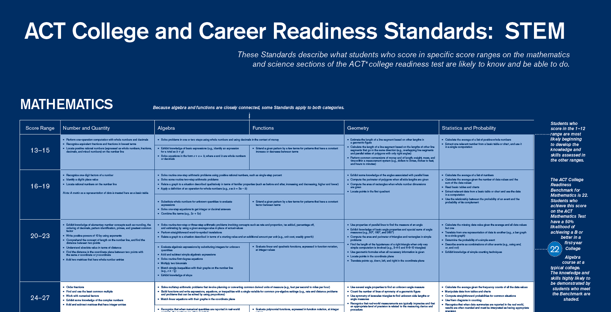
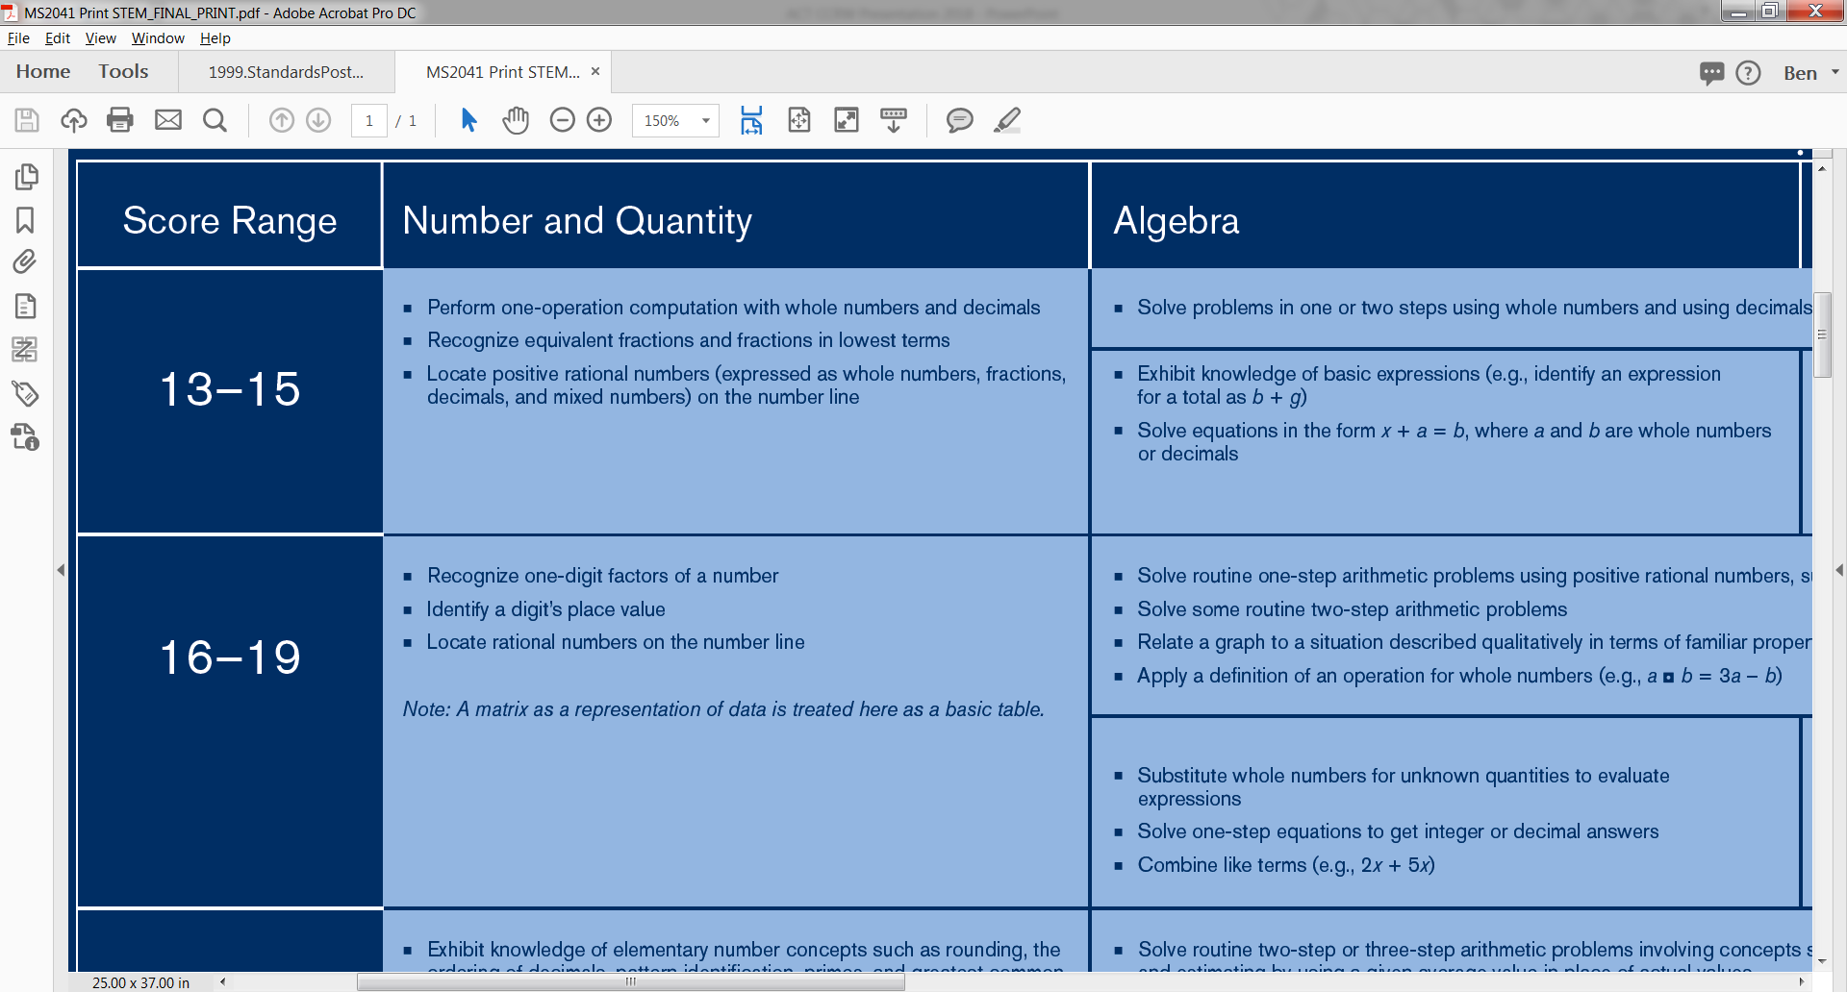
Notes:
The ACT College and Career Readiness Standards posters show you the skills and knowledge students need to reach each score level of the ACT assessment. They also show you which standards a student needs to master in order to reach the benchmark for that subject.
Here you can on the right that the math benchmark is 22 and that all of the skills in the blue shaded cells are what a student needs to master in order to reach that benchmark.

Slide 14
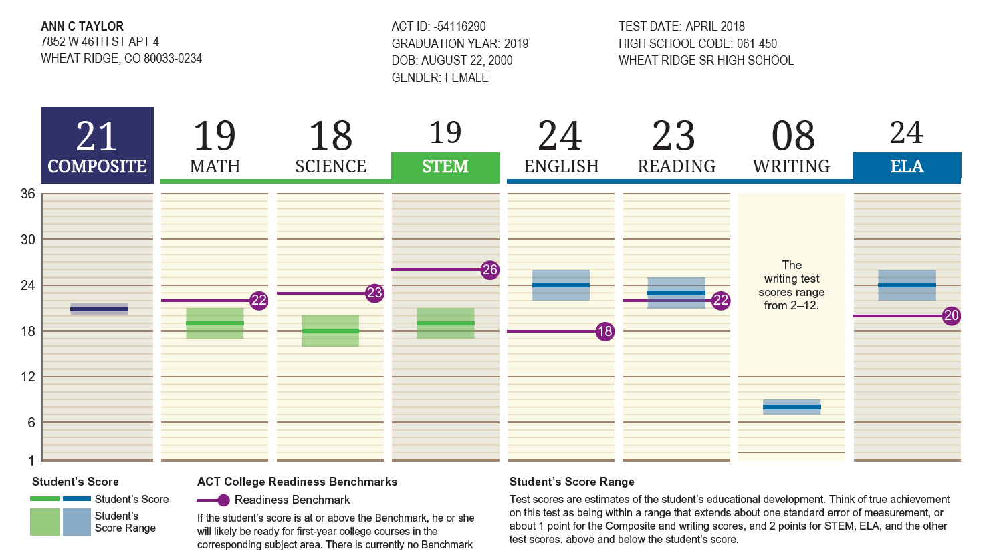
Notes:
COLLECT ACT SCORES
Score reports for the ACT test and PreACT® provide you with data (including scores and readiness benchmarks) on how each student performs in each subject and domain. These scores can be compared to the standards posters and documents to see what skills and knowledge are being mastered by the student.
CHECK THE BENCHMARKS
Has the student met the benchmarks, which are marked by a purple bar on the score report?

Slide 15
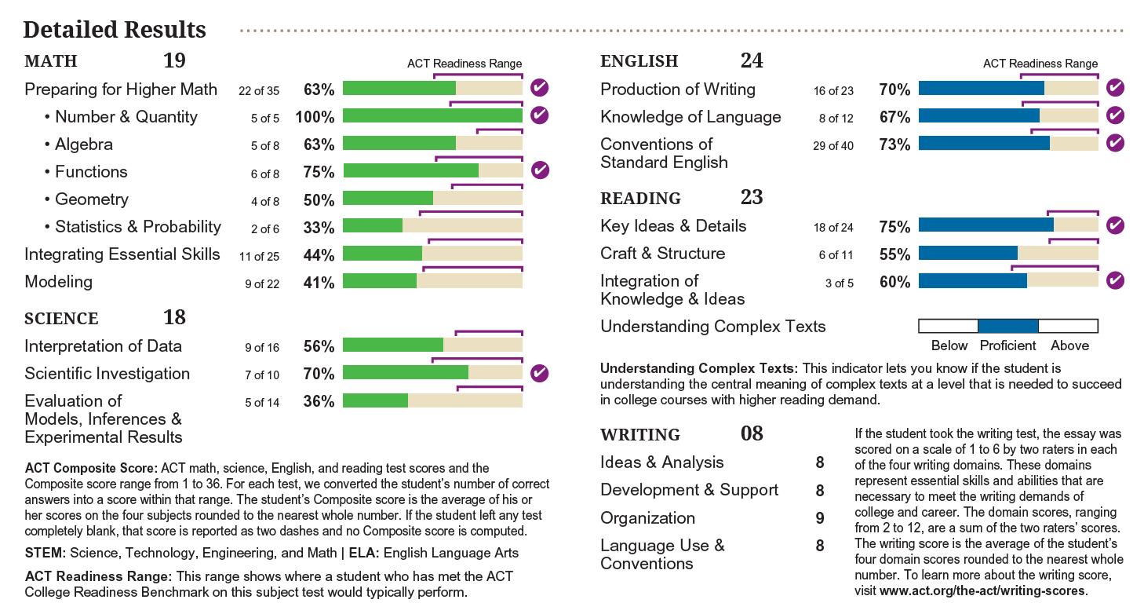
Notes:
IDENTIFY SKILLS GAPS
Compare the detailed results on the student score report with the skills listed on the poster. Which skill areas need the most focus or improvement?
For example, this student needs to improve on the skills listed under Algebra and Geometry on the poster.

Slide 16
Notes:
REVIEW THE SKILLS
On the poster, determine the score range where the student’s score falls in the far left column. Moving right across the rows, review the skills a student needs to learn to reach that score range.
INCREASE STUDENT SCORES
Look at the next score range down on the poster. Which skills should the student learn to reach the next level and increase his or her score?
The same technique of comparing student ACT and PreACT reports to standards documents can done with ACT Aspire and the PLDs.

Slide 17
STEM
PAGE 13
Source: Development of STEM Readiness Benchmarks to Assist Educational
and Career Decision Making
Notes:
Why does ACT include a benchmark for STEM?
The ACT is the only college entrance exam that truly measures science skills. Students interested in STEM careers (nearly half of all students) can turn to the ACT to assess readiness for college-level science courses. Unfortunately, recent research shows that many of these students are not ready for the rigorous coursework of STEM majors.
With the introduction of the ACT STEM benchmark, you have new data to evaluate your STEM programs, create student interest, and prepare students for success in STEM majors and careers.
This chart shows how achieving higher math and science scores leads to better grades in college STEM courses. By meeting the benchmark, students have a significantly higher probability for success. Notice that the “Math STEM benchmark” in the research is actually higher than the ACT Math Benchmark. This is because math and science courses for STEM majors are more rigorous. Again, you can take this information and apply it to those standards documents to see what students need to be learning.
3 Benefits of STEM Benchmark
Students interested in STEM but not meeting the STEM benchmark can take preemptive action to increase skills and knowledge
STEM score reports can create interest in STEM majors and careers for students academically ready but not previously interested
Educators can use student scores to begin evaluating the match between curriculum and the knowledge and skills assessed on the ACT test
STEM Report
I encourage each of you to read the report STEM Education in the U.S.: Where We Are and What We Can Do | 2017. The report addresses eight key findings that educators and policymakers need to know, as well as recommendations on what can be done to improve the state of STEM in the United States.
STEM Webinar
I also suggest you watch the recording of the webinar: STEM Talent: Increasing Demand, Decreasing Supply. It covers much of the material in the report.

Slide 18
ELA
PAGE 14
Graph like STEM benchmark
Source: Development and Validation of a Preliminary ELA Readiness Benchmark based on the ACT ELA Score
Notes:
Why does ACT include a benchmark for ELA?
Establishing the ELA Readiness Benchmark for the ACT test allows for the development of ACT Aspire Benchmarks for earlier grades. Early grade readiness benchmarks can be linked to the ACT ELA Benchmark, providing an early signal to students and educators on their ELA readiness to develop intervention initiatives well before they enter high school and graduate high school.
Providing students and educators with an indicator of ELA readiness will help ensure literacy skills are developed prior to entering college. If provided early enough, educators can take preemptive action to help students who intend to attend college but are not yet prepared for college-level coursework, thereby preventing the need for remedial courses.
This chart shows how achieving higher literacy in high school leads to better grades in college. By meeting the benchmark of 20, students have a significantly higher probability for overall success in college.

Slide 19

Social and Emotional Learning
SEL programs have a benefit-to-cost ratio of $11 to $1 for society
Conscientiousness measured in children predicted their occupational status, wages and job satisfaction 60 years later
Employers surveyed thought colleges should put more emphasis on teaching communication, critical thinking, complex problem solving, teamwork, etc.
Notes:
Social and Emotional Learning (SEL) skills are the noncognitive skills and characteristics (also known as soft skills, behavioral skills, employability skills, etc.) that are essential for a wide range of outcomes in academic and life success, including:
Conscientiousness
Agreeableness
Emotional Stability
Openness
Extraversion
SEL has been gaining traction with educators and policy makers thanks to the large volume of supporting research. But, understanding and creating an effective SEL program can still be a challenge. There is a great new eBook by Jonathan Martin—our Director of K12 Consulting Services at ACT—that outlines a process for proposing, developing, and executing your own program. The book walks through Eight Steps for Strengthening Social and Emotional Learning in Your School District (which happens to be the title of the book):
Explain the value of social and emotional learning (Here on the slide are just a few examples of its value. Coming up I’ll share our video from Kate Walton, a Principal Research Scientist at ACT working on SEL that speaks more directly to the benefits to your students)
Put SEL Front-and-Center in your mission and vision
Collect and use evidence of SEL program effectiveness (I’ll share one school’s success story with SEL next)
Identify, evaluate and prioritize gaps
Implement SEL program initiatives
Facilitate professional learning for administration and faculty
Empower students through goal setting, improvement, and self-monitoring
Measure, monitor, and repeat
FREE RESOURCES: This eBook will be included in the online toolkit you can download after the workshop. Add cover of the eBook.

Slide 20

UTAH SEL STORY
PAGE 16
Notes:
EAST HIGH CUSTOMER STORY
We know teaching SEL makes a difference because we’ve seen it at East High School in Salt Lake City, Utah. The school educates a large number of refugees, with 43 languages spoken in its hallways and socioeconomic backgrounds ranging from wealthy to homeless (more than 60 percent of students use the free-and-reduced-lunch program, compared to 37 percent statewide and 52 percent nationwide). East High’s unique student population multiplies the challenges of preparing students for college and career.

Slide 21
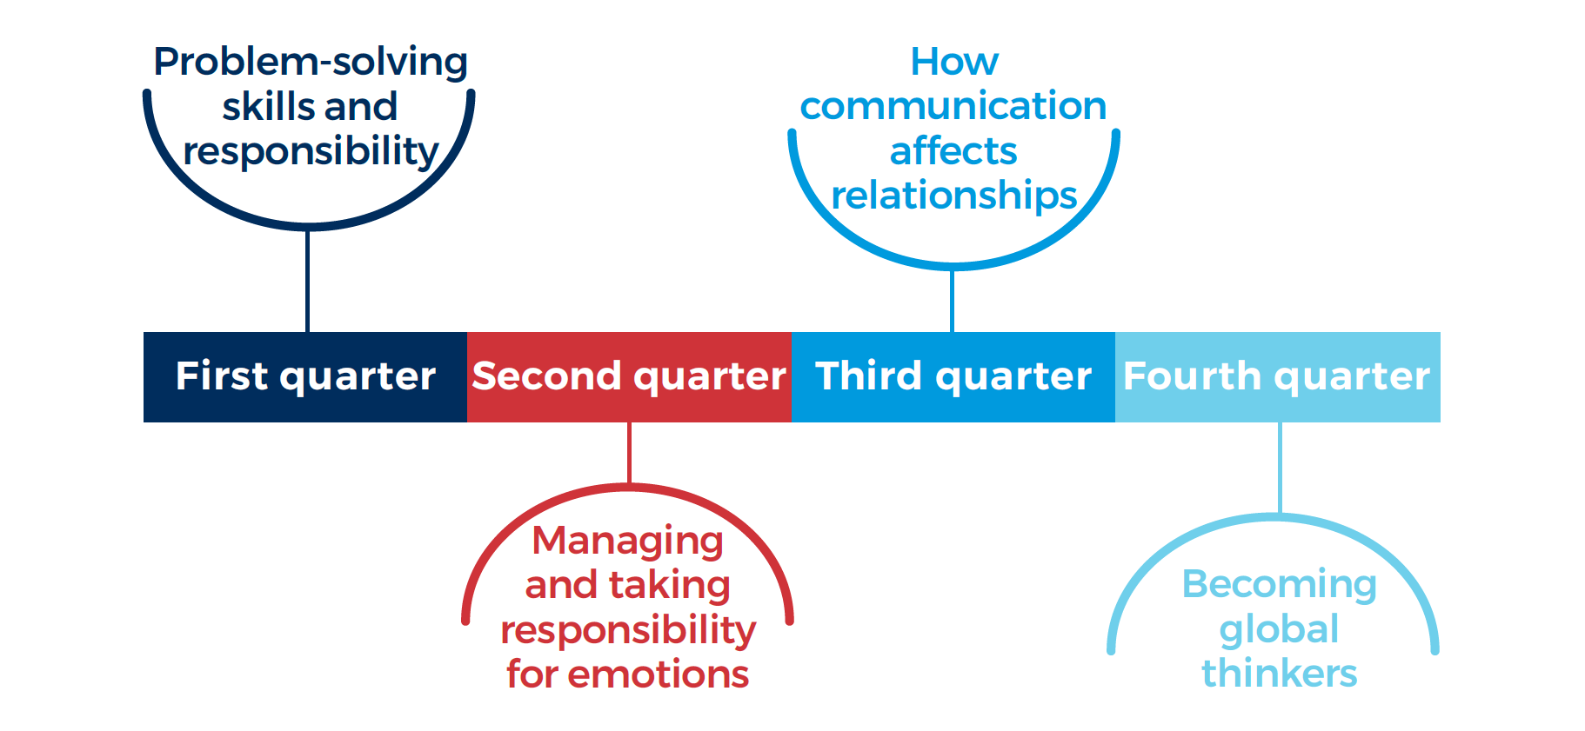
Notes:
East High developed an SEL-based curriculum, titled “Techniques for Tough Times.” Each quarter of the school year focuses on a different topic. The course also incorporates ACT Tessera assessments, which measure students’ progress in these behavioral skills.
Hundreds of students take the Techniques class each year, and students score higher than students in the national sample in all six constructs measured by Tessera.

Slide 22
Does SEL Impact Academic Ability
Tessera Skill | Correlation with High School GPA
Tenacity/Grit | .41
Organization/Responsibility | .38
Teamwork/Cooperation | .27
Composure/Resilience | .25
Curiosity/Ingenuity | .21
Leadership/Communication Style | .19
Notes:
ACT research shows instruction in social and emotional skills results in improved academic achievement and greater preparedness. In fact, ACT research shows a strong correlation between the six SEL constructs measured by Tessera assessments and high school GPA.

Slide 23
Being able to blend content knowledge into communication and collaboration skills helps students cross the threshold into success.
Greg Maughan, Principal
Notes:
Strong social and emotional learning skills have an impact on every aspect of our lives. In fact, research has demonstrated that these competencies strongly affect:
Academic performance
Behavioral problems
Happiness
Health
Longevity
Job performance
Job satisfaction
Peer relationships
One analysis showed that students who participated in social and emotional learning programs saw an 11% percent increase in the standardized test scores and a 23% increase in social and emotional skills.

Slide 24

Notes:
SEL Research Video (Kate Walton)
5 minutes

Slide 25
No matter what a student’s dream is, we can help identify the knowledge and skills they need to achieve it.

Slide 26
How will we know they are learning?
PAGE 18
Notes:
Data! More specifically a connected set of data across each student’s academic career, from elementary to high school. But, first you need to understand the data you have now.

Slide 27
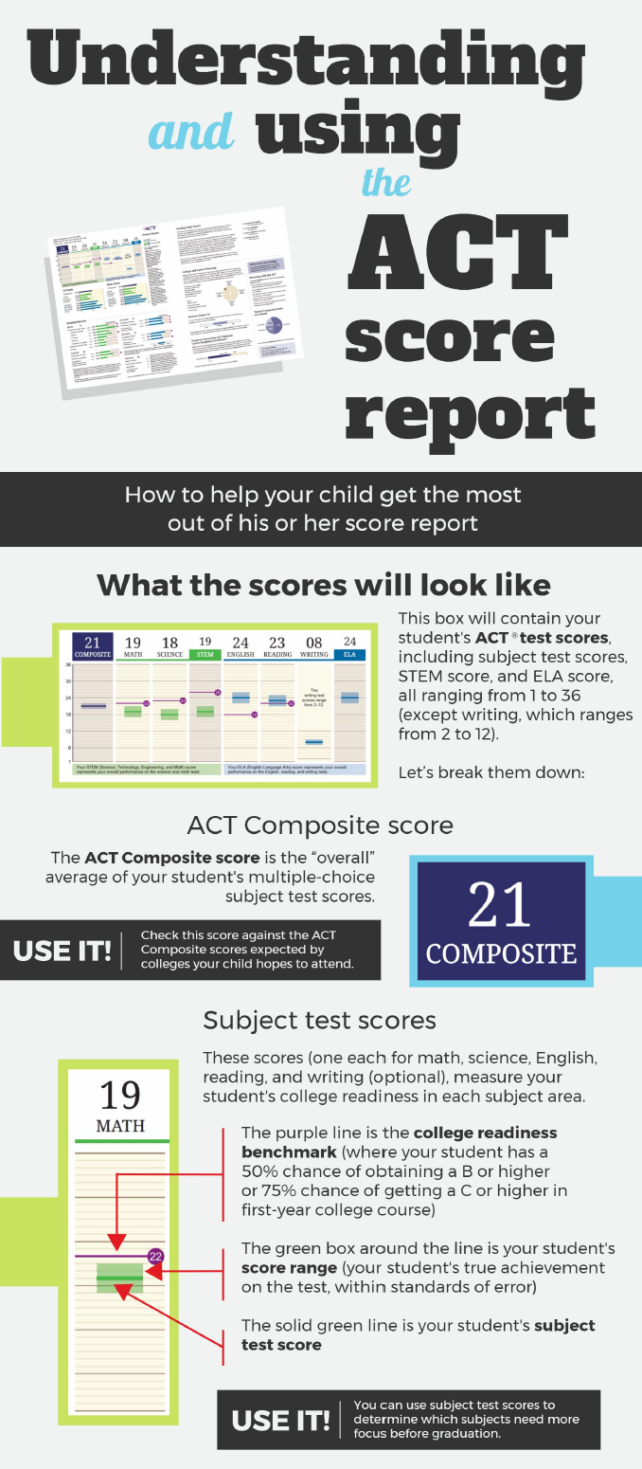
SO MANY WAYS TO LEARN!
act.org/ccrw-toolkit
Using Your ACT Results 2017-2018* (PDF)
Analyzing and Using ACT Scores (Video)
The ACT High School Report: Interpreting Data for Student Success (Video)
Understanding and Using the ACT Score Report Infographic (PDF)
Sample ACT Reports (PDF)
On-site Workshops
Understanding Your ACT Aspire and ACT Student Score Reports (Video)
ACT Aspire Summative Reporting and Data Usage Training Modules (Videos)
ACT Aspire Periodic Reporting and Data Usage Training Modules (Videos)
Understanding Your ACT Aspire Summative Results 2017-2018 (PDF)
Understanding Your ACT Aspire Interim Results 2017-2018 (PDF)
Using Your PreACT Results (PDF)
PreACT Interpretive Guide for Student and Aggregate Reports (PDF)
ACT Tessera Student Sample Report (PDF)
Notes:
In the past these workshops have largely focused on how to read and interpret your ACT score reports and data files. This year, we are focused on getting you the data you need and putting that data to use. In your workbook on page 18 is a list of materials to help you make sense of your ACT reports, including videos, training modules, and PDFs. These are all be available online in the CCRW Toolkit. I encourage you to watch and review these materials. If you have any questions while going through your reports, call me or send me an email.
ACT data reports and student reports provide a robust amount of information because we know that students are more than a score. And we want you to get the most out of your reports.
FREE RESOURCES:
LINK TO ALL OF THESE ON THE CCRW TOOLKIT PAGE:
http://actaspire.avocet.pearson.com/actaspire/home#alpha-U
https://actaspire.tms.pearson.com/
https://www.act.org/content/act/en/products-and-services/preact/preact-classroom/resources.html
https://www.act.org/content/act/en/products-and-services/the-act-educator/resources.html#scrollNav-4
https://www.act.org/content/act/en/products-and-services/the-act-educator/training.html#scrollNav-1-2
https://www.act.org/content/act/en/products-and-services/act-tessera/reporting.html
https://www.act.org/content/act/en/products-and-services/the-act/scores/understanding-your-scores.html

Slide 28
Making Data Make Sense
TAKE HOME ACTIVITY – PAGE 19

Slide 29
Open your ACT Profile Report to Table 3.1 Percent of Students in College and Career Readiness Standards (CCRS) Score Ranges and take note of the percentage of students for each of the score ranges.

Slide 30
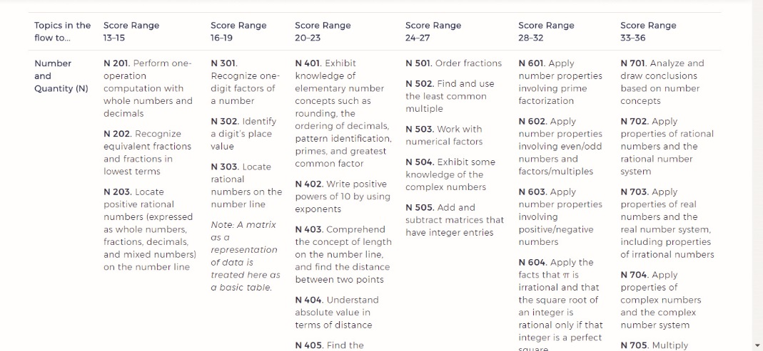
Open the ACT College and Career Readiness Standards at www.act.org/standards. Now, overlay data from the ACT Profile Report onto the standards by either writing on a printed copy of the standards or electronically on your computer. In the example below, 8% of students scored in the 13–15 range, 23% in the 16–19 range, and so on.
13–15
16–19
20–23
24–27
28–32
33–36
8%
23%
15%
30%
18%
6%
Notes:
Ask questions. Where do most of my students score? In the example above, an area of improvement we would note is that close to a quarter of our students are in the score band range below the benchmark. However, on a positive note we celebrate that 54% of students are scoring in the score band range above the benchmark. What are the skills for that score range? What skills should they work on to reach the next score range? Checking the Ideas for Progress at the bottom of the electronic version of the standards can assist in answering that question.

Slide 31

PAGE 21
Notes:
Cody, WY Story
Data visualization can be the difference between information and action. In 2015, Alan Shotts, Career Center Coordinator at Cody High School in Wyoming took student ACT scores and GPA information and by making one small change drove important professional development and conversations with educators and administrators about instruction, curriculum, grading practices, student course patterns, benchmarks, and social and emotional learning factors.
Just like that, data visualization changed the culture of the Cody school system.

Slide 32
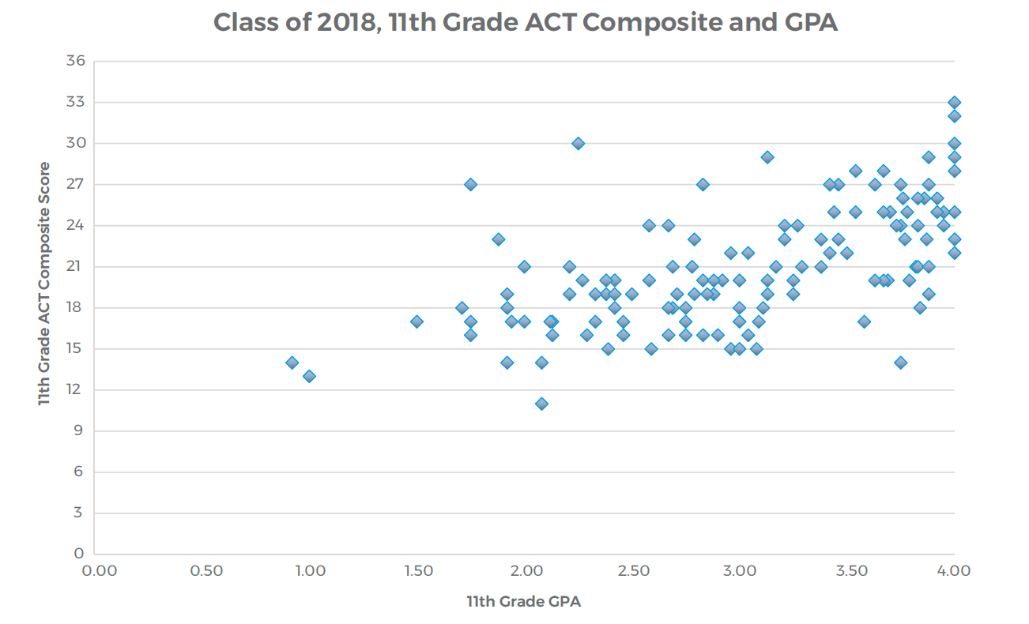
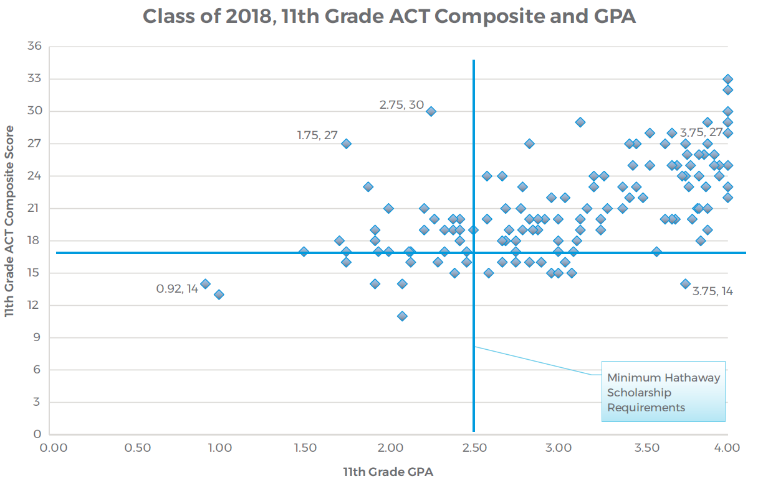
2.25,
Notes:
He created a simple scatter plot of students’ GPA and ACT Composite scores. The Cody High School staff could see a general correlation between GPA and ACT score, but was unable to identify any specific actions they could take to improve student results.
Click
By adding the minimum GPA and ACT score requirements for the Hathaway Scholarship to the graph, it became apparent that students in the upper right quadrant all qualified for this important financial benefit while students in the other three quadrants did not.
The focus has shifted to looking at individual students who were outliers on the chart. The school identified students whose GPA and ACT scores did not correlate and students who earned similar ACT Composite scores but had vastly different GPAs. As a result, conversations about the data began to focus on the causes behind these outliers:
What classes did they take?
What benchmarks are they achieving and what standards are they understanding?
What is being graded in the classroom, knowledge or action?
What are their social and emotional behaviors?
Is this something we have control over?
By asking and answering these tough questions, Cody High School is able to use data to identify areas— system wide and in the classroom—where changes make an observable difference in student performance. School wide this means focusing on grading what students know rather than what they do. In the classroom, educators can easily see where students struggle with specific standards and subjects, like algebra, and adjust curriculum to improve outcomes.

Slide 33
If you want to use data, you have to invest the time to make it something that everybody can use.
Alan Shotts, Career Center Coordinator

Slide 34

The Possibilities Begin to Rise
Notes:
When you understand your data better, you can begin to connect it across buildings and years to create a more complete picture of your educational system. It becomes easier to identify gaps, areas for improvement, students who need more attention, curriculum that needs adjustment, and so on. With more and better data, the possibilities begin to rise.

Slide 35
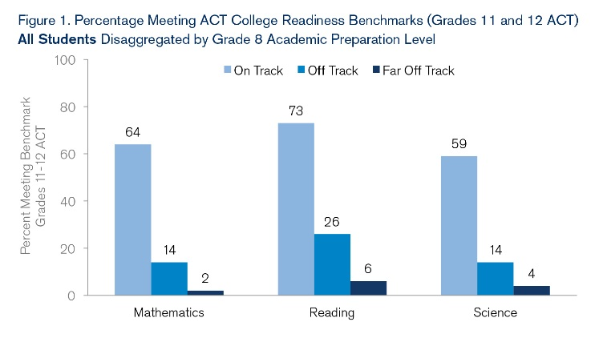
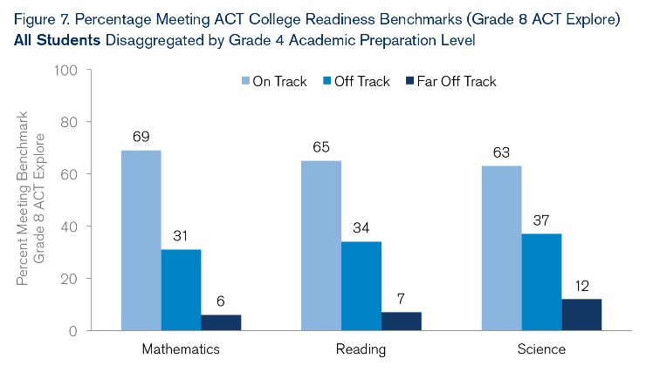
Early Intervention Matters
Notes:
Research shows that providing intervention at earlier grade levels is more successful in getting students on-track than at later grade levels.
Figure 1 and Figure 7 from the Catching Up to College and Career Readiness: The Challenge is Greater for At-Risk Students Research and Policy Brief.
A comparison of grades 8–high school with grades 4–8 provides evidence that students caught up at higher rates in the middle grades than in high school, especially in mathematics and science. The early emergence of preparation gaps and their tendency to widen over time underscore the importance of monitoring student progress in the early years.
Knowing how much students have learned from one grade to the next and how much they can be expected to learn in the future is valuable information. The growth models used as part of ACT Aspire reporting—including gain scores, student growth percentiles, ACT Readiness Benchmarks, and predicted score paths—are powerful tools you can use to understand your students’ academic progress over time.

Slide 36
Current State
Disconnected Data Systems
K–8
HS
College and Career Readiness
Resolving this DISCONNECT
is the essential bridge to success
Notes:
Unfortunately, when we examine district assessment plans we often find disconnected systems – disconnected by grade level and often by purpose. A disconnected system of assessments doesn’t allow you to see forward or backward along a students path to college and career readiness. It is also not unusual to find that districts are using more than one assessment for the same purpose.

Slide 37

PAGE 24
Notes:
FOX C-6 STORY
That is the situation the Fox C-6 School District near St. Louis, Missouri found themselves in four years ago. They wanted consistent data to track students’ progress toward college and career readiness across buildings, grade levels, and years. But, the thought of devoting more time and resources to external assessments and putting undue pressure on students and teachers was preventing that goal from being reached.

Slide 38
Fox C-6 Comprehensive Assessment Plan
Grades 3-9
ACT Aspire Summative
Grade 10
PreACT
Grade 11
The ACT Test
ACT WorkKeys
ACT Aspire Interim
Notes:
Since then, the district has put together a comprehensive assessment plan using ACT solutions that has limited their impact on instructional time and aligned data from grade 3 through high school:
Grades 3–9: ACT Aspire
Grade 10: PreACT
Grade 11: The ACT test or ACT WorkKeys
The first year they only tested grades 5, 7, and 9 to measure students once in elementary, middle school, and high school. But, when they saw the score reports and what the kids were gathering from it, they immediately added ACT testing to other grade levels. The district saw the importance of plotting a data point for every student, in every subject, every year. The emergence of trend lines allowed the district to identify what students know and don’t know, and implement academic intervention before it’s too late.

Slide 39
If you’re going to make a difference for a kid, you’ve got to start somewhere in elementary school.
Declan Fitzpatrick
Executive Director of Curriculum and Instruction
Notes:
For credible results, data MUST connect from one assessment to another and from one year to another. If the data set isn’t the same, how can we be certain progress is being made or if intervention strategies are working? Reliable trend lines cannot be created from data that cannot be reliably linked together. Comparisons between classes, schools, and districts can’t be made with different data sets.
Here is the full quote from Declan:
“Every two years is too long of a wait to develop a trend line. Every year is great, but starting in eighth grade is also too late. If you’re going to make a difference for a kid, you’ve got to start somewhere in elementary school because by the time you get to sixth grade, if you have a trend line that’s going in the wrong direction, you can really make a difference and change a kid’s life,”

Slide 40
CREATING A COMPREHENSIVE ASSESSMENT PLAN
WORKSHOP ACTIVITY – PAGE 26

Slide 41
Creating a Comprehensive Assessment Plan
Assessment Types and Purposes
Formative
High
Classroom Assessments
Interim Assessments
Frequency
Summative
Annual exams
State tests
Low
Stakes
Low
High
Notes:
A comprehensive assessment plan is a well-defined schedule and system of assessments designed to provide information that supports and enhances whole student learning from elementary through career.
So what is included when a district creates a comprehensive assessment plan? What types of assessments?
This diagram shows a common model of assessments, with formative assessments being lower stakes and summative assessments being higher stakes. Each assessment along the way serving a specific and meaningful purpose. These assessments might measure academic growth or social and emotional learning skills, or be used for college and career navigation.
Formative: Assessment for learning. How is a student progressing toward a learning or skills goal? How do we course correct and get them on track?
Summative: Assessment of learning. Did the student meet the learning or skills objective?
Data MUST connect from one assessment to another and from one year to another. If the data set isn’t the same how can we really tell if progress is being made or if intervention strategies are working? Reliable trend lines cannot be created from data that does not match. Comparisons between classes, schools, districts can’t be made with different data sets.

Slide 42
List All of Your Assessments
Grades Administered
Assessment Name
Holistic Framework Domain
Purpose
Notes:
Let’s dig into the assessments at your school or in your district.
Start by listing all of the standardized assessments you administer and the grade levels on page 27 of your workbook.
Next to each of the assessments you listed, check the holistic framework domains that the assessments fulfill
Then, describe the purpose of each assessment. For example, “SEL, college and career readiness”

Slide 43
How do the assessments I use fit in a CAP?
GRADE LEVELS |  | Assessments | Holistic Framework Domain | Purpose
 | 3
 | 4
 | 5
 | 6
 | 7
 | 8
 | 9
 | 10
 | 11
 | 12
Notes:
Now, let’s organize them and look for overlap, redundancies, and gaps. While you organize keep these questions in mind:
How many sources of data do you have?
Are there overlapping purposes of these assessments?
What data do you really need?
What data are you using or should you be using?
Do you have a systematic plan for administering assessments and using the data?
Are you giving too many assessments on one subject and not enough on another?
Have you communicated the purpose of the assessments to your stakeholders?
Can you answer the ultimate question: Who is making progress and what are you doing about those who are not?
Do we have all of the types we need: SEL, Academic Progress Monitoring, Summative, Diagnostic, etc.
FREE RESOURCES: This activity is available in the online toolkit.

Slide 44
Organize Your Comprehensive Assessment Plan
GRADE LEVELS |  | Assessments | Holistic Framework Domain | Purpose
 | 9 | ACT Aspire Summative ACT Aspire Interim State Assessment ACT Tessera | Core Academic Skills Core Academic Skills Core Academic Skills Behavioral Skills | Summative assessment to measure student achievement in E, M, R, S, W; year over year growth; college and career readiness measure Student progress, intra-year growth measure Summative accountability measure, required Character Education and Leadership goals
 | 10 | PreACT State Assessment | Core Academic Skills and Education and Career Navigation Core Academic Skills | Measure student achievement in E, M, R, and S, practice for ACT in setting, content and skills. Summative accountability measure, required
 | 11 | The ACT Test ACT Tessera | Core Academic Skills and Education and Career Navigation Core Academic Skills | Summative assessment to measure student achievement in E, M, R, S, W, college entrance exam, college and career navigation Character Education and Leadership goals
 | 12 | The ACT Test ACT WorkKeys | Core Academic Skills Education and Career Navigation | Summative assessment to measure student achievement in E, M, R, S, W, college entrance exam, college and career navigation Career readiness assessment and opportunity to earn NCRC (career credential)
Notes:
Once needs and goals are matched, justify each assessment. Look to eliminate redundant assessments and look to choose assessments that can fill more than one need (ACT Aspire) and serve more meaningful purposes. Eliminating unneeded assessments not only helps your teachers respect the data more, it also makes life easier. Assessment data that goes unused indicates an assessment that can be eliminated.
The complaint is, “We test too much.” What they are really saying is, “We don’t use the results from these tests. They aren’t relevant.” So it’s not always less testing, it should be more operable tests that provide the data we need to strengthen student learning and therefore show progress on our goals.

Slide 45
Complete Your CAP
GRADE LEVELS |  | Assessments | Holistic Framework Domain | Purpose
 | 3
 | 4
 | 5
 | 6
 | 7
 | 8
 | 9
 | 10
 | 11
 | 12
Notes:
Now you can begin to build a more meaningful assessment plan. Using your organized list you can begin to cross off the redundant assessments. In the chart on page 29 you can enter the assessments you need, what grades it is needed in, and it’s purpose.

Slide 46
How do ACT Assessments Fit into a CAP
Assessment Types and Purposes
Formative
ACT Aspire Classroom Assessments
Common Assessments in ACT Academy
Frequency
High
ACT Aspire Interim
PreACT
ACT Tessera
Summative
ACT Aspire Summative
State Test
The ACT
Stakes
Low
Low
High
Notes:
Looking back at the diagram on slide 34 we can see how ACT assessments fit into each area and can help you fill in the gaps or replace less meaningful measurements.

Slide 47
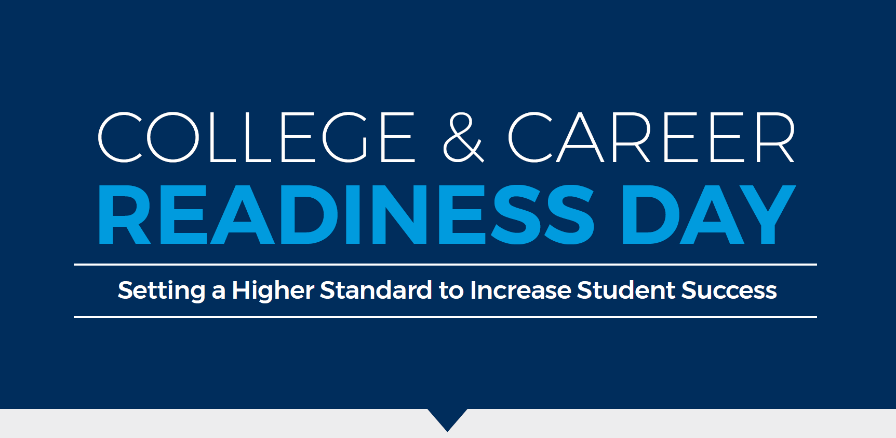
PAGE 31
Notes:
College and Career Readiness Day Story
Make the most of your administration strategy. How and when tests are administered can make life better for students, teachers, and yourself.
Three years ago, Affton High School in St. Louis, Missouri sought to improve student learning and readiness for college and career. To achieve their goal, administrators set a standard that all students who want a higher education have the academic skills to earn one. By dedicating a day to college and career readiness, they have had success.
Affton’s college and career readiness day is a regular school day set aside for ALL grades to participate in college readiness assessments.
First-year students take ACT Aspire
Sophomores take PreACT
Juniors take the ACT test
Seniors celebrate completing ACT testing at an offsite picnic
With the high-stakes nature and classroom schedule changes required to administer the ACT, schoolwide testing has simplified administration. And, with seniors offsite for a picnic, there are fewer interruptions. School administrators devote time before testing to educating students and their parents on the value of ACT assessments and to get students excited about planning for their futures.

Slide 48
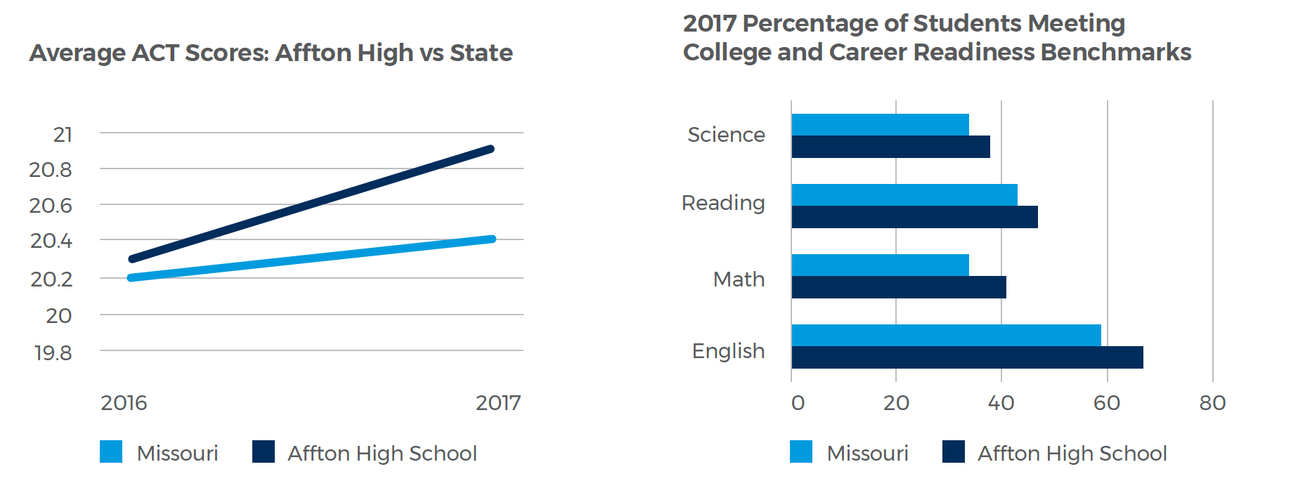
Notes:
After college and career readiness day, Affton uses the experience and ACT data to make improvements in everything from test administration to curriculum. Data is used to evaluate the curriculum, inform discussions at faculty meetings, implement new programs like reading and writing in noncore classes, and identify areas for professional development.
Today, Affton produces students who are more prepared for success in college and career, compared to the rest of Missouri. Affton’s ACT scores are higher compared to the state over the past five years. And, 41% of Affton students met three or four ACT College and Career Readiness Benchmarks, while only 35% of students statewide are at that same level. At the subject level, Affton outpaces the rest of the state with a higher percentage of their students meeting each subject benchmark. English holds the largest margin of separation.

Slide 49
It is the knowledge you build on year after year, starting in lower grades, that gets you ready for the ACT.
Dr. Vince Powell, Principal

Slide 50
BREAK

Slide 51

What’s New with ACT?
PAGE 33

Slide 52
ACT Aspire
The ACT Aspire Interim reports have been improved as a result of requests from educators and ACT Aspire Interim users, and our desire to ensure that reports help track progress toward college and career readiness. Some of the most notable changes include:
The ability to view longitudinal growth over the academic year
New scores reported including scale scores, ACT Interim Readiness Range, National Percentile Rank for subject tests, and Progress with Text Complexity Indicator (if students take the reading test)
Newly developed ACT Interim Readiness Benchmarks for each subject test
Skill Proficiency by Student listing individual students by “Meets Benchmark” or “Below Benchmark” by reporting category, with scale score ranges provided

Slide 53
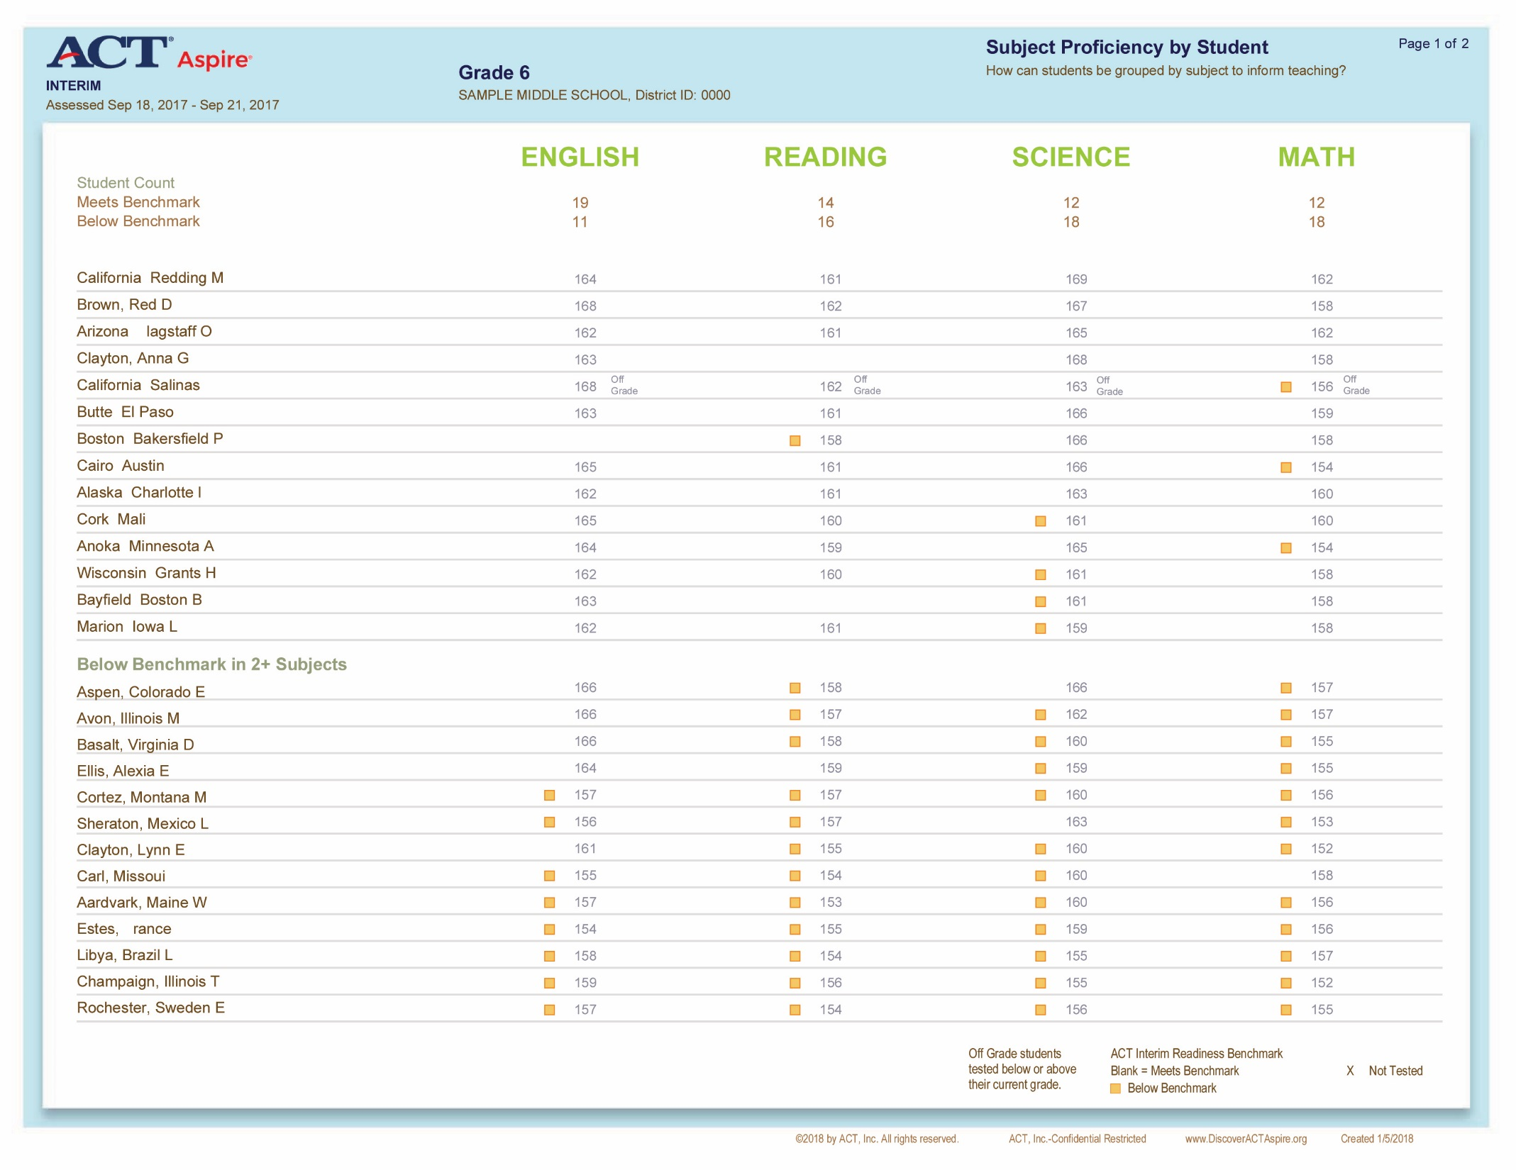

Slide 54
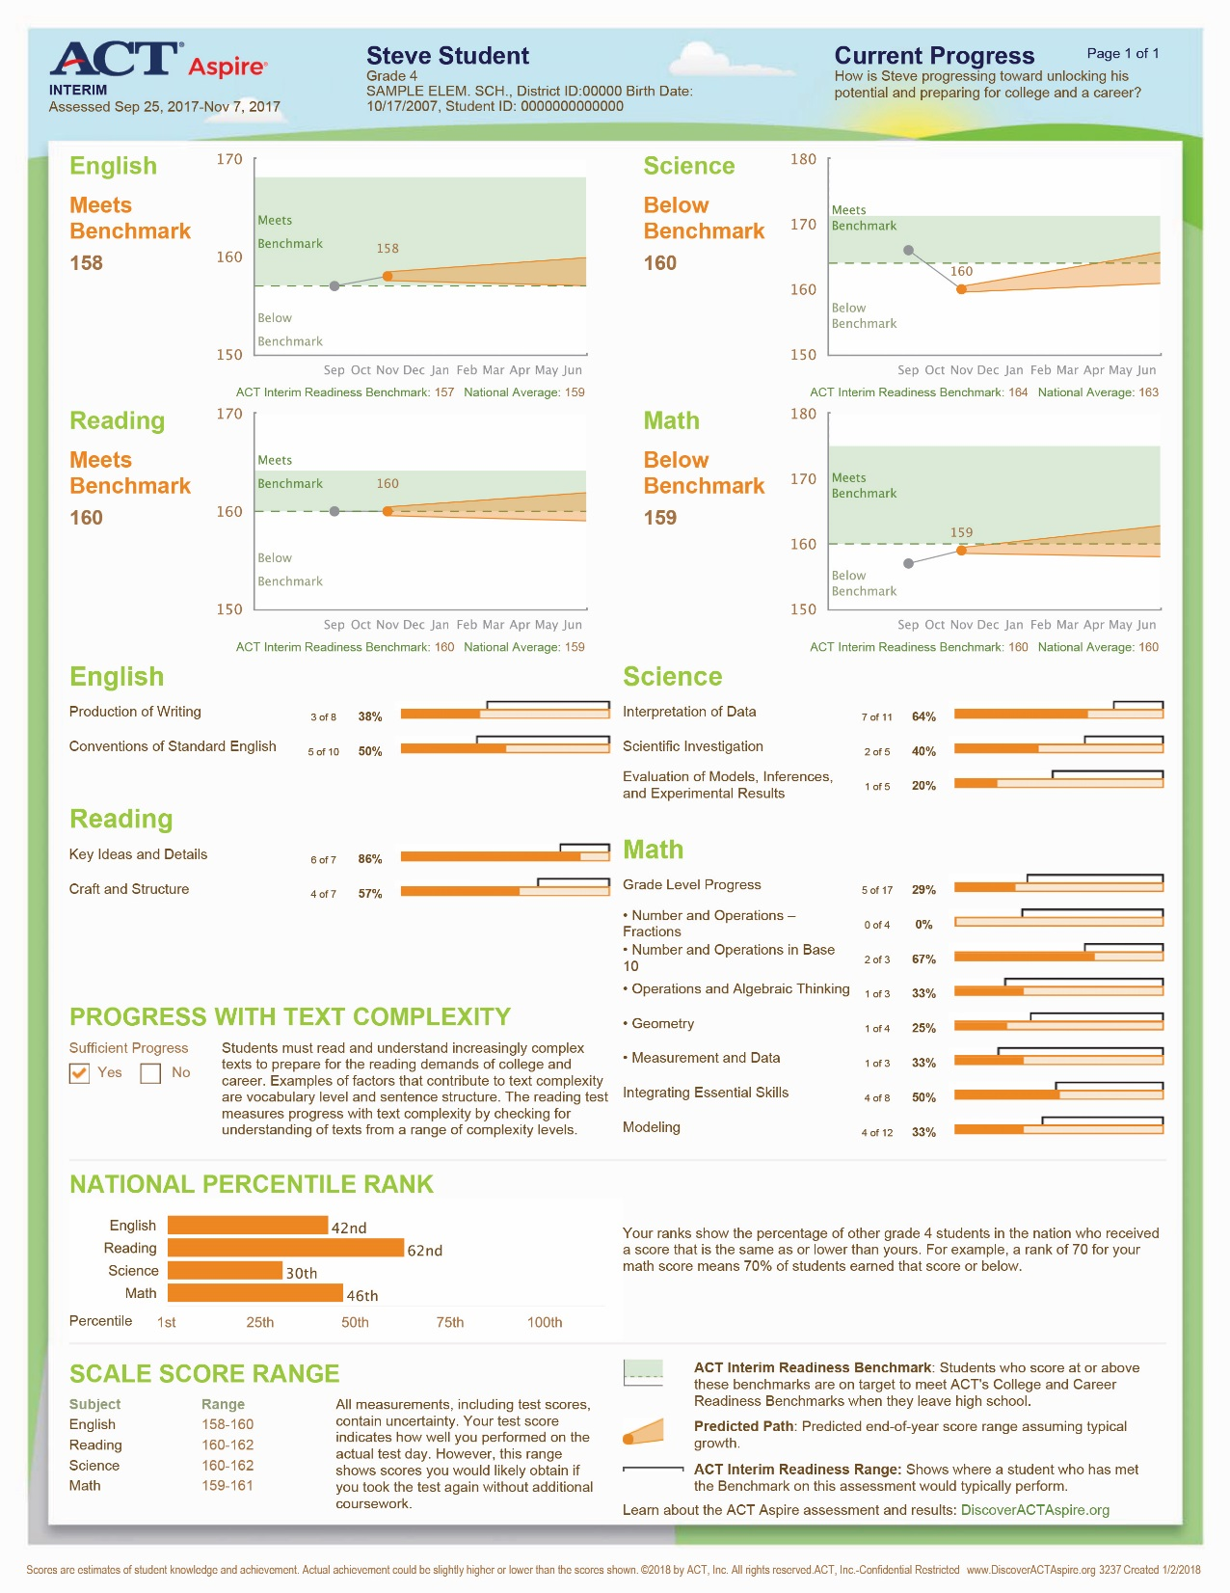

Slide 55
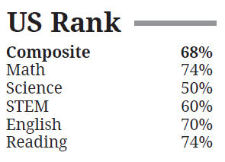
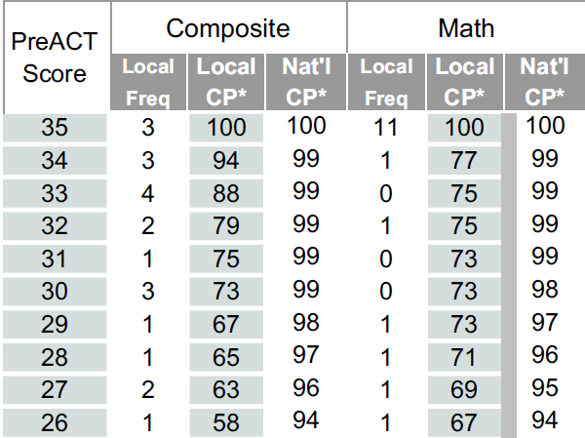
PreACT
US Ranks added to student score reports
National Cumulative Percentile added to educator reports
Notes:
US Ranks (National Norms) is the approximate percentage of recent testers, at the same grade level, who took the PreACT and received scores that are the same as or lower than the student's. For example, a rank of 56 for the student's Composite score means 56% of other tested students earned that Composite score or below.
CP* = Cumulative percent of students at or below a score
They are available for all subjects on educator reports – only showing composite and math for space reasons

Slide 56
Test Day Alignment
The ACT Aspire testing window for spring 2019 now aligns with the ACT late spring testing window allowing schools/districts the opportunity to establish their own College and Career Readiness Day and test multiple grades on the same day.
Assessment | Administration | Testing Window
ACT Aspire Summative | Fall 2018 | Oct 8 – Nov 30, 2018
ACT Aspire Periodic | 2018-19 | Sept 4, 2018 – June 28, 2019
ACT Aspire Summative | Spring 2019 | Apr 1 - May 24, 2019
The ACT | Late Spring: Paper | Apr 2, 2019
The ACT | Late Spring: Online | Apr 2 – Apr 4, 2019 Apr 9 - Apr 11, 2019
PreACT and Tessera can be given whenever you’d like throughout the school year!

Slide 57
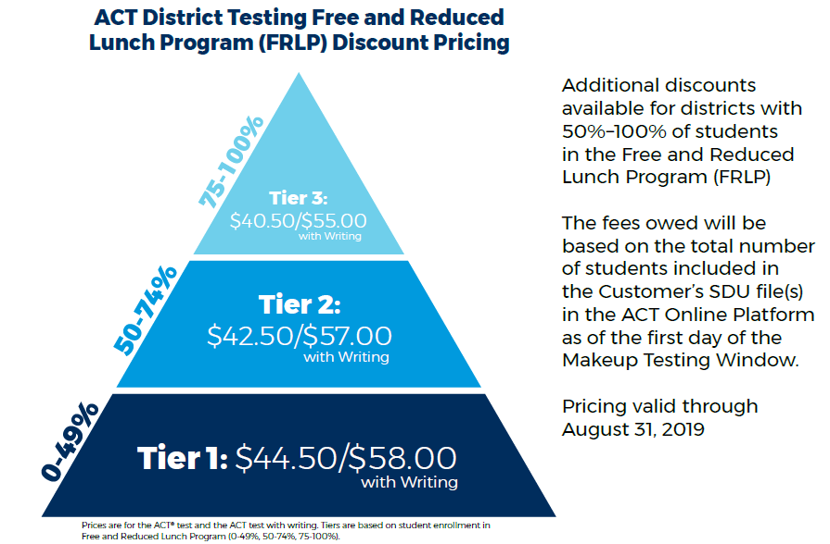
District Testing – The ACT
Updated billing process
New Tiered Pricing
Notes:
Billing now based on SDU file

Slide 58
The ACT Test Online Reporting
Free online platform, any designated faculty member can view
View the contents of your high school reports and print out student score labels
View and export data, with API integration with student information systems coming next year
Free training materials and webinars
Notes:
ACT Online Reporting Coming in 2018-2019
We’re excited to launch our interactive online reporting platform in December for national test dates! Through the free online platform, any designated faculty member can view the contents of your high school reports and print out student score labels. Get to the data you need to help individual students and inform decisions for groups of students, quickly and easily.
The rollout of the online interactive platform will be staged, with some schools getting access in the early part of 2019. Grad class aggregate reports will be posted online in the fall of 2019. Designated users will be able to view and export data, with API integration with student information systems coming next year. We will provide free training materials and webinars to help make the best use of the new platform.

Slide 59
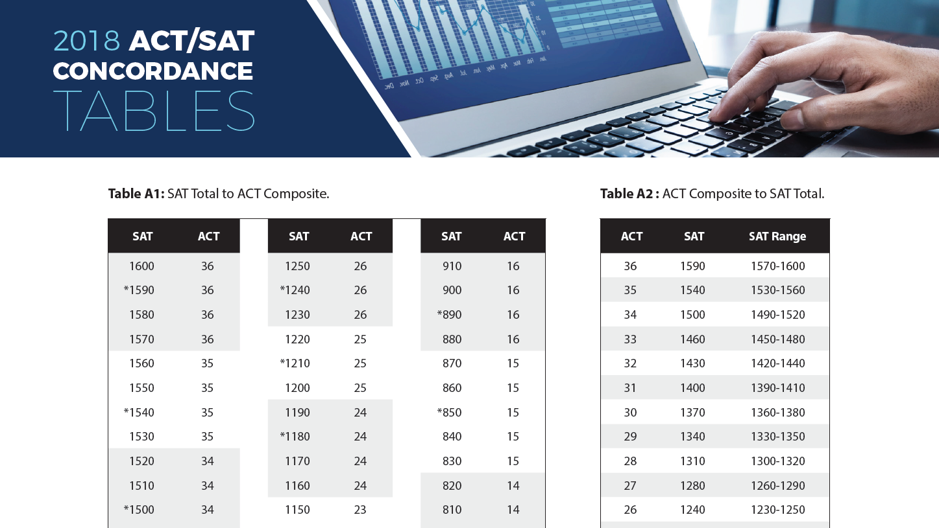
ACT/SAT Concordance (Learn more at act.org/concordance)
Notes:
On June 14, 2018, ACT and the College Board released the new concordance tables that allow users to compare scores from the ACT test and the new SAT test. The 2018 ACT/SAT concordance tables, derived from a joint comprehensive research study conducted by the two organizations over the past nine months, are based on scores of nearly 600,000 graduating seniors in the class of 2017 who took both tests.
Use concordance tables to:
Compare SAT and ACT scores across different students. When scores from either test are accepted, concordance tables can help institutions or other stakeholders who need to compare scores.
Establish a policy using comparable scores from both tests. An institution, scholarship, or program may use a specific test score as one factor to establish eligibility.
Convert scores for use in a predictive model or index. Many colleges and universities have built indices or models to predict the likelihood that individual students will apply, enroll, or succeed academically. These models typically include a variety of factors, including test scores, high school GPA, and course rigor. Institutions can apply the concordance tables in these prediction models.

Slide 60
ACT Tessera
Improved reporting to provide educators with additional tools for instruction. New School Comparison Aggregate Report making comparison to other schools possible.
  New One-page Summary Individual Student Report with a simplified student and parent overview of key findings.
  Current Individual Student Report will be enhanced with detailed constructs
  Roster Report transitioned to the ACT Aspire Student Performance File format for consistency across assessments.
Additions and digital delivery of the ACT Tessera Teacher Playbook for quick accessibility.
The best of ACT® Engage® will be incorporated into Tessera, including school climate items.
Reduced assessment time by 15 minutes to maximize class time, with the same reliable results.

Slide 61
ACT WORKKEYS
Updates include:
New and updated skills and item content to better reflect today’s jobs
New and improved assessment delivery platform to be more stable and faster
Fully aligned curriculum to better support skill development and test prep
More intuitive assessment titles:
ACT WorkKeys Applied Math
ACT WorkKeys Graphic Literacy
ACT WorkKeys Workplace Documents
ACT WorkKeys National Career Readiness Certificate
PDF of certificate can now be generated and printed at no additional fee.
Notes:
Throughout 2017, ACT launched updated versions of the ACT® WorkKeys® National Career Readiness Certificate (NCRC®) assessments and credential, as well as the aligned curriculum, test prep, and job profiling products and services. The updated assessments continue to measure the same core set of broadly relevant career readiness skills that have historically been measured by the NCRC assessments. The updated credential continues to be a reliable signal of career readiness, trusted by job seekers, employers, and educators domestically as well as internationally.
A few other new features:
-The new NCRC shows a “positive summary report” on the back of the certificate for all three assessments
-Practice test are now online and free
-The new assessments are on a new and improved platform, TAO. This TAO platform offers more accessible features than the previous platform. A few new capabilities are a calculator, magnifying tool, contrast colors, answer eliminator and more. TAO also has improved test security and test data privacy controls.
-The new (3) WorkKeys assessments now come in Spanish accommodated versions.
-Faster and simpler electronic docu-sign (contract) process that is valid for 3 years

Slide 62
ACT K12 Consulting Services: New in 2018
Short (1-day) & Long (up to 1-2 year) Engagements
On-site and Customized, with On-Demand Resources Available
Led by Experienced School-Based Practitioners
Leadership Coaching, Board training, Team-Building
Professional Learning for Teachers and Administrators
Topics
Social-Emotional Learning, including Program Planning and Teacher PD
Data Aggregation, Analysis, & Action Planning
Assessment for Learning, including Formative and Higher Order Thinking
K12 Standards Alignment, including Portraits of the Graduate and the Holistic Framework
Contact us at ACTConsultingServices@act.org

Slide 63
ACT Certified Educator
Learn teaching strategies to ensure more students are prepared for college and career
Establish specific ACT knowledge regarding accommodations, fee waivers, and other resources
Provide tailored counseling regarding college and career based on student Score Report and Interest Inventory
Notes:
ACT Certified Educator is an innovative credentialing program to recognize individuals who meet certification requirements to tutor students preparing to take the ACT test. Modules include the recommended ACT Basics course as well as any or all of the specialized ACT test subject areas: English, math, science, and reading. ACT Certified Educator is the only certification tied to the research of ACT’s college and career readiness standards.

Slide 64
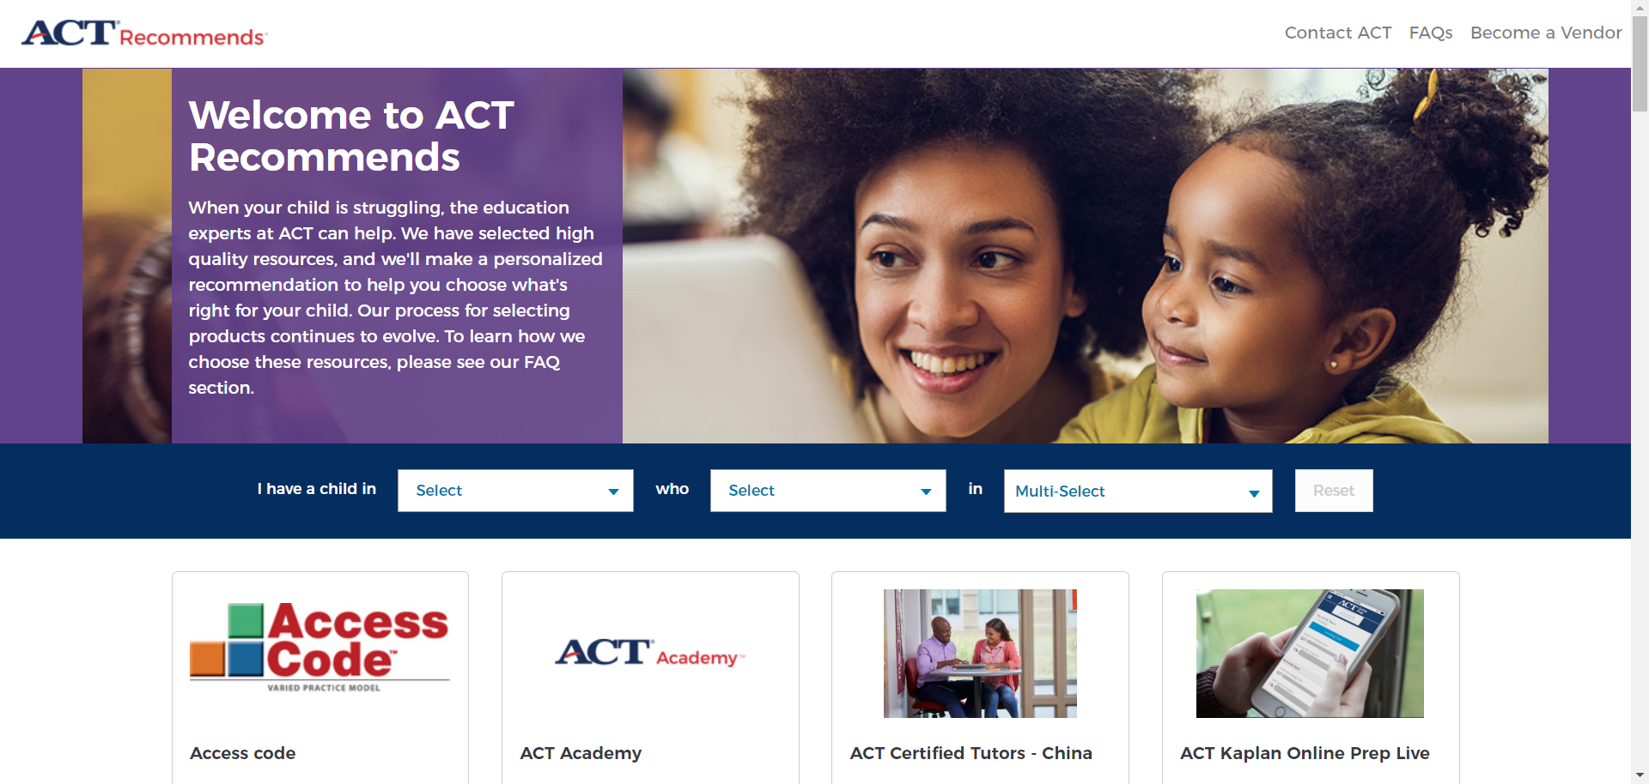
ACT Recommends
http://www.myacthub.org/#/marketplace/home
Notes:
When kids are struggling academically, parents want to help. ACT Recommends is a tool to help parents find high-quality learning resources that are relevant to their child’s needs. In doing so, it connects educational technology vendors who make learning-science based products with students. Surface appeal and flash can easily trump products with research-based learning models. ACT Recommends provides students in PK-12 with recommendations of high-quality learning resources for needs ranging from deep, conceptual understanding to strand-level practice.
Products are provided for students who need:
Test Prep
Practice
To Get Ahead
Help when they are struggling academically
What it is not:
A laundry list of products: Customers can get that through Google. They want to know which products ACT has selected because they are high quality and relevant to their child. “When I was initially looking this would have saved me a lot of time separating the junk from the good stuff.”

Slide 65

Equity
PAGE 41
Notes:
Everyone has the potential to learn—and a student’s background or family income should not determine educational or career opportunities.
Underserved students represent nearly half (46 percent) of ACT-tested 2017 U.S. high school graduates.
Underserved students are defined as students who would be the first generation in their family to attend college, come from low-income families and/or self-identify their race/ethnicity as minority. ACT research suggests students with any of these three characteristics are less likely than others to have access to high-quality educational and career planning opportunities and resources.
ACT is dedicated to ensuring underserved students have access to quality coursework and information to assist them in planning for the future and launched the ACT Center for Equity in Learning to help do that.

Slide 66
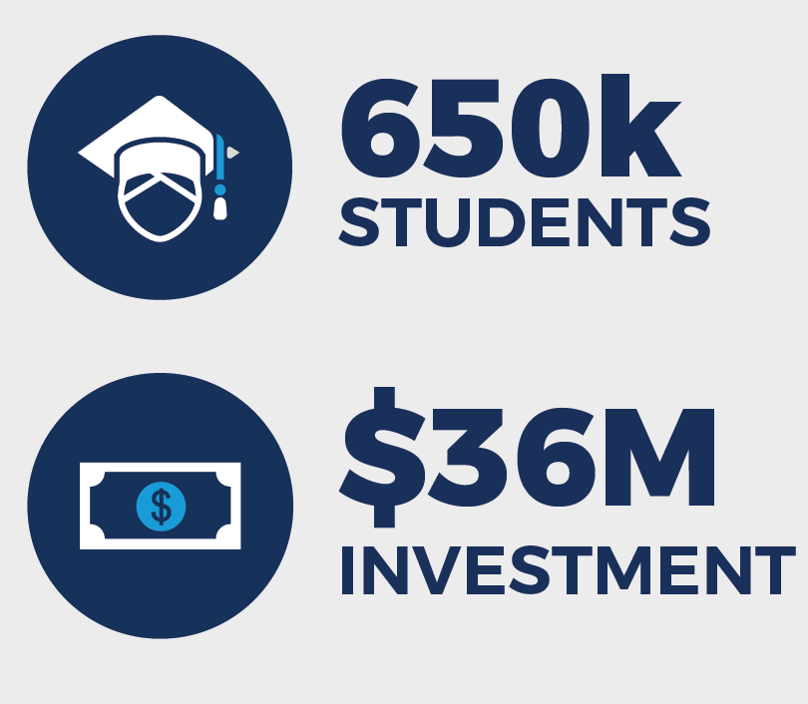
Fee Waivers
High
Low
act.org/the-act/fees
Notes:
We provide more access to more students through free ACT tests for low-income families because we believe all students deserve to have
equal and equitable educational opportunities. Make sure students know about and have access to fee waivers. Even if you do district testing, students may still be able to test a second time for free.
Eligible students may use a maximum of two separate fee waivers.
ACT provided fee waivers to more than 650,000 students who have demonstrated financial need so that they could take the ACT test for free. Those waivers, a value of $36 million, are just the start to help level the playing field for all students.
FYI - FEE WAIVER ELIGIBILITY:
Each student who receives an ACT Fee Waiver must meet ALL eligibility requirements:
Be currently enrolled in high school in the 11th or 12th grade.
Be a United States citizen or testing in the United States, US territories, or Puerto Rico.
Meet one or more of the indicators of economic need listed below:
Enrolled in a federal free or reduced-price lunch program at school, based on US Department of Agriculture (USDA) income levels.
Enrolled in a program for the economically disadvantaged (for example, a federally funded program such as GEAR UP or Upward Bound).
Note: If the student participates in a program, but is not economically disadvantaged, they are not eligible for a fee waiver.
Resides in a foster home, is a ward of the state, or is homeless.
Family receives low-income public assistance or lives in federally subsidized public housing.
Family’s total annual income is at or below USDA levels for free or reduced-price lunches
Number in Household Total Annual Income Before Taxes
(including the student) (in last calendar year)
1 $22, 311
2 $30,044
3 $37,777
4 $45, 510
5 $53,243
6 $60,976
Each Additional plus $7,733 each

Slide 67

Test Prep is free for students register with a fee waiver
ACT® Online Prep (AOP)
ACT® Kaplan® Online Prep Live
Notes:
Students who use fee waivers to register for the ACT test automatically receive free access to a convenient online test preparation resource – ACT Online Prep. Operational on any device, the prep aids students for the test by evaluating their academic strengths and areas for development.
In addition, the students automatically receive free access to ACT Kaplan Online Prep Live, which provides live content-based instruction from expert teachers.

Slide 68
Students in low-income families face a series of unique challenges and barriers that can reduce their access to higher education and sending ACT scores to the colleges they aspire to attend should not be one of them.
Suzana Delanghe, ACT Chief Commercial Officer
Notes:
New this year, low-income students can send scores to up to 20 colleges free.

Slide 69
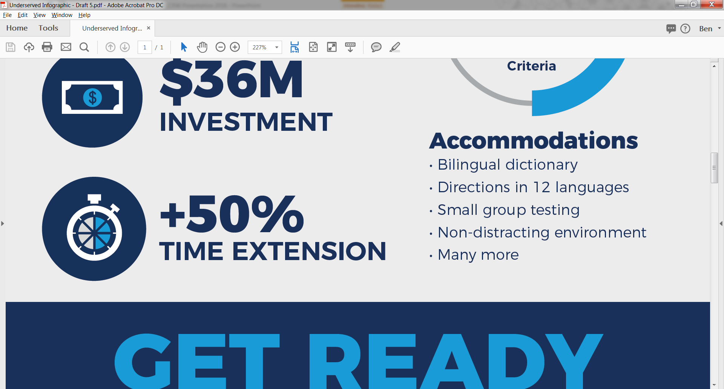
Accommodations
Bilingual Dictionary (word-to-word without definitions)
Directions in 12 Languages
Small Group Testing
Non-Distracting Environment
Many more
Notes:
ACT is committed to serving examinees with documented disabilities by providing reasonable accommodations appropriate to the examinee's diagnosis and needs. We’ve made a few updates this year to improve our service to these students.
Enrolling Update:
To make the accommodations process a little easier, the student information and registered test date will now automatically appear in TAA, even if it is a student’s first time requesting accommodations.
ACT will now notify counselors via email when action is required. When a student registers online, we will continue to direct them to forward their accommodations instructions email to counselors. However, ACT will automatically create a new request in TAA, or update a previously submitted request, when the student indicates a need for accommodations or English learner supports.
Extended Time Update:
Starting in September 2018, examinees with diagnosed disabilities or English learning needs who qualify for extended-time accommodations on the ACT test will have a time limit on each section of the test, with a hard stop after each section. This is a change from the existing rules, under which examinees are given a total of five hours to complete the four test sections at their own pace, with no individual time limits on each section.
The change will impact only examinees who qualify for National Extended Time testing, the most commonly granted accommodation on the ACT. Such examinees will receive time-and-a-half on each of the four required multiple-choice subject area tests (English, mathematics, reading and science). The time limits for National Extended Time testing will be as follows:
NATIONAL EXTENDED TIME TESTING
Subject Extended Time Standard Time
English 70 minutes 45 minutes
Mathematics 90 minutes 60 minutes
Reading 55 minutes 35 minutes
Science 55 minutes 35 minutes
FREE RESOURCES: Training and guidance for registering accommodations is available in the online workshop materials.

Slide 70
The earlier you can begin collecting data, the more informed you will be at critical points on your students’ paths toward achieving their dreams.

Slide 71
How will we respond if they don’t learn it?
PAGE 44
Notes:
If we discover that students are off track, our first priority must be to get them back on track. Reasons for students being off track can range from gaps in the curriculum to social and emotional behaviors to individual academic struggles. Our job is to find the cause and correct it.

Slide 72
Curriculum Review
TAKE HOME ACTIVITY – PAGE 44

Slide 73
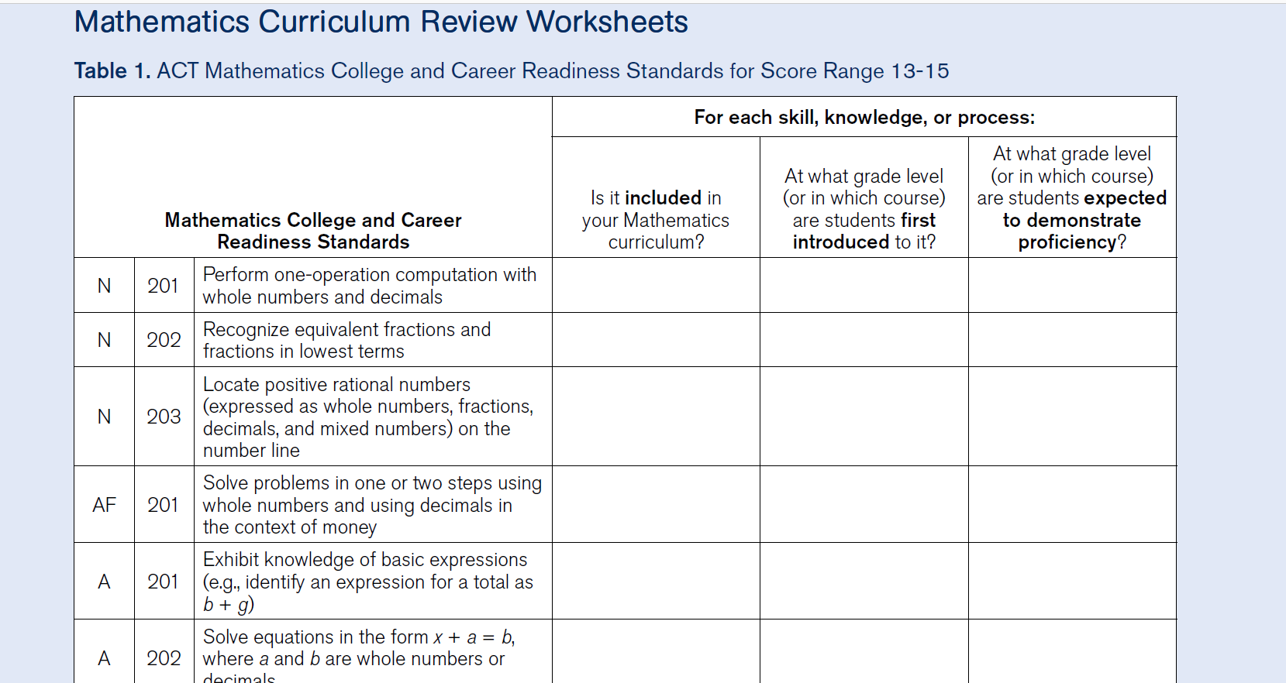
Notes:
Curriculum review worksheets help you identify potential gaps among state standards, curriculum, and the ACT. Worksheets include all of the standards that are assessed for that subject on the ACT test. Notice the codes in the left hand column that correspond to the specific skills. These abbreviations are all in the standards documents on our website. For example, N is Number and Quantity, A is Algebra, F is Functions. Can all of these standards be found in your curriculum?
Activity you can take back to your school:
On your own, evaluate the first 10-15 standards in the score band range that includes the benchmark for your subject
When everyone has finished, compare answers with your team
FREE RESOURCES: These worksheets are in the online workshop materials.

Slide 74
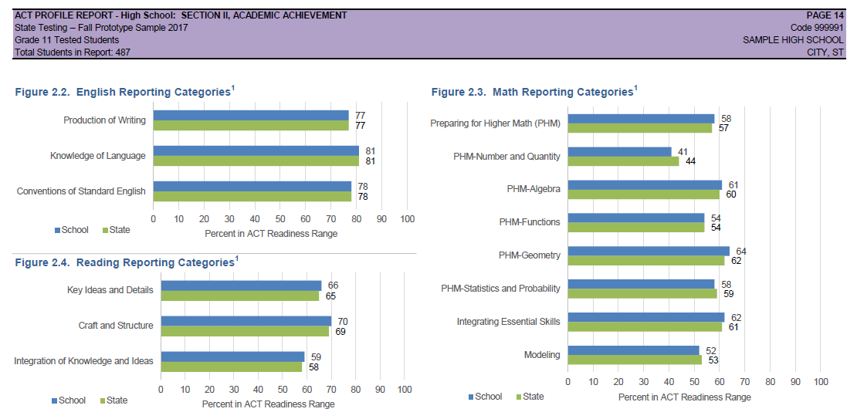
Notes:
In the ACT Profile Report and on the ACT High School reports, subject area reporting gives you student performance data on specific skills and abilities within each subject area, such as language conventions, data interpretation, and preparing for higher math. This data, used with the ACT Curriculum Review Worksheets, help you identify areas for improvement in your instruction and curriculum.
Here we can see that students as a group struggle with Number and Quantity. This is an opportunity for you to look at the Curriculum Review Worksheet to make sure all of the standards are being taught. And if they are, you can begin to investigate why it isn’t resonating.

Slide 75
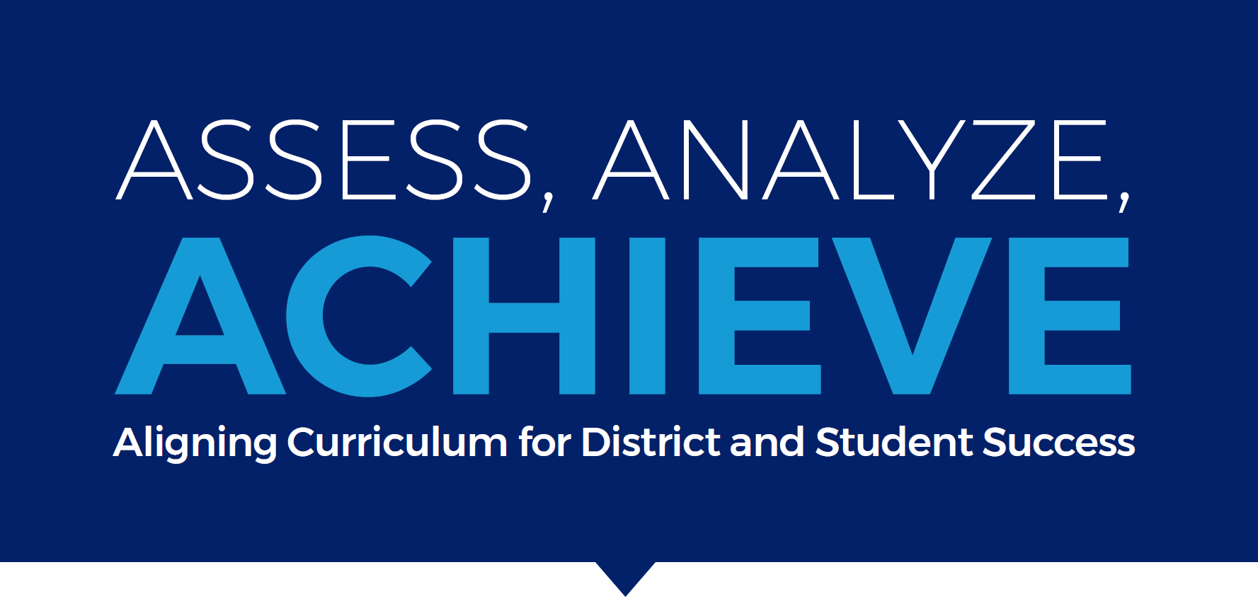
PAGE 47
Notes:
Helena Customer Story
Aligning your curriculum to the ACT-recommended course patterns can make a difference in your students’ readiness for college and careers.
Before 2014, Greg Upham, the Assistant Superintendent, faced two challenges:
Without a proven and detailed course pattern, teacher topic preference and bias produced problems of practice among district schools.
Lacking a tool that could supply concrete data or results, he found it difficult to have conversations about adjusting curriculum.
Then, in 2014, the state of Montana implemented a grant that allowed the Helena Public School District to administer the ACT to all high school juniors. And, they quickly discovered that achievement on the test was closely correlated to course rigor.

Slide 76
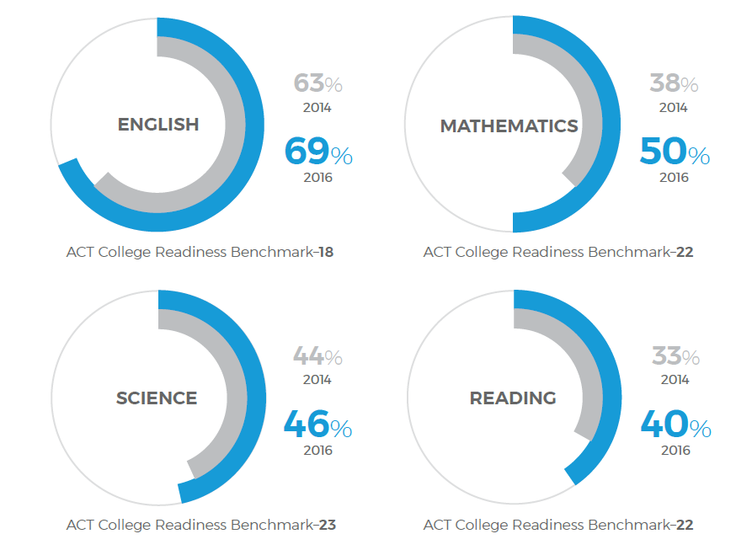
Notes:
Using the ACT and an aligned course pattern, Helena public schools now have a much higher percentage of students meeting each benchmark than the percentage of students overall in Montana.
This is the growth the Helena Public School District saw just two years after adjusting their curriculum.
Over the span of four years, using the ACT-recommended course patterns as a guideline, they have been able to identify the course combinations students should take to achieve higher scores on the ACT and therefore be more prepared for college.

Slide 77
For students not meeting benchmark, an intense review of students’ results assists us in informing instruction.
Greg Upham, Assistant Superintendent

Slide 78
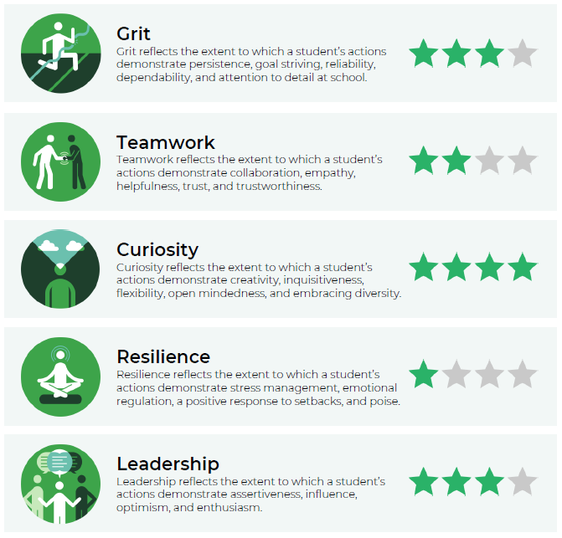
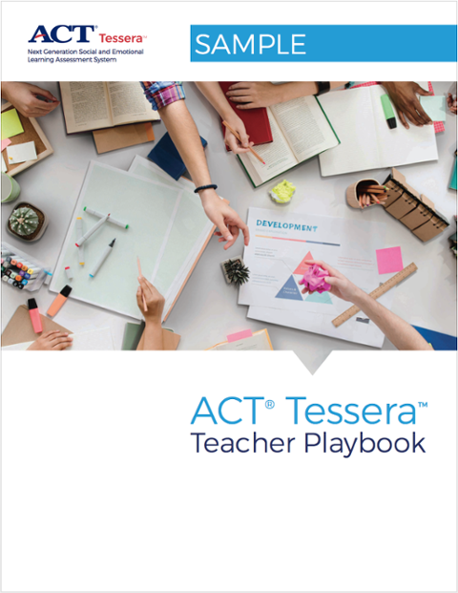
Tessera and the Teacher Playbook
PAGE 49
Notes:
When you identify students who are academically off track, it can help to explore all potential causes. By administering ACT Tessera on an as-needed, on-demand basis, you can identify and explore social and emotional causes while saving on your budget.
Clear, accurate understanding of existing student skills and strengths is essential in order to target interventions and support holistic initiatives. And, highly effective Social and Emotional Learning skill-building efforts depend on reliable assessment.
Tessera:
Our online assessment tool is easy for schools to administer and requires no special or time-consuming preparation.
The assessment tool integrates three different methodologies to reliably and validly measure a student’s Social and Emotional Learning skills.
Our detailed reports deliver the data required to support student and school self-knowledge, growth, Whole Child development, and continuous improvement.
The ACT Tessera Teacher Playbook provides actionable lessons for teachers looking to integrate SEL into their classrooms. Its curriculum and activities are designed to help students continue to develop their social and emotional skill strengths and to improve upon their weaknesses.

Slide 79
McPherson Story
PAGE 51
Notes:
Jeff Allmon, a school counselor at McPherson Middle School, has seen a lot of promising, college-bound students filter through the school. They have great GPAs and test scores, are academically prepared for college, but drop out because they don’t have strong SEL skills like grit, teamwork, resilience, or leadership.
Developing SEL skills is now the focus of his work, and he uses ACT Tessera and the ACT Tessera Teacher Playbook to help him do so. He schedules workshops for 30 minutes with five or six students who scored a one-star on a specific construct. Using the Playbook’s curriculum, he spends the first 15 minutes talking about the construct and lecturing. Then, for the last 15 minutes, he chooses one of the physical activities listed in the Playbook to help reinforce the lesson in a fun, engaging way.
Schoolwide reception of the program has been extremely positive, especially with teachers, because they believe in the research and because he includes them in helping strengthen their students’ SEL skills. In the morning before classes, students meet in small groups with teachers, and pick out an activity, along with objectives from the Playbook, for teachers to cover with their group.

Slide 80
“The Teacher Playbook is a great teaching tool. The lesson plans are really flexible and concrete—you’re not locked into a particular plan or series. You pick and choose whatever you want.”
Jeff Allmon, School Counselor
McPherson Middle School
McPherson, Kansas

Slide 81
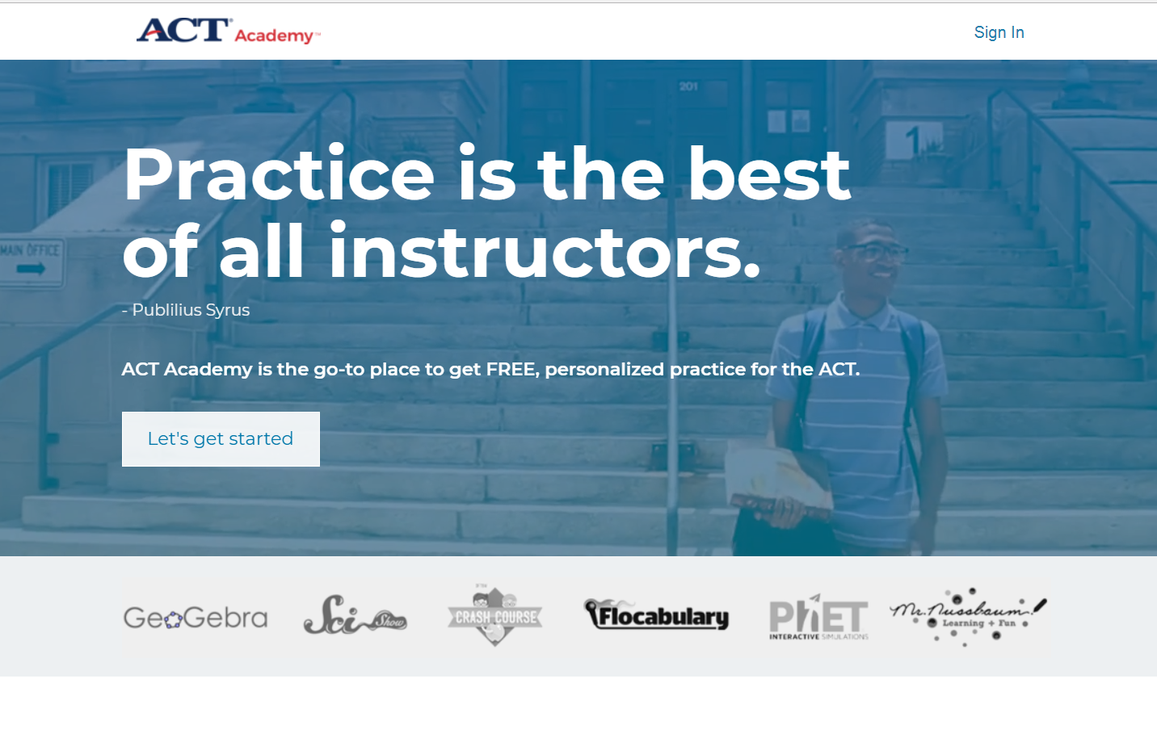
ACT Academy
Notes:
How many of you have seen the new ACT Academy? It’s an incredible, new, free resource built on our OpenEd system. It identifies areas where students struggle academically and automatically serves up lessons and quizzes to help them get on track for college and career readiness and the ACT test.
It’s free!
ACT Academy is free to all students everywhere. Having an account allows your students to track their progress and keep moving forward.
Create a playlist: Take a quiz or enter a score.
Short quizzes are designed to help students identify the content they have mastered and to clarify areas where more focus is needed. If your students have already taken the ACT or PreACT they can simply enter their scores and custom playlists will be automatically created!
Watch and learn.
ACT Academy creates automated daily playlists to hit on the basic lessons your students need to master the ACT. After each lesson, a short quiz will determine if the resources they were given helped them learn the material needed.

Slide 82
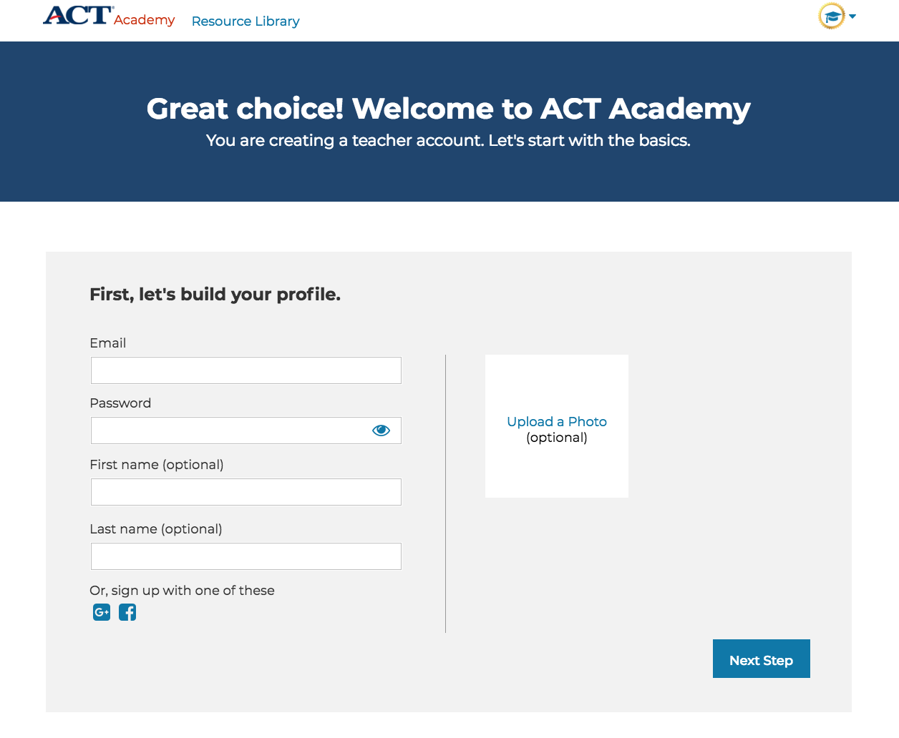
Notes:
Students have 3 options:
They can take a quiz in the platform
They can enter their scores from a previous exam
They can dive in and start on resources laid out and then take a quiz following
If they opt to jump into this plan they will see an option to take a full length exam about mid way through the resources-
Note: at this point we have 1 full length test; we need to work together to change the narrative around this. We feel that shorter segments is most need fulfilling for students and there are not many Juniors in high school that have the time to take a full length exam multiple times before their test day.

Slide 83
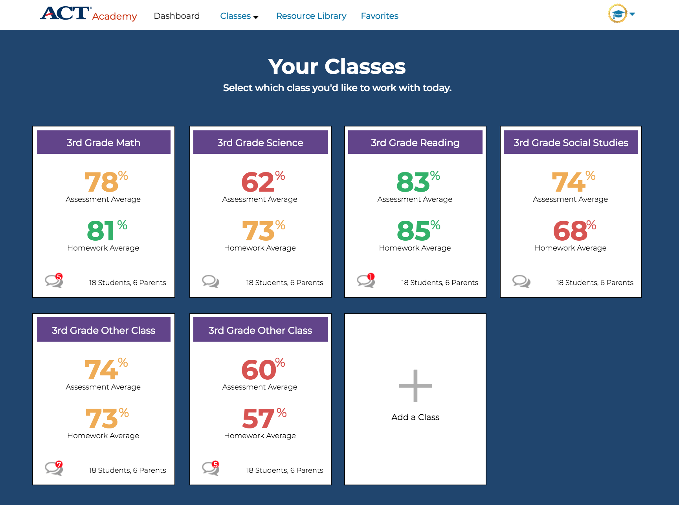
Notes:
This is your dashboard where you can view and select your classes. It shows you the average assessment and homework scores. You can also add classes.

Slide 84
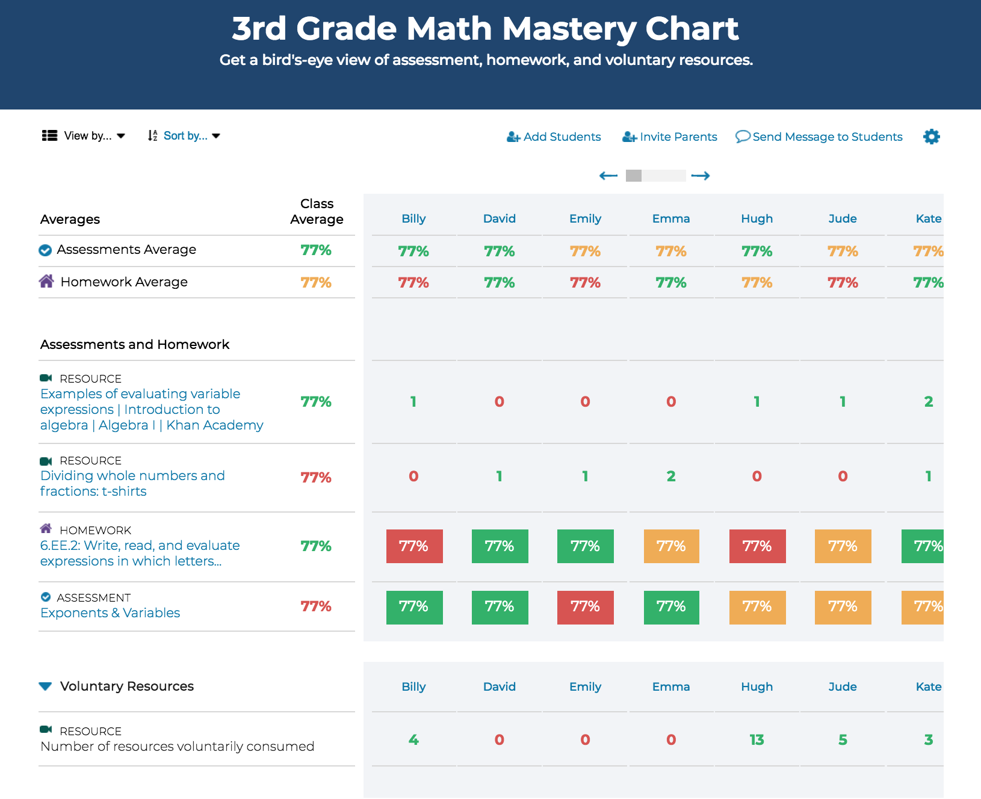
Notes:
When you select a class you can see the students and their scores on homework and assessments.

Slide 85
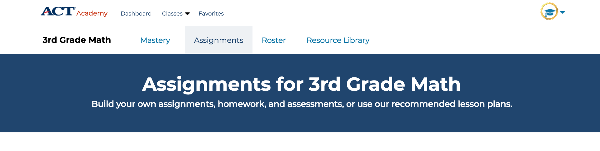
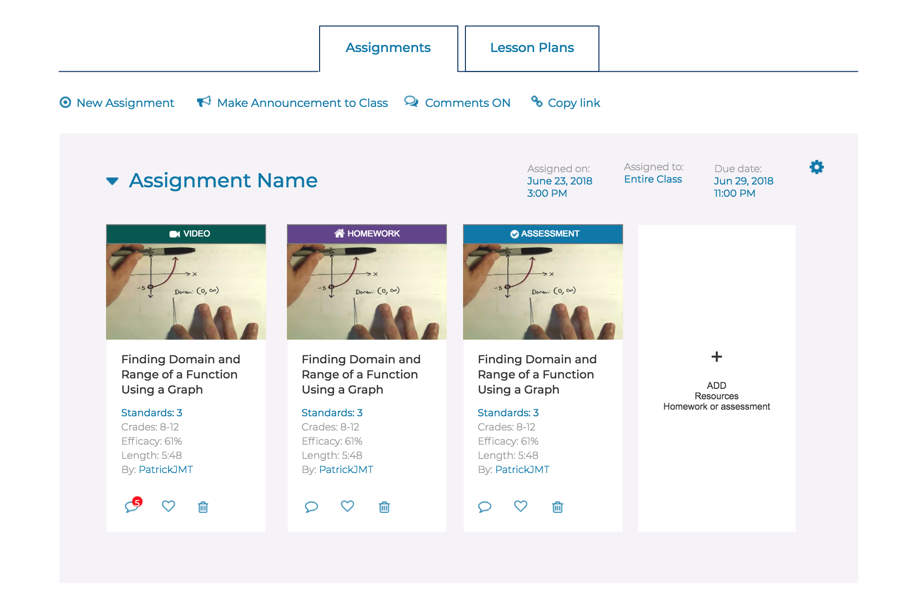
Notes:
All the resources in ACT Academy are curated!
Hundreds of hand-picked resources for each reporting category
Constantly adding new resources from even more publishers
Many different learning styles are accounted for
Students can select which videos and styles are most interesting to them
Efficacy
Resources are selected based on proven efficacy
Efficacy of the resources has been calculated across a variety of different questions, most of which are non-ACT specific
This means the videos help students grasp the concept and DO NOT TEACH TO THE ACT TEST
About mid way through a recommendation to take the full length practice will come up

Slide 86
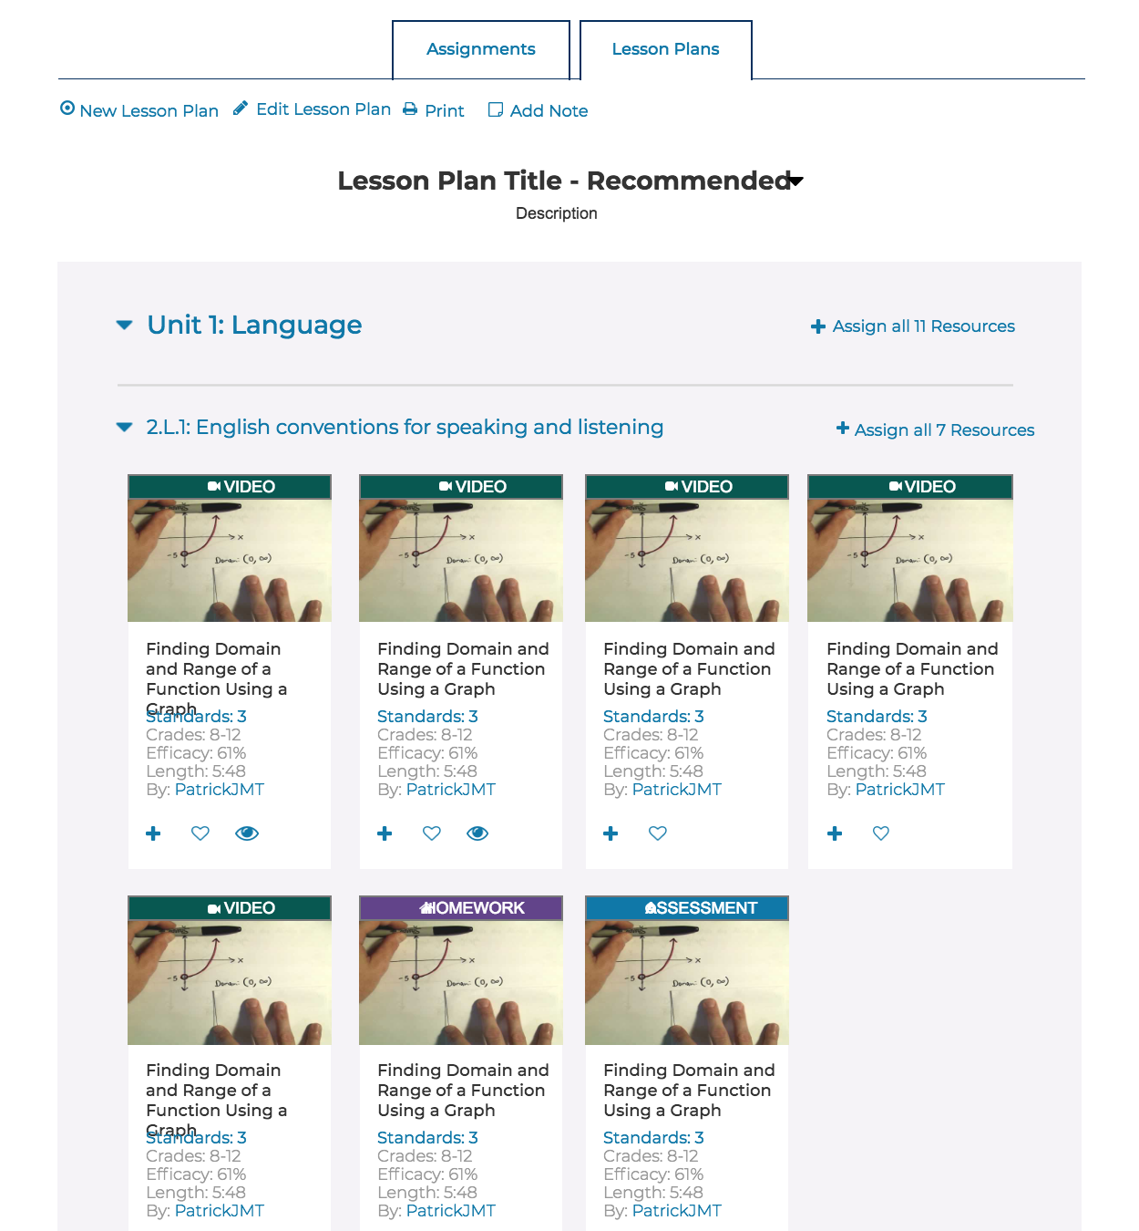
Notes:
You can create lesson plans within ACT Academy.

Slide 87
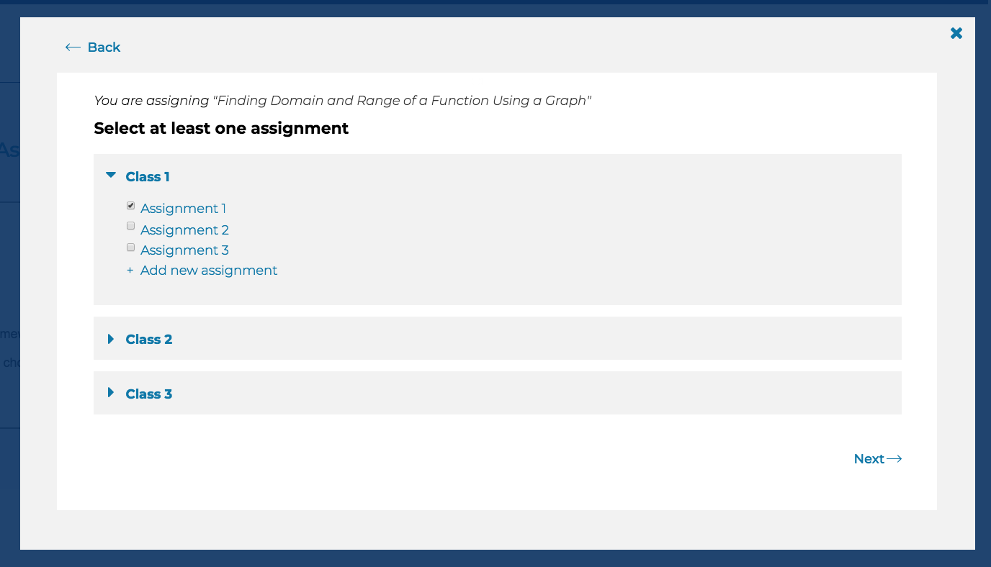
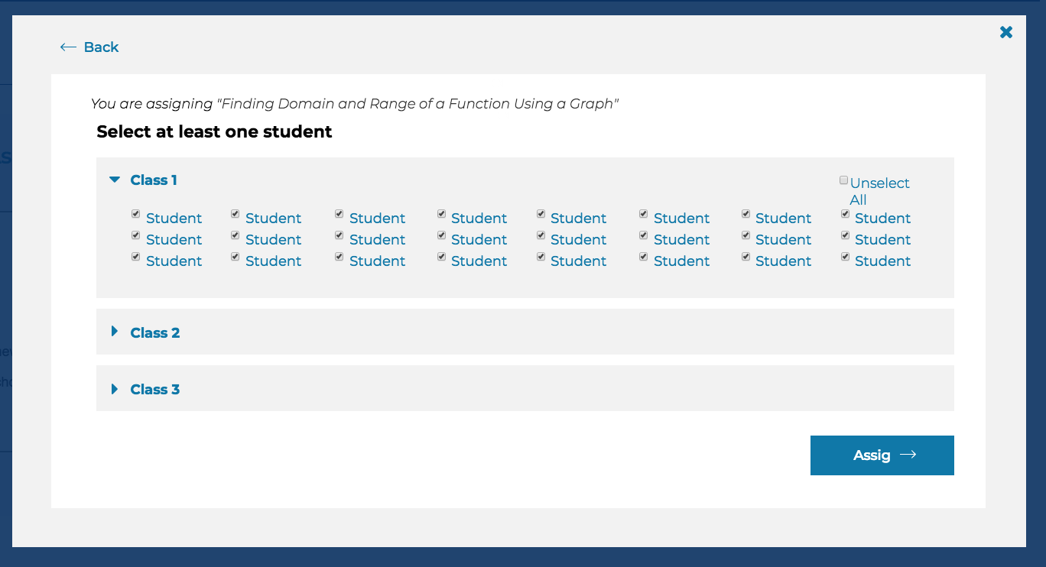
Notes:
You can assign content to students to complete as homework.

Slide 88
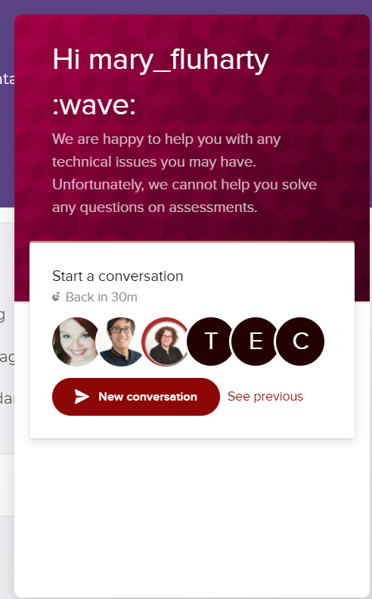
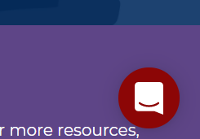
Embedded Support
Notes:
Customer support is built into the platform.

Slide 89
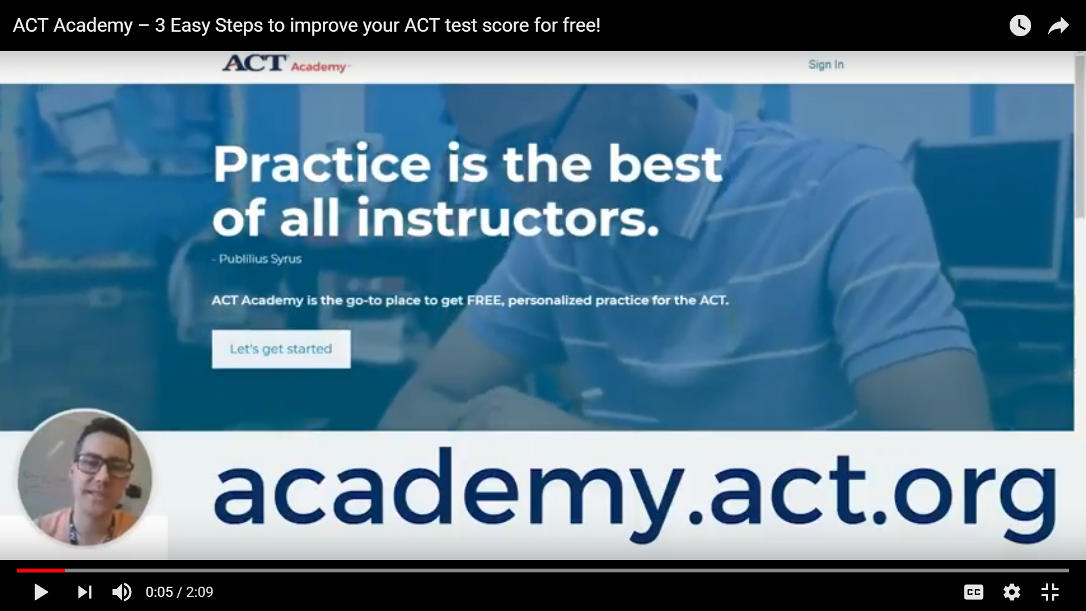

Slide 90
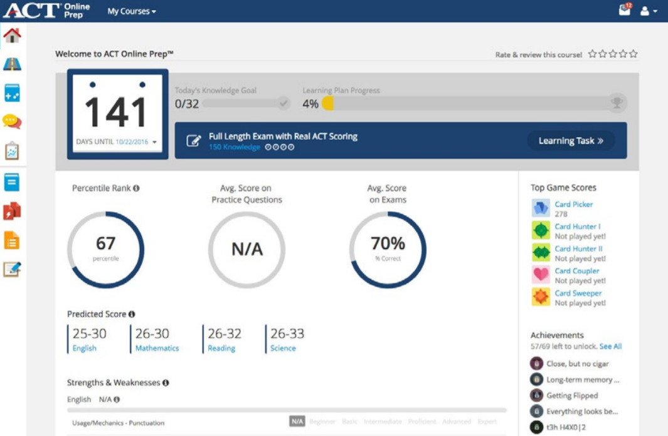
ACT Online Prep
Notes:
ACT Online Prep is an engaging, interactive test prep program:
Flexible, personalized learning paths customized to each student’s needs and test timeframe so they can review material at their own pace
Two full-length tests and thousands more practice questions help students become familiar with the ACT format and build their confidence so there are no surprises on test day
Engaging games they can play with other students encourage them to test their knowledge
Students can access the program online or through a free mobile app at school, home, or on the go, anytime.
Administrator dashboards let you track students’ progress at an individual and aggregate level, including time spent on the program, performance on the practice questions and tests, and areas in which an entire class may need help.
Plus, teachers can assign work in ACT Online Prep for students to complete as part of test prep within a classroom or as learning enhancement.

Slide 91




Overview | A virtual classroom. Get live instruction from the experts, delivered online. | A video archive at your fingertips. Access a library of top-quality recorded instruction. | Includes both ACT Rapid Review Live and ACT Rapid Review On Demand.
Real-time support from experts
24/7 access to instruction
Access period | 3 months | 6 months | 6 months
Price | $75 | $40 | $99*

Slide 92

ACT® CollegeReady™
ACT CollegeReady is a student success tool that identifies knowledge and skill gaps in math and English for incoming college students and creates a personalized learning path that empowers students to address their individual academic needs.

Slide 93
While originally intended for incoming college freshman, this may be a great tool to assist some of your HS Seniors:
Support for Underperforming Seniors Based on ACT Scores: Districts can accurately target students who will likely have difficulty in college based on their ACT scores (either from District Testing or from National Testing).
Readiness Solution for HS Seniors: Districts can use their own data sources to target seniors who will likely have difficulty in college.
Parent Support: Districts can offer the purchase of CollegeReady to parents through the school (if the district chooses to set up an account).
Notes:
CollegeReady
We are only positioning this with seniors since the content is designed for entering college freshman and may not be appropriate for lower grade levels. In addition – we don’t want to cause market confusion with all the other products we have in the 9-12 space.
(First 2 bullets) Districts can look at their data and use this as a solution for those seniors who took the ACT and did not meet the ACT benchmarks, or are in need of remediation based on other data sources, to get them on track before leaving HS. It may be in the form of a class for seniors to help them prepare.
Parent support bullet – ACT CollegeReady is not available as a B2C product, but if schools wanted to purchase ACT CR and then pass along the cost to parents who are looking for support to assist their senior, that would be a way they could do that.
By offering CollegeReady, districts have a proven tool to assist students and families and help them save time and money by avoiding remedial/non-credit bearing courses.

Slide 94
ACT CollegeReady
Here’s how it works:
Assessment—Students take an initial knowledge inventory through the platform that tells them, and your school, if they are ready for college-level math and English.
Placement—Learners who receive a high score can be placed into college-level coursework. For high schools, this could mean dual-enrollment courses.
Development—Those who need to improve their readiness use CollegeReady to help them achieve that goal prior to college registration by utilizing the personalized learning path CollegeReady creates for them.
Reporting—Institutions receive actionable data with real-time information on student progress.
Continued Improvement—CollegeReady can continue to support students’ skill improvement
Notes:
More than 50 percent of students entering two-year colleges and nearly 20 percent of those entering four-year universities are placed in remedial classes. Unfortunately, it’s estimated that fewer than 1 in 10 of these learners graduate from community colleges within three years and little more than a third complete bachelor’s degrees in six years.
(Note: research comes from Complete College America)
ACT CollegeReady is a new student success tool that identifies student knowledge and skill gaps in math and English and creates a personalized learning path that empowers students to address their individual academic needs. We are encouraging colleges and universities to use CollegeReady to help students succeed in the transition to college and throughout their college career.
Benefits for Learners:
Increased preparedness: Learners have an easy-to-use online platform to guide their preparation for success in college-level math and English.
Accelerated learning: Learners gain access to a personalized study path, enabling them to accelerate their progress by focusing on their areas for development.
Cost savings: Learners can avoid—or dramatically reduce—the need for traditional remediation through non-credit developmental courses, saving time and money.
Expanded knowledge base: Learners can choose to utilize CollegeReady as a resource and learning aid throughout their educational journey.
Student-centered: Learners receive real-time feedback about what they already know, what they need to review, and what they need to learn to become college-ready. This feedback is particularly helpful for adult learners, who are juggling multiple priorities and need to maximize their study time.

Slide 95
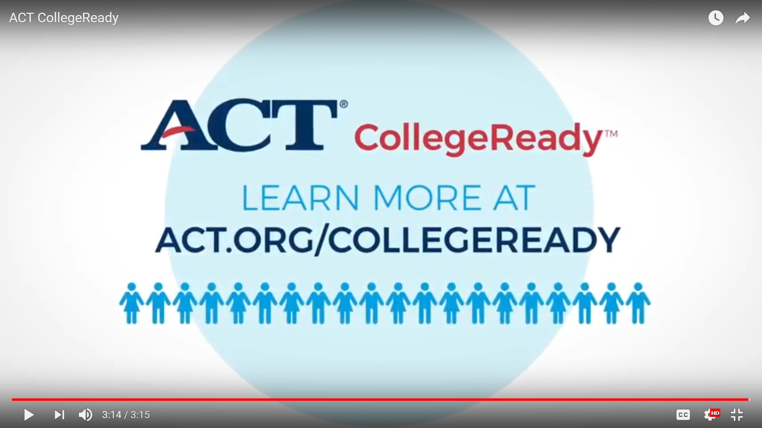

Slide 96
Retesting
45%
50%
RETESTED
INCREASE THEIR SCORE
Notes:
Once students have had an opportunity to expand their skills and knowledge, they should be encouraged to take the ACT test again. On second testing, average ACT Composite scores in recent graduating classes have risen by nearly a point, compared to first testing. Similarly, more than half of all graduates who take the ACT at least twice see a Composite score gain from first to second testing.

Slide 97

PAGE 56
Notes:
A few years ago, The Tennessee Department of Education set a goal to raise the average ACT Composite score for public school students to 21 (the current national average) by 2020. Thanks to a state-paid opportunity for seniors to take the test for a second time during regular school hours, they are on track to surpass that goal.

Slide 98
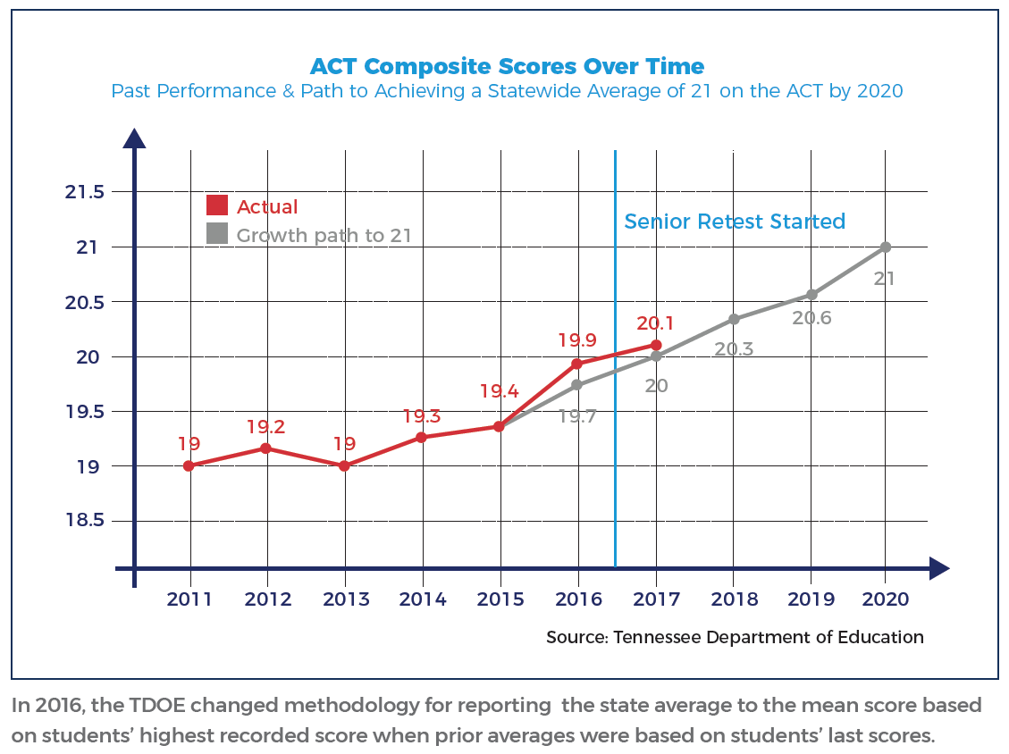
Increasing Your Average
Notes:
Projections developed by the Tennessee Department of Education outlined the growth necessary to achieving their goal. From 2011 to 2015 the average ACT Composite score for Tennessee public students increased from 19.0 to 19.4. With the implementation of senior retesting, Tennessee moved ahead of their projections.
In The Condition of College & Career Readiness 2017 – Tennessee Key Findings report, ACT research estimated that an increase of 0.1 in state average ACT Composite score for the 2017 graduating class would result in:
159 more students enrolling in college
190 more students persisting to year two
156 fewer students needing remedial English
307 fewer students needing remedial math
214 more students persisting to year four
230 more students earning a postsecondary degree within six years
That is to say, these incremental increases matter to students. And they matter a lot.
In October 2017, nearly 52,000 students in the graduating class of 2018 participated in the Senior Retake Day and almost 19,000 increased their overall score. Moreover, 2,333 seniors raised their score to a 21 or higher, making them eligible to access $37 million in HOPE Scholarship funds that provide up to $16,000 per student.
Additionally, scores earned from the 2017 ACT Senior Retake Day will save Tennessee students up to $7.8 million by allowing them to enroll directly in credit-bearing postsecondary coursework, avoiding remedial classes that take additional time and money and may make it less likely they will graduate.

Slide 99
We don’t always get a second chance when it comes to life’s major events. When it comes to retaking the ACT, however, this is a second chance that we can and should provide to all students.
Jerre Maynor,
Director of Student Readiness
Tennessee Department of Education

Slide 100
Making every student’s dream a reality is easier done when driven by evidence-based data.

Slide 101
How will we respond if they already know it?
PAGE 58
Notes:
When students are on track, we can focus on the important work of planning for their future.

Slide 102

College and Career Interests
PAGE 58
Notes:
As your students prepare for the next step, they may be excited and overwhelmed with the number of paths that lie before them. Choosing a major, a school, and a career are important decisions that can determine the course of their futures. Those choices should be made using the proper tools. Unlike other assessments for college and career readiness, the ACT and PreACT include interest measurement and report that information back to the student and school.
As part of the ACT exam process, students complete the Interest Inventory survey, which includes questions about familiar work-related activities. Students indicate whether they would like, dislike, or be indifferent to these different activities. The ACT Interest Inventory was designed to help students see the connections between possible careers and the everyday things they like to do. The results of the survey are reported on the PreACT and ACT score reports. Aggregated data on the major, school, and career interests of your students is available in the Profile report.
You can use information from PreACT and the ACT score reports to get them focused on their future and find areas to help them achieve their goals.

Slide 103
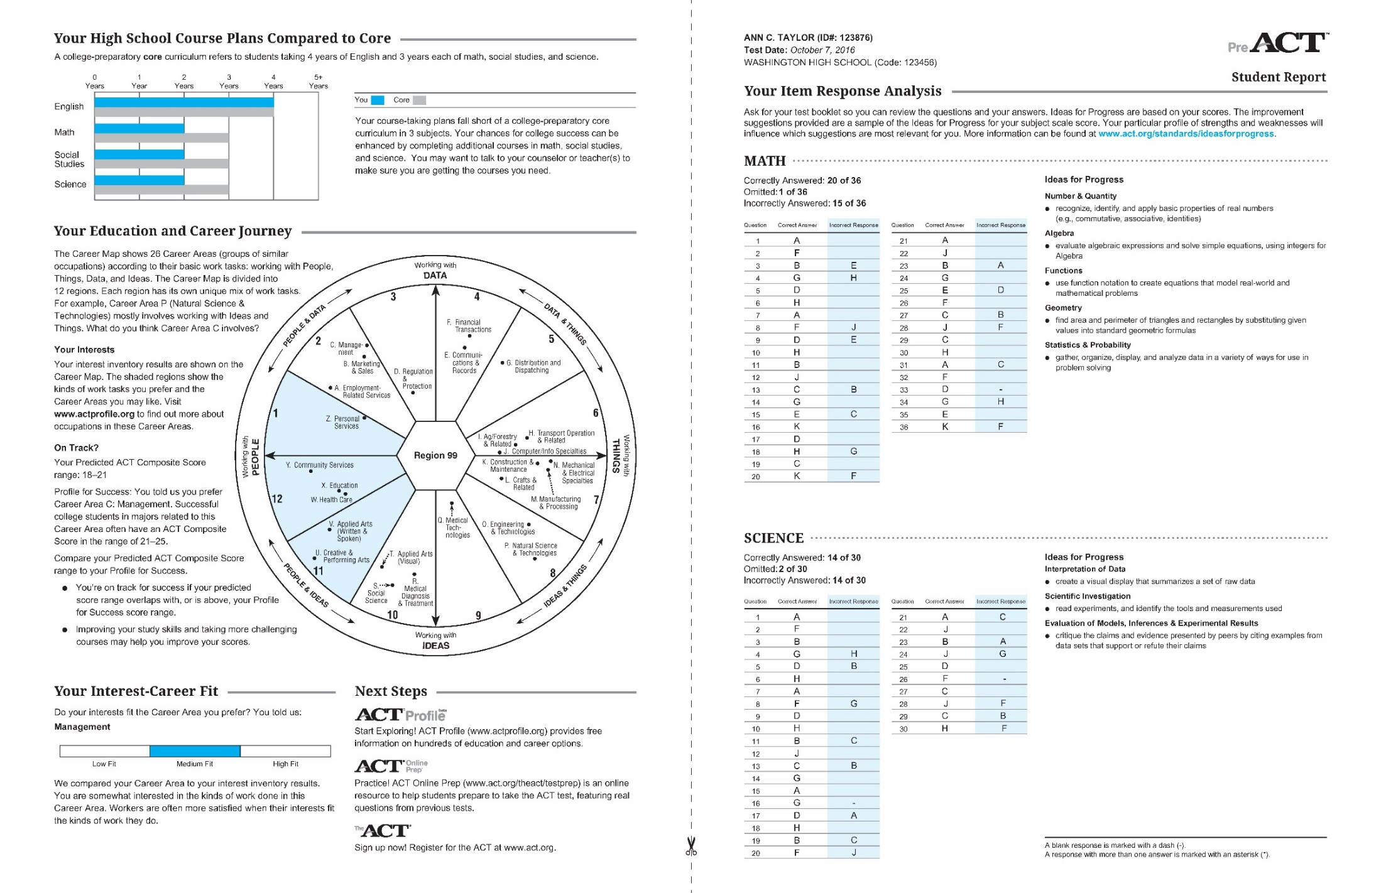
Notes:
The PreACT score report includes 2 indicators of career and interest measurement:
Education and Career Journey, which helps students identify their career-related interests and encourages follow up with career exploration activities. In addition, this section reports information that can help students evaluate whether they are on track to meet their self-reported educational goals.
Interest-Career Fit, which displays the level of agreement between the student’s interests and the career area they selected. For example, high fit means that the student’s measured interests are in agreement with the kinds of occupations they prefer.

Slide 104
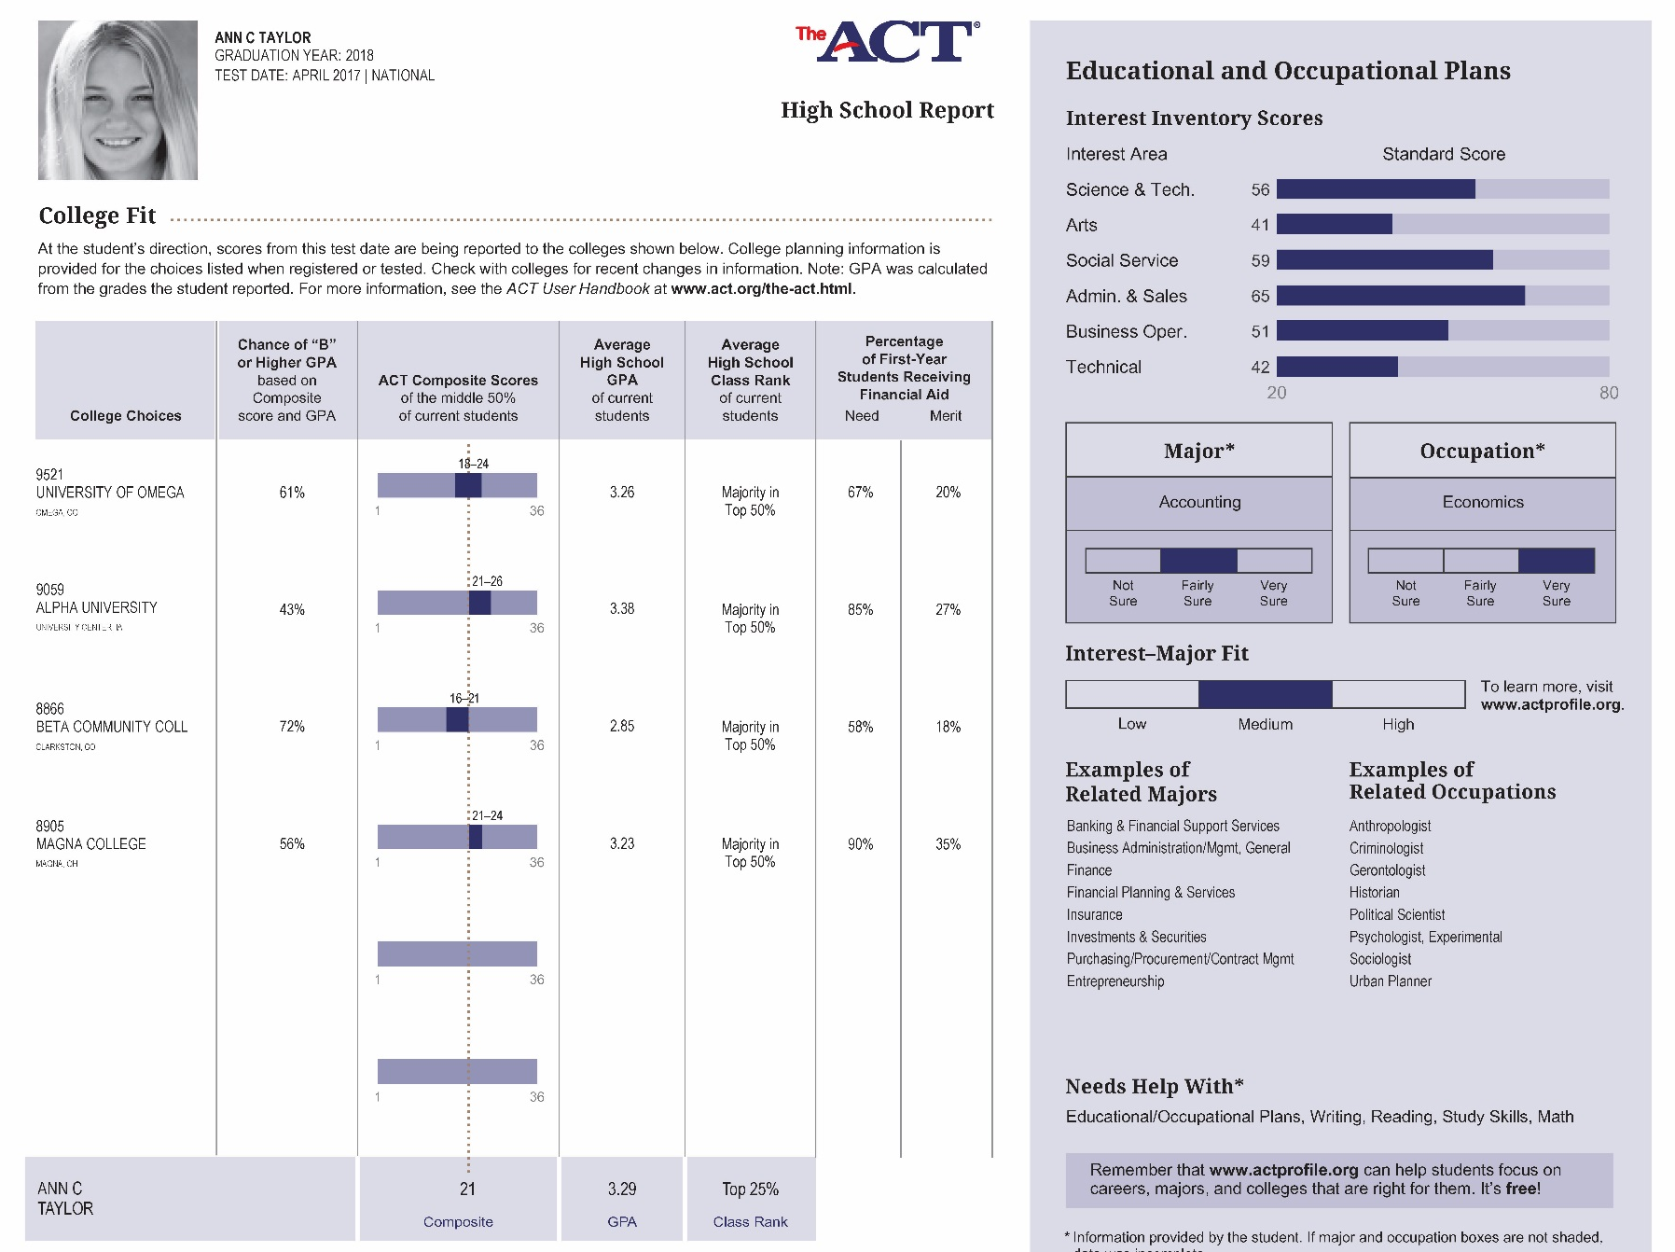
Notes:
The ACT High School Report:
The second page focuses on post-high school aspirations and fit. There is information about college fit, interest inventory scores, interest-major fit and some recommendations for educational and occupational planning.
CLICK
Student responses generate scores on six scales: Science and Technology, Arts, Social Service, Administration and Sales, Business Operations, and Technical. You can see the student’s relative interest in each area indicated by the scores. Here, Ann scored high in Admin and Sales, Science and Tech and Social Service.
CLICK
This information is cross-walked with the student’s reported intended major and occupation (here, accounting and economics) to produce the Interest-Major Fit. This fit between a student’s interests and college major is important in understanding and predicting outcomes, like a student’s likelihood of remaining in their major, persisting in college, and completing a college degree program in a timely manner. The alignment between a student’s intended majors and career fields and their own interests offers important counseling opportunities.
Ann is fairly sure she wants to major in accounting with her sights on a career in Economics. To assist Ann further, ACT lists examples of other majors and fields that also match her stated interests that you and Ann might want to explore together.
CLICK
Under all of this information, the report lists what areas Ann herself thinks she needs help in to succeed. This can be compared to her actual scores in the Detailed Results section to determine her level of confidence against her actual performance in each area. For example, she scored above the readiness level in two reporting categories in reading, but it appears she could use some work in Craft and Structure. So in her senior year she may want to consider taking a literature analysis course or some other course in which she can learn more about analyzing text structures and text interpretation. We’ve already discussed Ann’s proficiency in writing, but her perception is that she needs help in that area. She is more likely to do better in the future if she has confidence in herself and is able to accurately judge her own work.
CLICK
As part of the pre-test process, students are also able to select up to four universities to send their score reports to. This is a valuable opportunity to send free reports to specific universities that a particular student has interest in attending. The reporting information that is returned to the student is graphed on the second page of the High School report under “College Fit.” This portion of the report provides a number of data points about each of the schools. This table can be helpful as you counsel students about their college choices.
CLICK
During her prework for the ACT, Ann reported her grades for the courses she has taken so far in high school and ACT calculated a GPA from those grades. That GPA is reported in the College Fit section at the bottom of the page. The 4th column includes the average GPA of entering freshman at each school to which Ann sent her scores. This is a place to start to compare herself against her potential peers at each university. This also gives you an opportunity to discuss which schools fit best with Ann’s interests and abilities.
CLICK
Ann’s GPA along with her Composite score and the information regarding the Composite Scores of the middle 50% of students at each school is reported in the second column. This helps Ann see her chances of earning a “B” or higher GPA at each school. You and Ann could use all of this data, including the average class rank of current students and financial aid information, to learn more about the academic culture of each school and how it fits with Ann’s wants and needs.

Slide 105
Online ACT Account
ACT accounts provide Students with tools to explore their plans for the future. Students can:
Take the ACT Interest Inventory, Abilities Inventory, and Values Inventory
Search for careers
Discover military careers
Find majors that match their interests
Explore schools
my.act.org
Notes:
Online ACT Account
Student ACT accounts provide them with tools to explore their plans for the future. Students can:
Take the ACT Interest Inventory, Abilities Inventory, and Values Inventory
Search for careers and see which ones match with their inventory results—career listings include job responsibilities, estimated salary, required training, and job qualities
Discover military careers and explore the background, training, and related careers for each position
Find majors that match their interests—listings provide a snapshot of the major, common coursework, and related jobs
Explore schools and filter results based on major, location, admission difficulty, annual cost, and student enrollment size
How You Can Use It: You can expand on Interest Inventory results in several ways. Besides briefly describing the results, you can foster discussions around questions and issues such as these:
Measured interests are more informative when supported by life experiences. What kinds of experiences has the student had in the types of activities that their inventory results indicate? Did they enjoy them?
Does the student understand the connection between their reported interests and the list of related majors and occupations? Do any of these sound interesting to the student?
Learning more about their options can help students make more informed decisions as they confirm their plans life beyond high school.

Slide 106
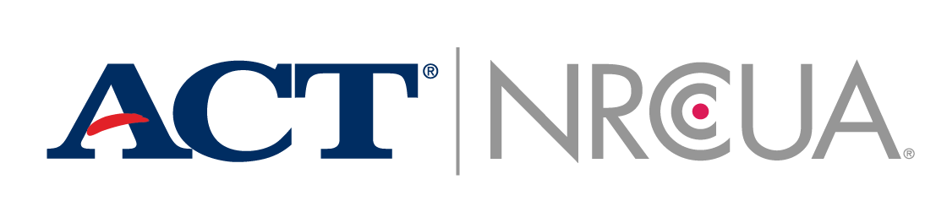
Smarter Together
K-12 students, their parents and high school professionals will have increased access to free, comprehensive career and college planning tools and resources.
By accessing actionable data science and relevant research delivered through EncouraData Lab, post-secondary institutions will be able to enhance and evolve their marketing and recruiting efforts.
Through data science, analytics, technology, and digital services, higher education institutions can make more informed decisions that help improve student outcomes.
With over 100 combined years of experience in connecting students with higher education institutions, ACT and NRCCUA are mission aligned in helping both students and institutions make more informed decisions that optimize fit for the highest probability of success.

Slide 107

Benefits to K-12 Students, Parents and Professionals
Increased access to more college and career planning through myOptions, the nation’s largest free college and career planning program:
Provides assistance and resources to students, parents, high school professionals - all at no cost to them
Provides a mobile app for students
Delivers personalized college, career and scholarship information
Produces reporting and progress monitoring tools for educators

Slide 108
Smarter Together
With over 100 combined years of experience in connecting students with higher education institutions, ACT and NRCCUA are mission aligned in helping both students and institutions make more informed decisions that optimize fit for the highest probability of success.
How to find us:
 | ACT | NRCCUA | myOptions
Website | https://encoura.org | https://myOptions.org
Contact Email | contact@nrccua.org | help@myOptions.org
Overview Video | https://vimeo.com/290784776 | https://vimeo.com/254371817

Slide 109

Toolkits
Notes:
Creating a culture of college and career readiness requires open and consistent communication with students and parents about the value of measuring academic readiness, assessing non-cognitive skills, and preparing for the future. This open dialogue can help improve student learning and outcomes as part of a larger college and career readiness action plan. ACT has prepared a variety of communication tools for you to use to make this task easier:
The ACT test
PreACT
ACT Aspire
ACT Tessera
These toolkits include:
Email communications to be used throughout the school year
Engaging social media images for sharing from your school’s accounts
PowerPoint slides related to each of the ACT assessments
Student-focused digital resources such as eBooks, infographics, and videos
We’ve heard from other counselors that the information has been great to share with parents and students.
FREE RESOURCES: These toolkits will be linked on act.org/ccrw

Slide 110

Notes:
Arkansas Customer Story
Communicating with students in positive and fun ways can redefine their attitudes about college readiness testing and the opportunities it provides.
In spring 2017, the Arkansas Department of Education (ADE) started paying for all high school juniors in the state to take the ACT test. One year later, the ADE launched a new campaign—called “No Limits”—to encourage students to use test prep resources and to take the assessment more than once.
Many underrepresented students lack the resources, information, and family and peer support they need to prepare for success after high school. In the
Arkansas graduating class of 2017, 9,025 students (or 26 percent) had parents who did not attend college. Special efforts, like the “No Limits” campaign, help to level the playing field for these students to have equal opportunity to succeed.

Slide 111

Notes:
The “No Limits” campaign launched in January with this video starring Arkansas students highlighting five important points about the ACT, and featuring a song written and performed by an Arkansas student.
Play video.
All Arkansas public high schools were encouraged to show the video to their juniors prior to taking the exam in February, and students were encouraged to share the video on social media using the hashtag #NoLimitsAR. Additionally, every high school received a mailer the first week in February with informational posters, banners, and a checklist of each step school staff take leading up to testing. The ADE also prepared a presentation and lesson plans for teachers to help students understand and prepare for the test, identify schools they may be interested in, and complete the ACT Interest Inventory.

Slide 112
We really need to get information out to our schools to make sure they realize that this is an opportunity. This isn’t just another test.
Stacy Smith
Assistant Commissioner of Learning Services
Notes:
This campaign has had a positive reception for Arkansas. The ADE has worked diligently to ensure students take advantage of every opportunity given to them, and the “No Limits” campaign is another step forward.

Slide 113
ACT Newsletters
Administrator Newsletter
Counselor Newsletter
Class of 2019 Newsletter
Class of 2020 Newsletter
Class of 2021 Newsletter
Notes:
Every month, ACT provides timely information in our newsletters specifically written for administrators, counselors, students, and parents. Sign up to receive the newsletters at www.act.org/ccrw-toolkit.
For Administrative Staff, Teachers, and Counselors:
Administrator Newsletter—Information about important upcoming deadlines and events, professional development opportunities, new research, product updates, and ACT assessment news
Counselor Newsletter—Tools and information to improve communication with students and parents
For Students and Parents:
Class of 2019 Newsletter—Information on making decisions about applying to and paying for college.
Class of 2020 Newsletter—Information for students about weighing their options for life after high school.
Class of 2021 Newsletter—Information to help students try new things and start establishing college and career goals.

Slide 114





eBooks
Notes:
We’ve developed several eBooks and resources for students to help them along the way to college. These are great materials for you, your students, and their parents to read. eBooks include:
Planning for Your Future: 6 Easy Ways to Start Preparing for What’s Next
5 Questions Students Must Ask While College and Career Planning: Junior Year Edition
Avoiding the “Senior Slide”: How to Finish Strong During Your Last Year of High School
Financial Aid: Paying for College and University
The Ultimate Guide to Conquering Campus Visits
Keep Your Eyes on the Prize: How to Prepare for the Future During Your Sophomore Year
Before, During, & After: 3 Stages of Taking a College Entrance Exam
FREE RESOURCES: These ebooks are all on act.org/ccrw

Slide 115


Educational Opportunity Service (EOS)
Notes:
Encourage your students to sign up for the ACT Educational Opportunity Service when registering for the ACT test or PreACT. Signing up will help them:
Get discovered by colleges: 84% of EOS participants in a recent graduating class had their names selected by at least one college.
Find financial aid programs: Groups that oversee scholarships and other forms of financial aid use it to connect with students
Broaden their college search: Students find college opportunities all over the country. EOS-enrolled students typically are selected by more than 16 colleges, on average
FREE RESOURCES: EOS is a free resource for students.

Slide 116

Course Planning
Notes:
You can use information from score reports and student course patterns from the profile report to help students plot a path to the major, school, and career of their choice.
Common Course Pattern data provides information on how students performed on the ACT subject test in comparison to the courses students have completed in that subject. Look for trends between student course patterns and ACT scores to identify paths you can recommend to other students.
PreACT score reports show how students plans for courses compares to those needed for college preparedness. This can help you, help them, create a schedule that gets them into all of the classes they need before graduating.
Identifying a students interests (for example Accounting) on the score reports and comparing that to their performance in specific subject areas (like math) can also help you recommend courses to students. Or a student’s proficiency in an unrelated subject may prompt you and the student to look into majors and careers more aligned to those skills.

Slide 117

Honors Course Enrollment
Notes:
For students who have shown a greater proficiency in a subject, you can guide them toward taking honors courses.
Passing an honors class is an excellent way for high school students to demonstrate their academic competency and discipline to college admissions boards. And, successfully graduating from a high school honors program shows colleges how serious the student is about academics and how prepared they are to challenge themselves. In certain situations, the honors student may be exempt from taking certain beginning college courses, which will save significant time and money, but only dual-enrollment courses guarantee college credit with a passing grade.

Slide 118
Dual Enrollment Courses
41%
37%
27%
Students who took the ACT were ready for college-level math
Students who took the ACT were ready for college-level science
Students who took the ACT were ready in all subject areas
Notes:
Dual enrollment is an increasingly popular model of collaboration between K–12 and postsecondary education institutions. With the assistance of national education organizations, ACT is working to increase the number of eligible high school students in dual enrollment programs across the nation.
Students who are eligible for these courses should be encouraged to enroll. The Condition of College and Career Readiness 2017 report suggest that more students may be prepared for dual enrollment programs than we think. According to the report, 41 percent of students who took the ACT were ready for college-level math and 37 percent were ready for college-level science. Overall, 27 percent were ready in all four subject areas (English, math, reading, and science).
Every credit a student earns in high school is potentially a credit they don’t have to pay for in college. A students ability to earn college credit is based on their performance in the class and coursework, not on a summative exam.
Research, published in Dual-Credit/Dual Enrollment Coursework, shows that high school graduates who enter college with credits from dual enrollment are more likely to succeed in college, including completing a bachelor’s degree in less time, than students who enter college without such credits.
ACT works with federal and state policymakers and education organizations to ensure that all eligible students have the opportunity, at as little cost to them as possible, to earn college credit from qualified instructors in high-quality dual enrollment programs. Participation in dual enrollment programs exposes students to more rigorous courses, college-level instruction, and the ability to explore programs with the potential to strengthen their familiarity with both college and workplace success.

Slide 119
I was not going to take it [the ACT test] anymore, but I decided to give the senior retake a try. I went to tutoring before and after school, and worked on some skills within my classes. I raised my score to a 30, and qualified for 20,000 more dollars of scholarship money.
Senior, Jefferson County High School
Notes:
Even if students perform well on the ACT test and demonstrate their readiness for college and careers, they should take the test again. Increasing their score by just one point on the ACT test can be the difference between a small scholarship and a larger one. By taking the ACT test at least twice, students increase their chances of paying for college with more funds that don’t have to be repaid.
IN THE GRADUATING CLASS OF 2017, STUDENTS WHO TOOK THE ACT ONCE HAD AN AVERAGE COMPOSITE SCORE OF 16.5. THOSE WHO TOOK IT A SECOND TIME HAD AN AVERAGE COMPOSITE SCORE OF 21.1.

Slide 120

Scholarships
Notes:
With rising costs, paying for college is a growing concern for students and their parents. ACT can help students find that funding, with EOS and scholarships at many colleges connected to their test scores. The Financial Aid eBook is a great resource for you to help students walk through the process of finding the money to pay for college.
A recent study, by Edmit and Princeton Review, on test score requirements for merit-based scholarships at public universities has identified that some scholarships provide an advantage to students taking the ACT or SAT. Of the 100 scholarships offered at 58 flagship/prominent schools using ACT/SAT scores:
34 scholarships favor the ACT
15 scholarships favor the SAT
Researchers also reached out to high school counselor Leslie Trundy in Bath Maine, who was the focus of an ACT story on the higher merit aid her students would be awarded for their ACT scores. “One student ranked 3rd in her class would have received no merit aid with her SAT score but she won an offer of $6,000/year with her ACT score,” wrote Trundy in an email.
FREE RESOURCES: Download the free ebook Financial Aid: Paying for College and University from act.org/ccrw

Slide 121

PAGE 66
Notes:
All juniors at Morse High School in Bath, Maine are required to take the SAT test, and as a result, many students don’t take the ACT. Leslie Trundy, a counselor at Morse High School, sought to put her students in a better position for college.
Trundy, an ACT test site supervisor for the past 11 years, has consistently encouraged students planning to attend a four-year college to take both the ACT and the SAT as a best practice. For students taking both tests, she saw a marked difference in merit awards students received at the University of Maine based upon their ACT scores compared to SAT scores.

Slide 122

Notes:
In monitoring the relationship between Morse students’ test scores and merit award packages received from the University of Maine, Trundy found that of the 277 students taking both tests within the past 10 years:
66% were offered some kind of merit award based upon their ACT score (compared to only 44% with their SAT score)
118 received greater amounts of merit awards based upon their ACT score (only 6 students received greater amounts based on their SAT score)
Students were collectively offered $262Kin total merit awards for their first year of college based upon their ACT scores
Over 4 years of college, the total amount of merit awards offered could add up to more than $1 million for these students

Slide 123
When I’m talking with parents, I tell them that since your student is taking rigorous coursework here at school, then it is worth your time and money to sign your student up for the ACT.
Leslie Trundy, School Counselor
Notes:
While this may not apply to all students in all cases, her findings certainly support her practice of encouraging students to take the ACT. It both provides a strong measure of college and career readiness and could open doors to more scholarship and financial opportunities.

Slide 124
Helping students achieve their dreams is a big task, but it’s why we do what we do.

Slide 125


Slide 126

Let your voice be heard!
Mission: Building a community of educators who help people achieve education and workplace success
11,800+ members representing the K-Career continuum
Free to join – no obligations
Join at www.act.org/stateorgs/membership

Slide 127
Thank you

