Slide 1
Welcome to the Accommodations Q&A Session for Spring 2016 Testing
You may ask questions using a headset with a microphone, or the private chat feature. If you chat a question, we will not chat a response. Instead, we will read these out loud and respond to them.

Slide 2
Topics
Requesting ACT-approved accommodations in TAA
Accommodations Decision Notification
Requesting reconsideration
Searching by status and completing an advanced search
Preliminary roster
Late Consideration
Final roster
ACT-approved vs. non-college reportable
Ordering non-college reportable accommodations
Ordering Practice Materials
ACT phone: 800.553.6244, ext. 1788 email: ACTStateAccoms@act.org

Slide 3
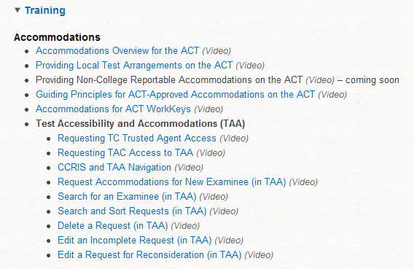
1. Requesting ACT-Approved Accommodations in TAA: Resources
College and Career Readiness System (CCRIS) Login Screen: https://readiness.act.org/ccr/app/home
Accommodations on the ACT® Test: http://www.act.org/aap/pdf/Accoms-on-the-ACT-Test.pdf
TAA User Guide: http://www.act.org/aap/pdf/Test-Accessibility-and-Accommodations-User-Guide.pdf
Training videos

Slide 4
1. Requesting ACT-Approved Accommodations in TAA: CCRIS URL
https://readiness.act.org/ccr/app/home

Slide 5
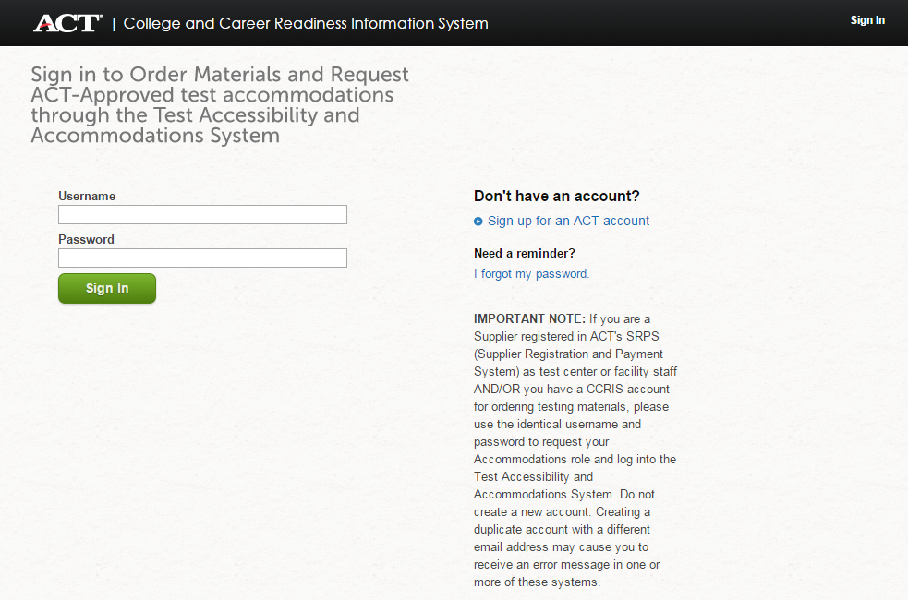
1. Requesting ACT-Approved Accommodations in TAA: CCRIS Log In Screen

Slide 6
1. Requesting ACT-Approved Accommodations in TAA: Deadline
All requests must be submitted by the request deadline in your Schedule of Events document.

Slide 7
1. Requesting ACT-Approved Accommodations in TAA: Select Your Organization

Slide 8
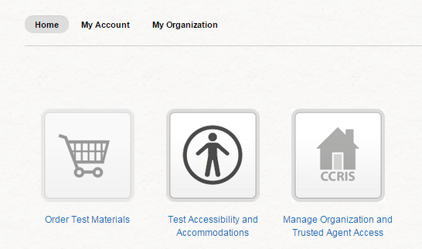
1. Requesting ACT-Approved Accommodations in TAA: Select Test Accessibility and Accommodations System (TAA)

Slide 9
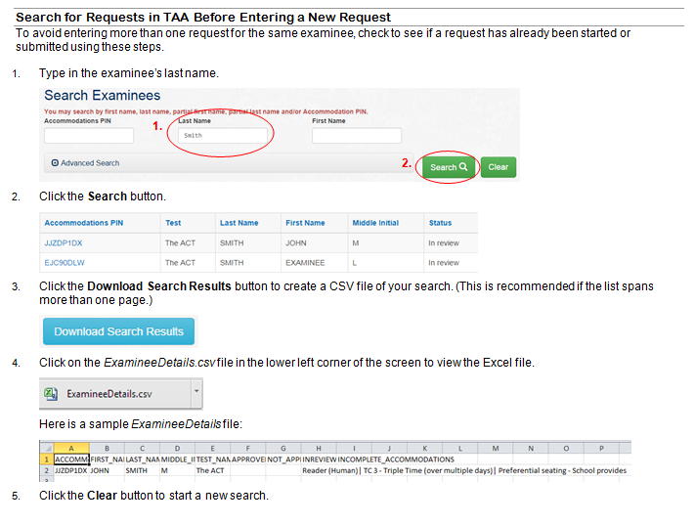
1. Requesting ACT-Approved Accommodations in TAA: Search for Requests Before Entering a New Request

Slide 10
1. Requesting ACT-Approved Accommodations in TAA: Using the Blue Icon and Previous Button

Slide 11
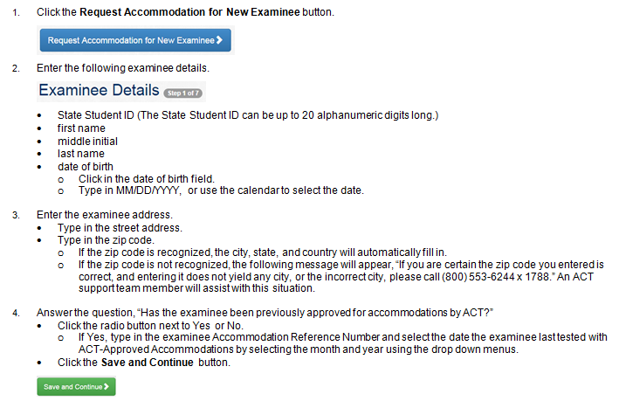
1. Requesting ACT-Approved Accommodations in TAA: Examinee Details

Slide 12
1. Requesting ACT-Approved Accommodations in TAA: Testing Information

Slide 13
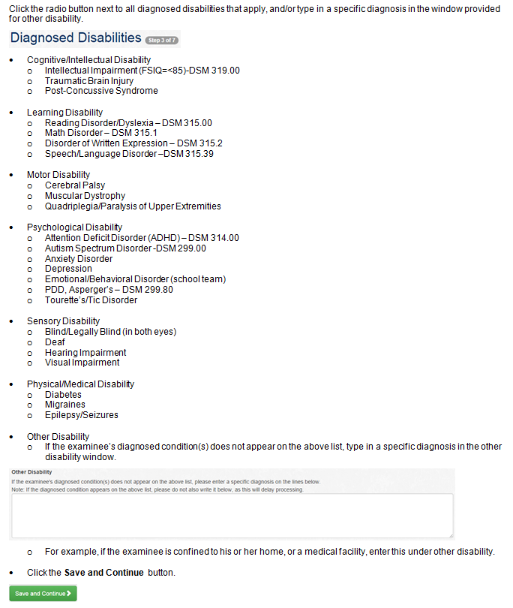
1. Requesting ACT-Approved Accommodations in TAA: Diagnosed Disabilities

Slide 14
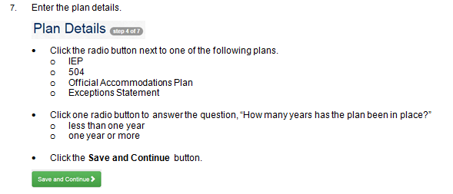
1. Requesting ACT-Approved Accommodations in TAA: Plan Details

Slide 15
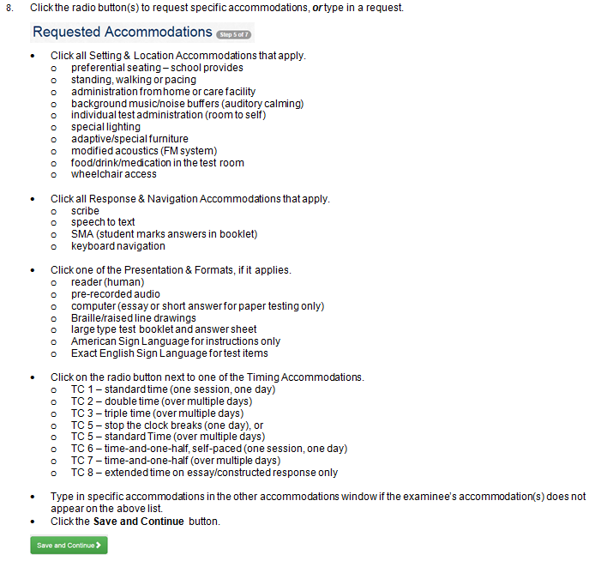
1. Requesting ACT-Approved Accommodations in TAA: Requested Accommodations

Slide 16
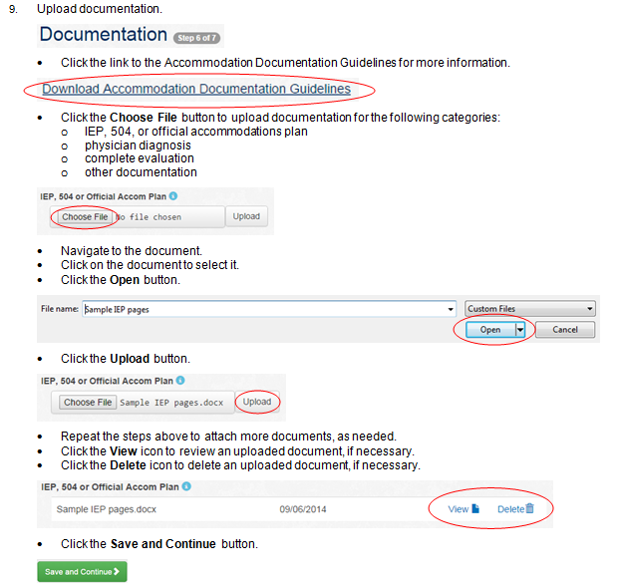
1. Requesting ACT-Approved Accommodations in TAA: Uploading Documentation

Slide 17
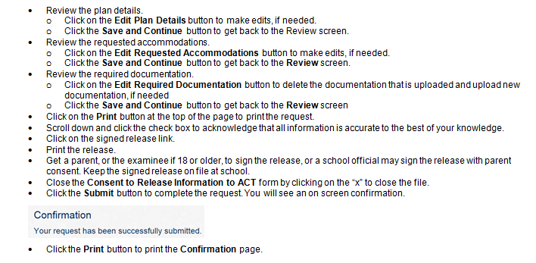
1. Requesting ACT-Approved Accommodations in TAA: Reviewing and Submitting the Request

Slide 18
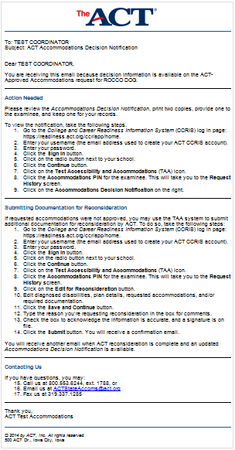
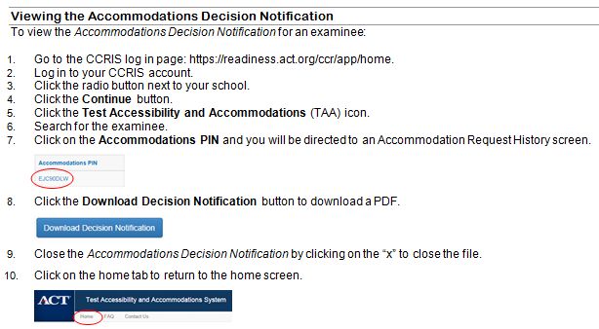
2. Accommodations Decision Notification

Slide 19
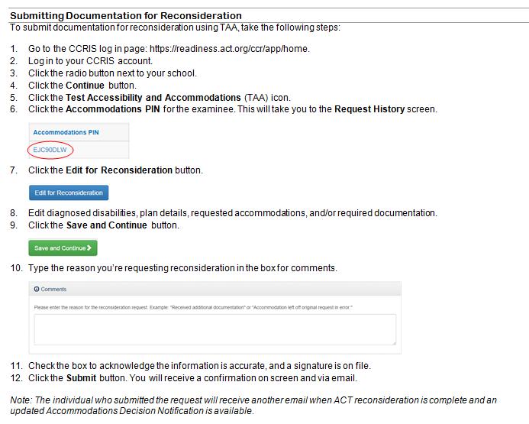
3. Requesting Reconsideration

Slide 20
4. Searching by Status of Requests

Slide 21
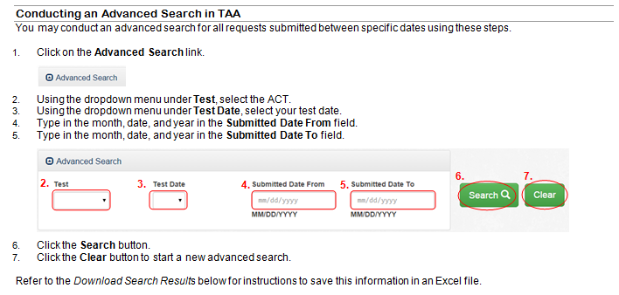
4. Completing an Advanced Search

Slide 22
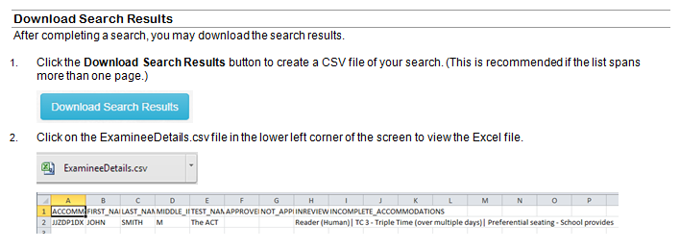
4. Completing an Advanced Search: Download Search Results

Slide 23
5. Preliminary Roster

Slide 24
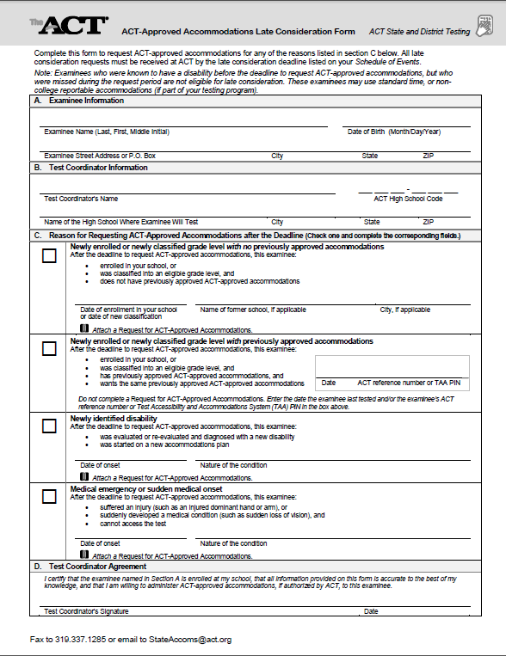
6. Late Consideration

Slide 25
7. Final Roster
final roster
sent to the attention of the test coordinator
the final roster is included with secure ACT-approved accommodations materials for paper testing

Slide 26
8. ACT-Approved vs. Non-College Reportable
ACT-Approved Accommodations
Result in college reportable scores
Request needed
ACT approves timing and ships materials in a kit
Non-College Reportable Accommodations
NOT college reportable, used for accountability
Order materials for students online
School staff determine timing and accommodations
School staff organize materials

Slide 27
9. Ordering Non-College Reportable Accommodations Materials
Non-College Reportable Material Ordering (if applicable to your testing program)
Test coordinator:
will receive an email with ordering instructions
will log into PearsonAccess^{next} to place an order

Slide 28
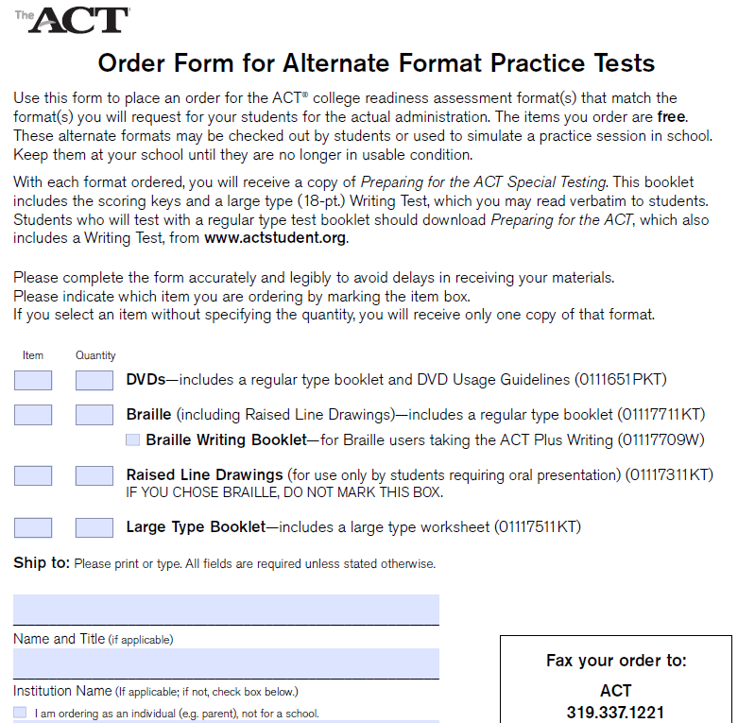
10. Ordering Practice Materials
Alternate format practice materials: http://media.actstudent.org/documents/alt_practice.pdf

Slide 29
ACT Contact Information and Resources
Phone: 800.553.6244, ext. 1788
Email: ACTStateAccoms@act.org
College and Career Readiness System (CCRIS) Login Screen: https://readiness.act.org/ccr/app/home
Accommodations on the ACT® Test: http://www.act.org/aap/pdf/Accoms-on-the-ACT-Test.pdf
TAA User Guide: http://www.act.org/aap/pdf/Test-Accessibility-and-Accommodations-User-Guide.pdf

