Slide 1
PreACT Online Reporting
North Carolina
Feb 18, 2021
Dr. Bryan Williams, Presenter

Slide 2
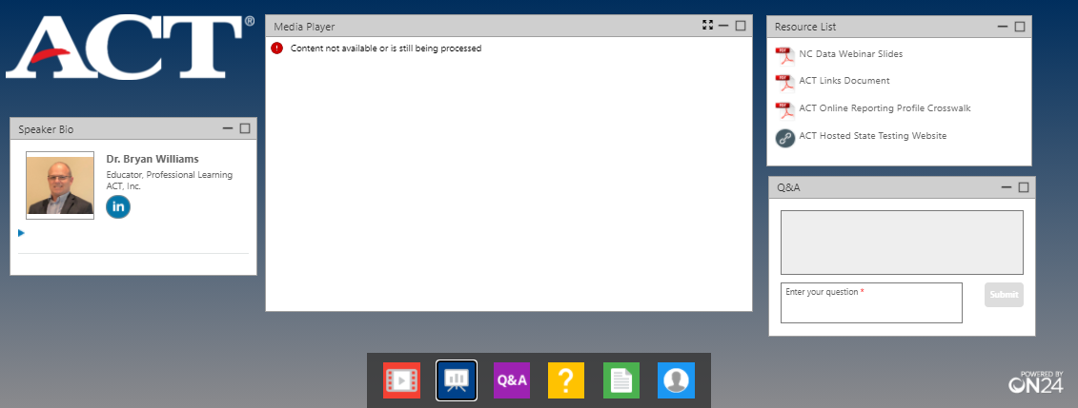

Notes:
PRESENTER SCRIPT:
Let’s take care of some housekeeping before we get started:
First, this webinar is being recorded and we will send a link to the recording within 24 hours, to those who registered. You can also use the same link you used today to join this webinar and the recording will be ready about an hour or two after we finish.
In the center of your screen, you should see the title slide that we started the webinar with. On both sides of the Title Slide, you will see several “widgets”, each with a different purpose.
On the top right you will find the Resource List. This widget holds links and documents that will be mentioned in the webinar today. The documents can be downloaded now if you would like, so make sure you get your copy before the webinar is over.
If, during the webinar, you have any questions you would like to ask, use the Q & A widget shown here in the bottom right side of your screen. Just type the question into the Q & A “widget” then hit “Enter” to submit the question.
When the question disappears on your end, know that I have receive it on my end. We will have set aside time at the end of the presentation to answer any questions we have received during the webinar and any others that may come up.
You also have the ability to resize any of the boxes on the screen or to minimize them if you would like to.

Slide 3
PreACT Online Reporting
Agenda
Multiple Resources
Accessing Online Reporting (video)
PreACT Online Reporting User Guide
PreACT Online Reporting Crosswalk
Available Data
Individual Student (Actual and Predictive)
School
District
School and District
Composite
Content
NCRC
Item Analysis
Download Data Hub
Notes:
Presenter Note: Add to what is shown below, but keep brief
PreACT Online Reporting
Agenda
Multiple Resources
Accessing Online Reporting (video)
PreACT Online Reporting User Guide
PreACT Online Reporting Crosswalk
Available Data
Individual Student (Actual and Predictive)
School
District
School and District
Composite
Content
NCRC
Item Analysis
Download Data Hub

Slide 4
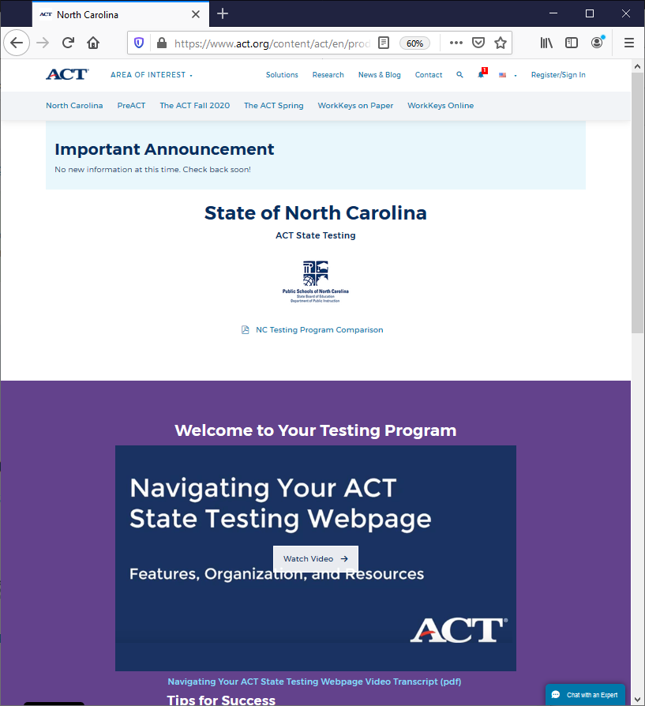
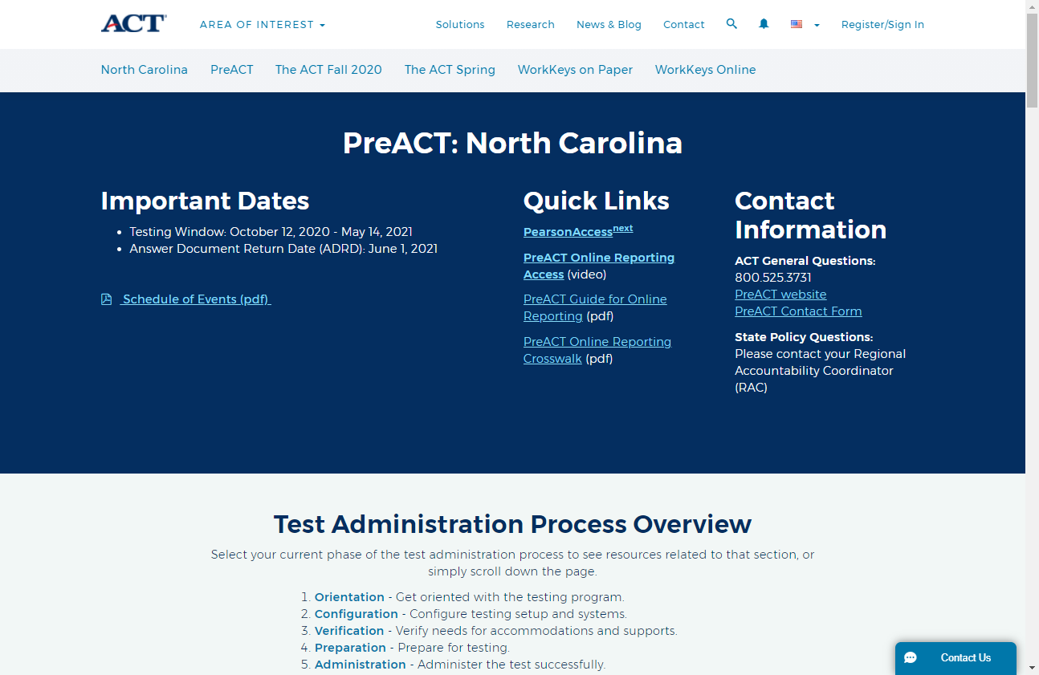
Did you know about the ACT State Testing Webpage?
Notes:
There are some great supports available to you. Knowing about these supports is the first step. Using these supports depends on you and your needs.
The link to this wealth of information is in the Resource widget.
<click> On the page, the ACT products available to North Carolina schools is listed across the top of the page.
<Click> Today’s webinar will focus on the PreACT and the data your school or district receives from your taking the PreACT.

Slide 5

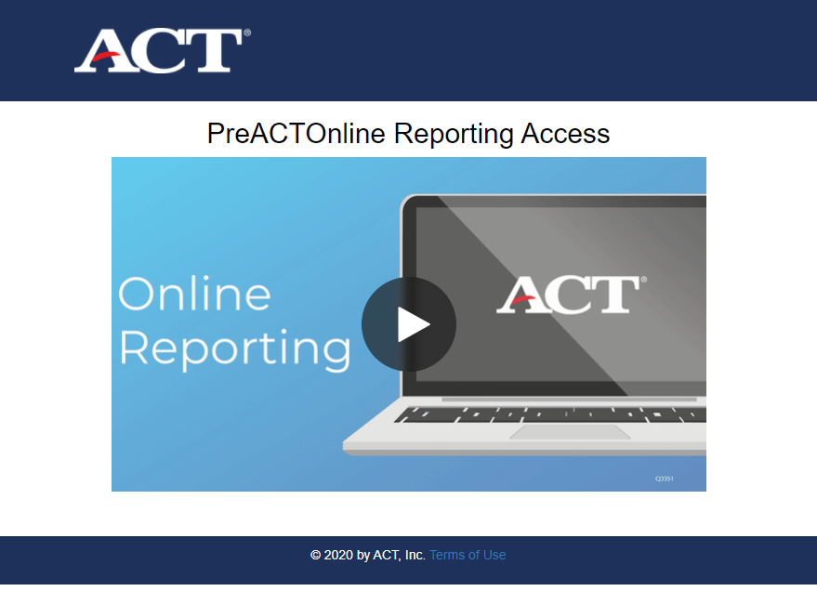
Notes:
Supports are provided on the ACT – North Carolina webpage

Slide 6
Notes:
Awareness of how to access Online Reporting – NC ACT State Webpage

Slide 7
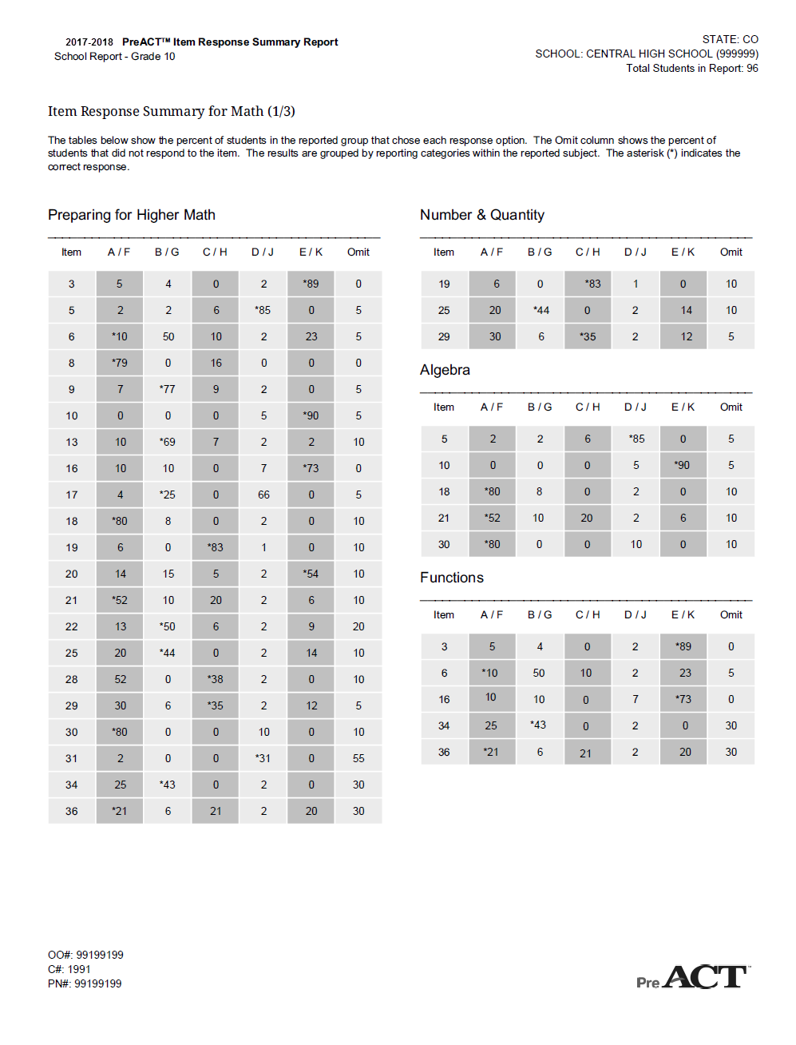
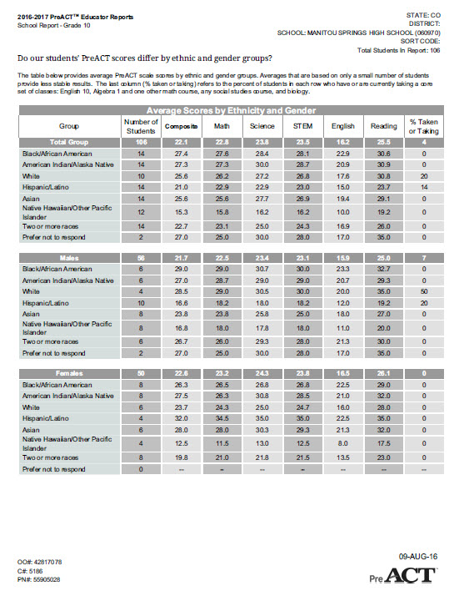
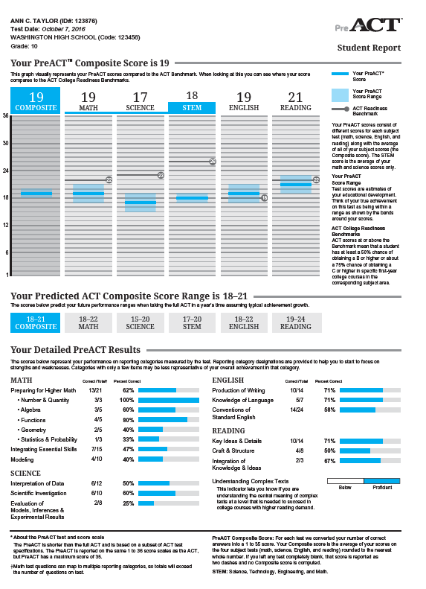
PreACT Reports
Item Response Summary
Educator Report
Student Report
Notes:
As I mentioned earlier, we’ll focus on a few key reports that are generated from a student’s performance on the test. Those reports are:
The Student Report
The Educator Report
The Item Response Summary Report
(next slide)

Slide 8
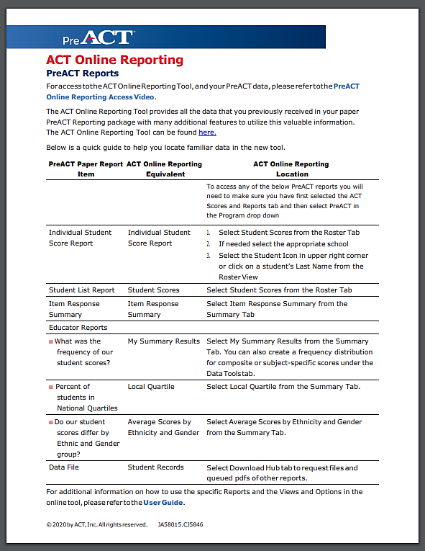
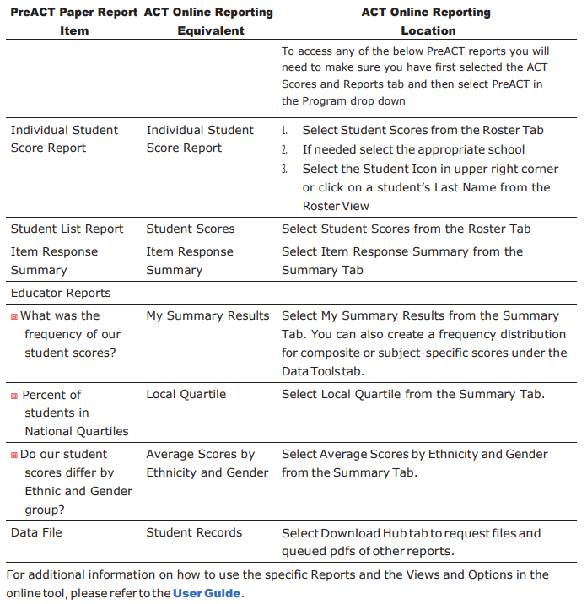
Notes:
Crosswalk document view

Slide 9
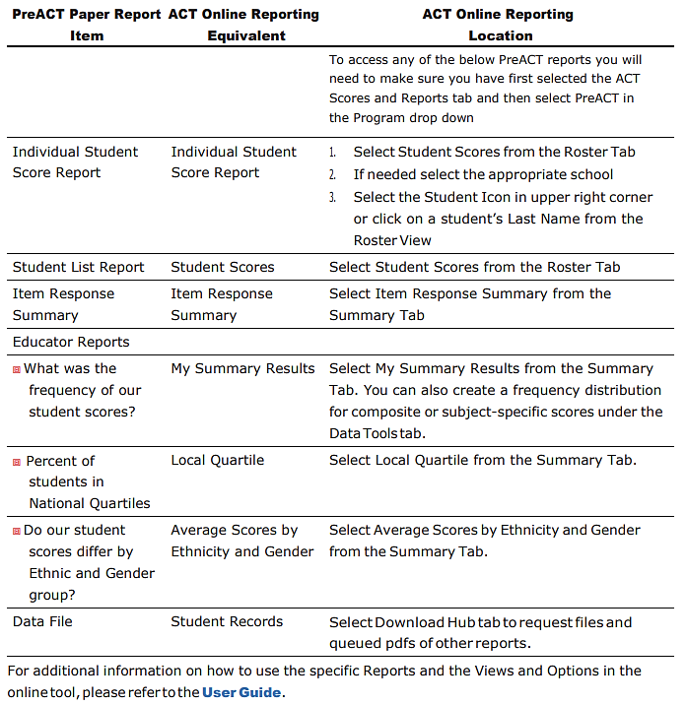
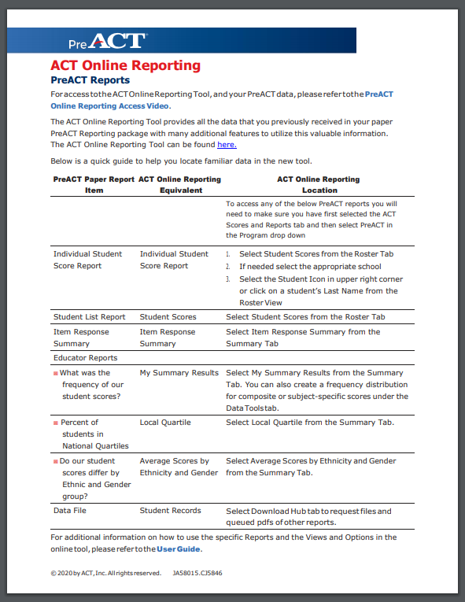
Notes:
Crosswalk document increased view

Slide 10
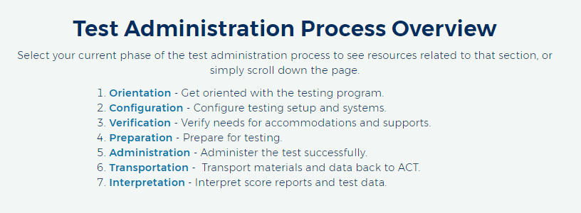
Notes:
Back to the NC webpage – calling out the test administration process overview FOR THE PreACT.

Slide 11
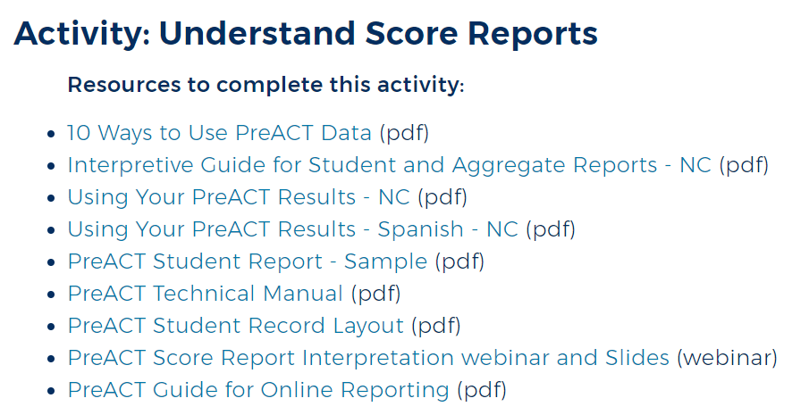
Notes:
Calling attention to the PreACT Guide for Online Reporting and the Interpretive Guide for Student and Aggregate Reports for NC.

Slide 12

Additional Resource
Notes:
Show steps to creating a freq. distribution chart

Slide 13
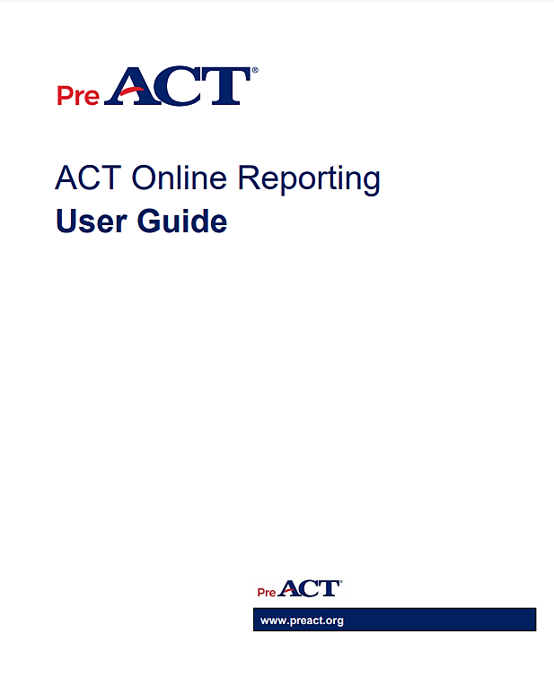
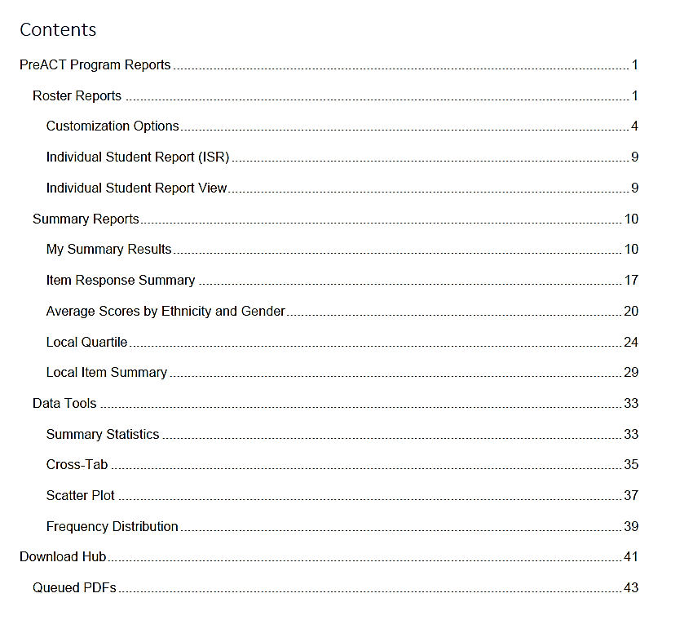
Notes:
Title page and TOC of the PreACT Online Reporting Guide

Slide 14
Differences in Access Rights
Detailed Viewer
Displays school or district data and rosters/individual student
My Summary Results
Local Item Summary
Item Response Summary
Average Scores by Ethnicity and Gender
Local Quartile
Summary Viewer
Displays school or district data
My Summary Results
Local Item Summary
Item Response Summary
Average Scores by Ethnicity and Gender
Local Quartile
Notes:
Call out high level difference between Detailed and Summary Viewer
Detailed and Summary are identified at access creation – Are you going to have rights to view your school or do you need rights to view district level, which includes school viewer rights.

Slide 15
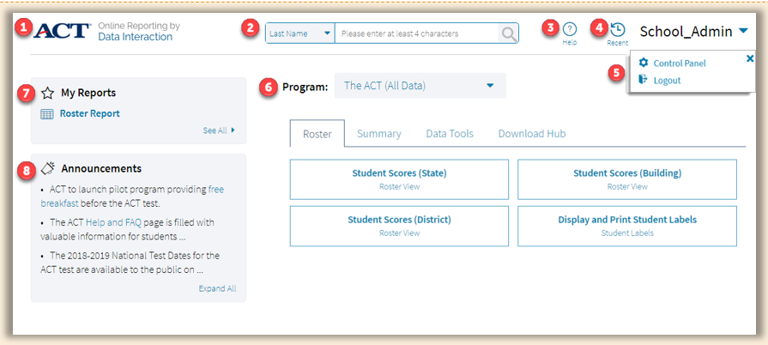
Notes:
1: The ACT logo serves as a Home link. Select the logo from any page view to return to the online reporting landing page.
2: The student search feature allows users to search for a student by Last Name, First Name, ACT ID, State ID, or Local ID.
3: The Help icon will direct to the ACT Help and Support site.
4: The Recent icon will bring up a list of recently viewed reports. Once a user logs out, these reports will be cleared.
5: The upper right-hand corner includes a user drop-down with the following options:
Control Panel: Select to view User Activity Reports for admin users.
Logout: Select to log out of online reporting and return to success.act.org.
6: The Program drop-down allows users to select a specific program.
Note: Click the drop-down menu to view State Contract, District Contract, and PreACT programs.
7: The My Reports panel displays the four most recently saved reports. Select See All to display all saved reports.
8: The Announcements panel displays up to four recent announcements. Select Expand All to view the announcements in their entirety.

Slide 16

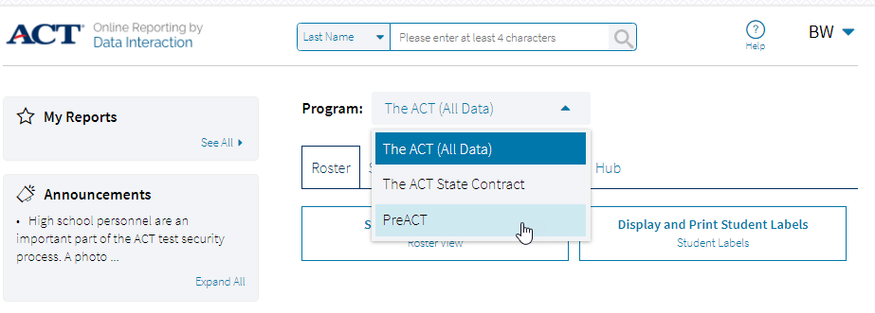

Select Program: PreACT
Notes:
Emphasize – Program needs to select “PreACT”. This resets every time a new data search is started.
I also want to point out the ability to search for student records from the landing page.
Looking for ACT student scores? Select The ACT (All Data)
Want PreACT scores? Select PreACT under Program:

Slide 17
Making the Data Dynamic
Options – Organization
Choose School or District
Options – Fields
General information, student ID, demographics
Options – Scores
Composite, Content, Benchmark, US Rank, Score Range
Points Earned, Percent Correct (by content)
Options – Search
and/or Relationships
Options – Filters
Predefined variables in drop down list (female/male, Race/Ethnicity)
Customization Options
Utilize the PreACT Guide for Online Reporting – beginning on page 4
Notes:
Calling attention to the PreACT Guide for Online Reporting – Options available that make the data dynamic.

Slide 18
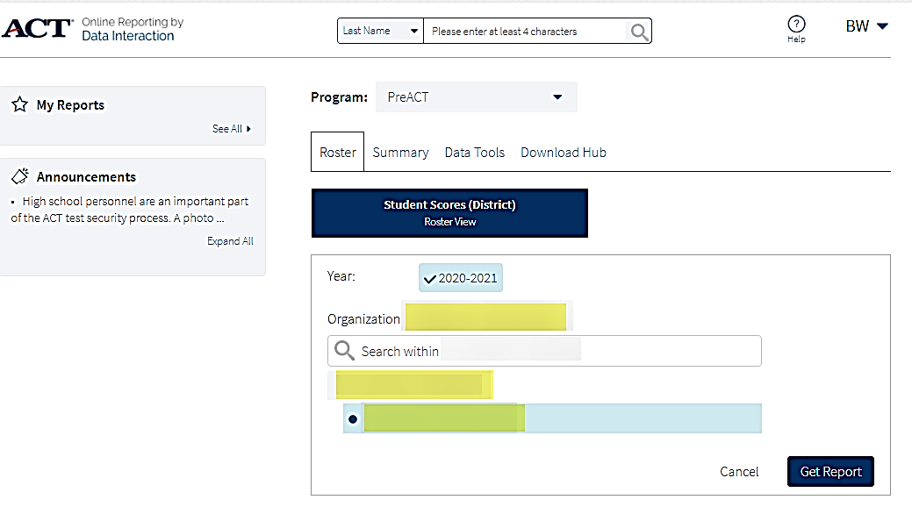
Individual Student Score Report
Notes:
Starting with the Individual Student Score Report
Roster Reports (access with Detailed Viewer rights assigned to the Online Reporting System)
If you don’t see Roster tab, you don’t have Detailed Viewer rights.

Slide 19
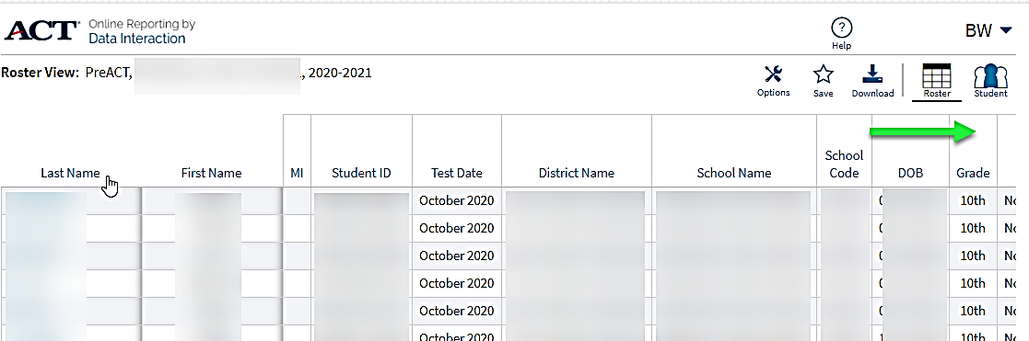
Roster Report and
Individual Student Score Report
Notes:
Starting with the Individual Student Score Report
Roster Reports (access with Detailed Viewer rights assigned to the Online Reporting System)
Green arrow indicating more data on each row (shown on next screen)

Slide 20
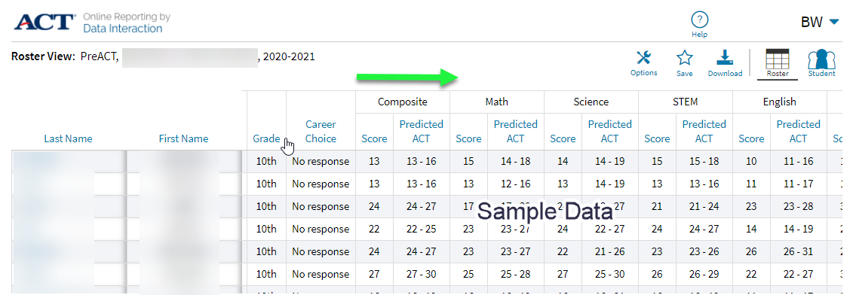
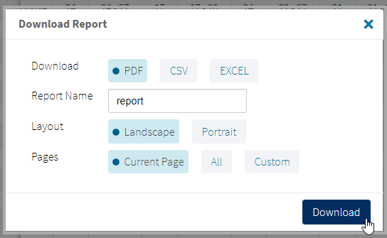
Roster Report and
Individual Student Score Report
Notes:
Looking at the data on the row continuing from previous slide…
Each student’s scores are presented by Composite, Math, Science, STEM, English, and Reading.
You can Download this data as a CSV or Excel format

Slide 21
Roster Report and
Individual Student Score Report
Notes:
Individual student score reports called up
Roster
<click>
ISR

Slide 22
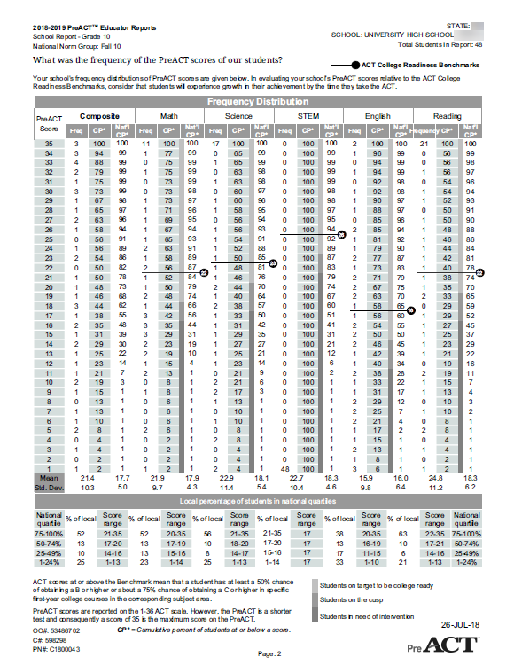
PreACT Composite
and
Content scores
- a consistent score from year to year
Educator Report, p. 2
Notes:
PreACT view from Educators Report (paper version)

Slide 23
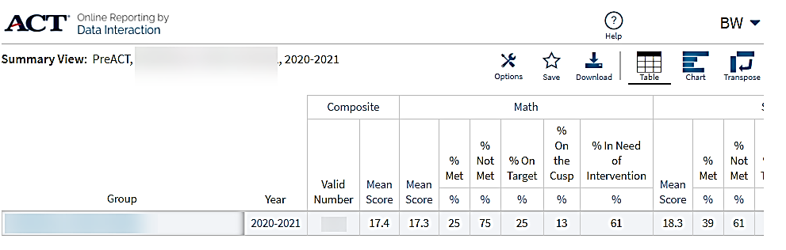
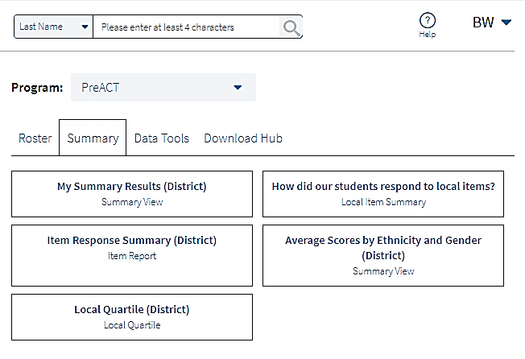
Summary Reports
Notes:
Summary Report - showing the aggregate data – Composite and Content

Slide 24
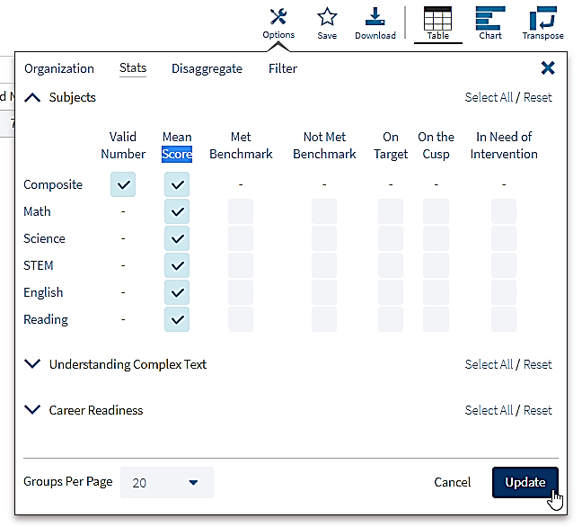
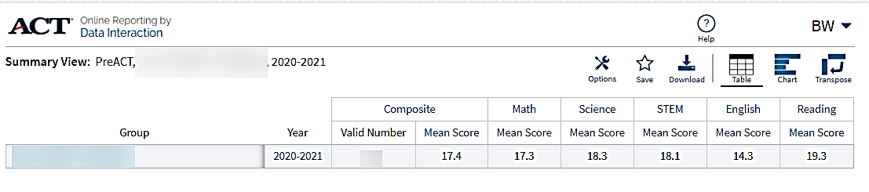
Summary Reports
Notes:
Using Stats, I can filter out the other data filling up the page. Now, I am looking at just the Composite and Content scores, I can easily make a PDF showing these scores.

Slide 25
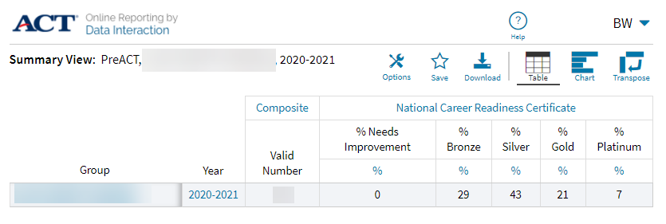
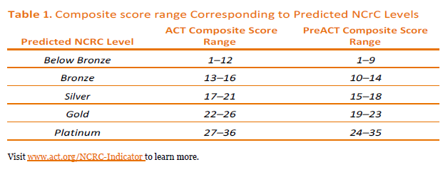
NCRC Predicted
School-level Percents
Notes:
Summary Report - showing the aggregate data – Composite and Content
Ability to remove any Options under Stats to focus on “% of students On the Cusp” for example.
Here I have kept only “On the Cusp”

Slide 26
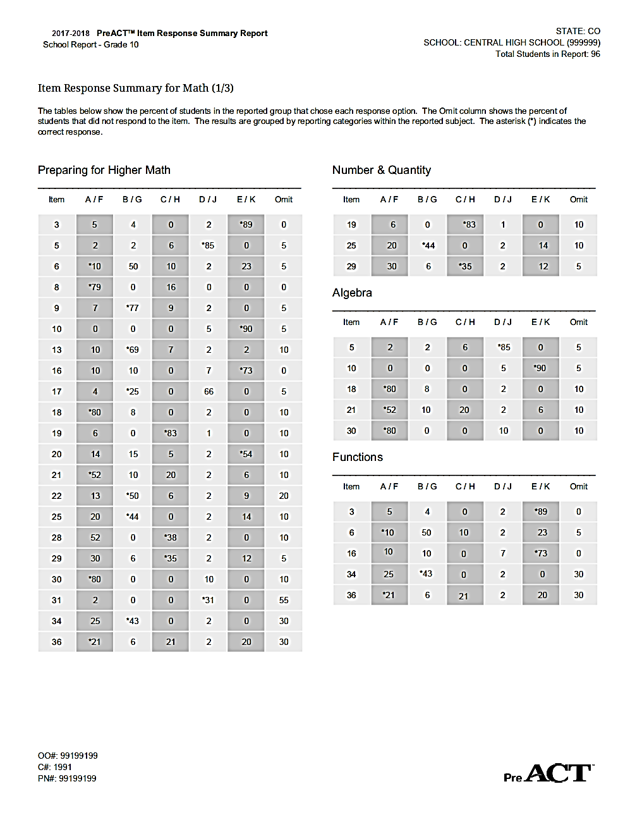
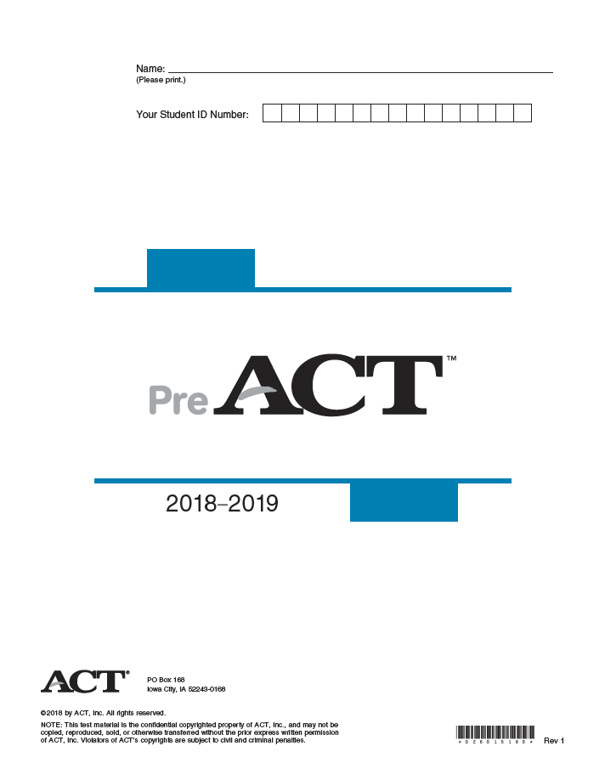
PreACT
Item Analysis for Educators

Slide 27
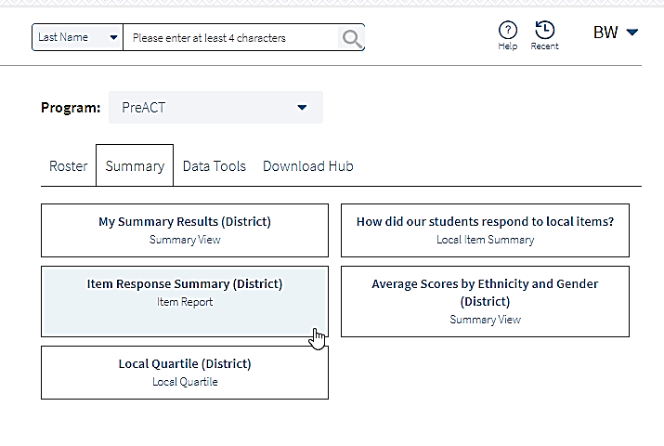
Summary > Item Response Summary
More needed here

Slide 28
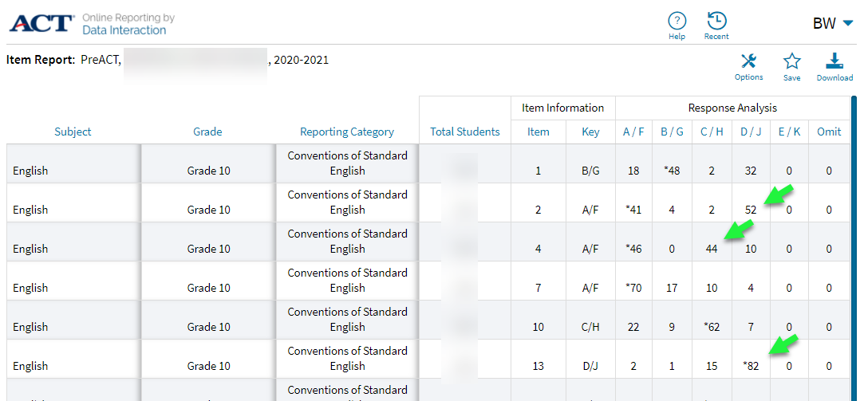
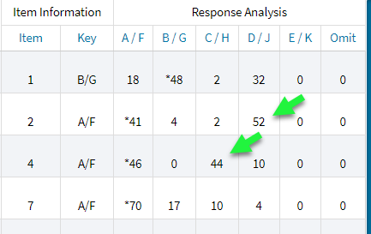
Item Analysis slide
Which questions had a Response % above the correct answer?
Question #2
Notes:
Item Analysis with an enlarged view available.

Slide 29
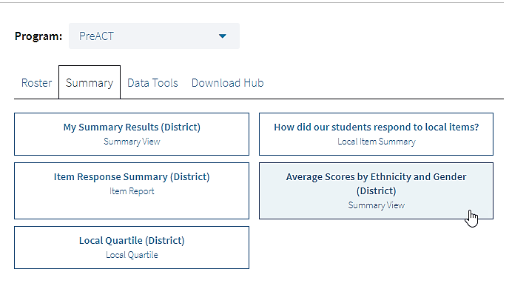
Summary > Average Scores by Ethnicity and Gender

Slide 30
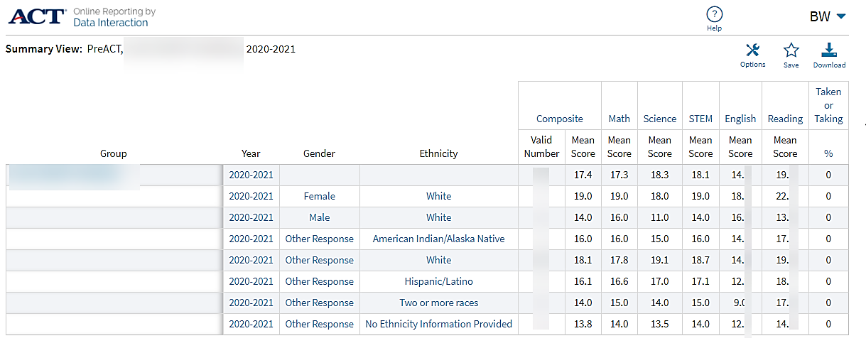
Summary > Average Scores by Ethnicity and Gender

Slide 31
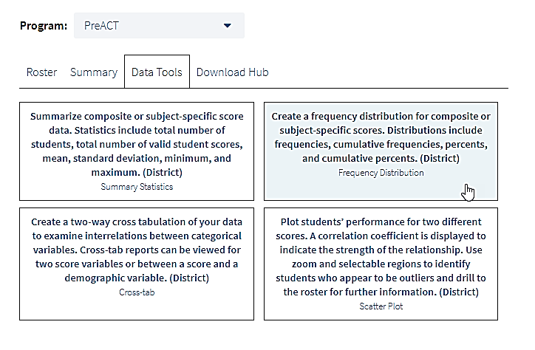
Data Tools > Create a frequency distribution for …

Slide 32
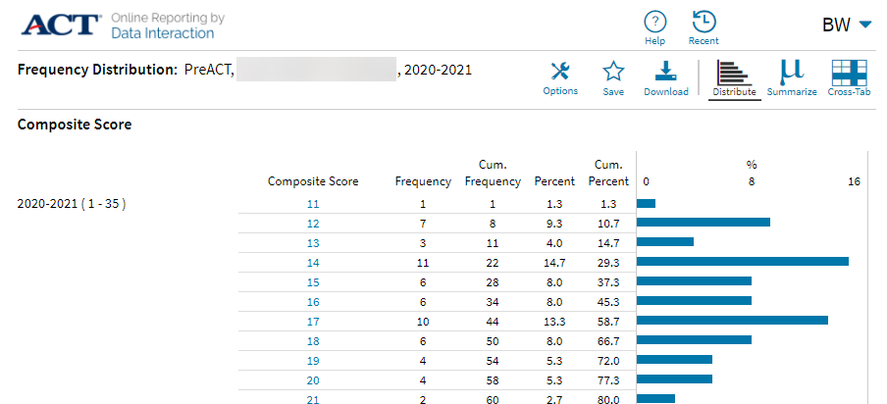
Data Tools > Frequency Distribution
Notes:
Show steps to creating a freq distribution chart

Slide 33
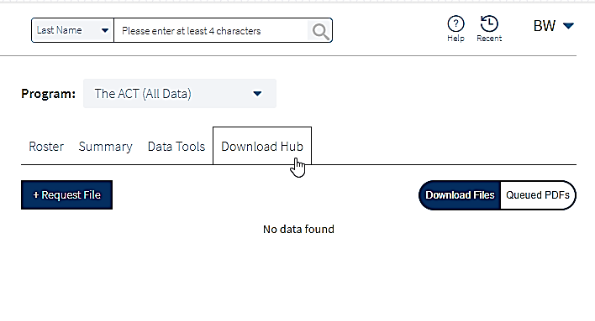
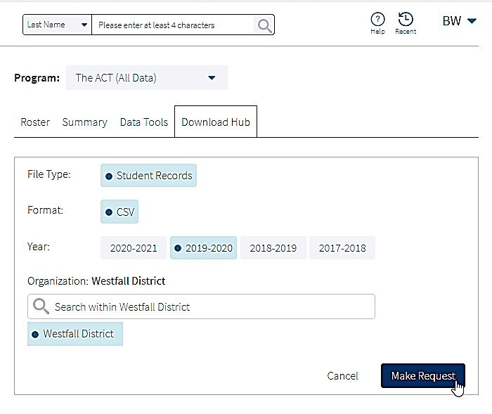
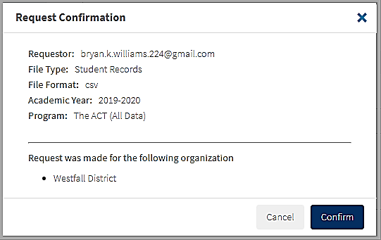

Slide 34
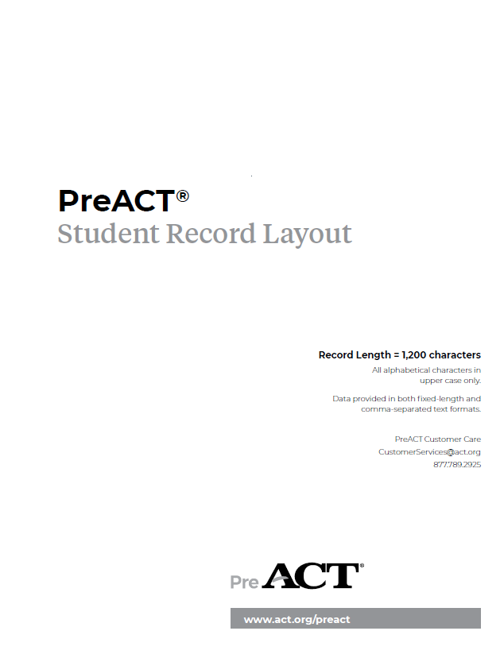
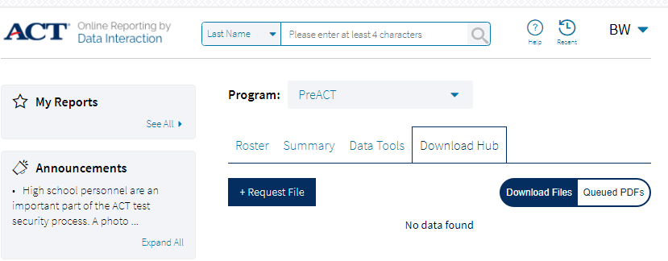
Notes:
The next three slides provides insight into the Data Download for the PreACT.

Slide 35
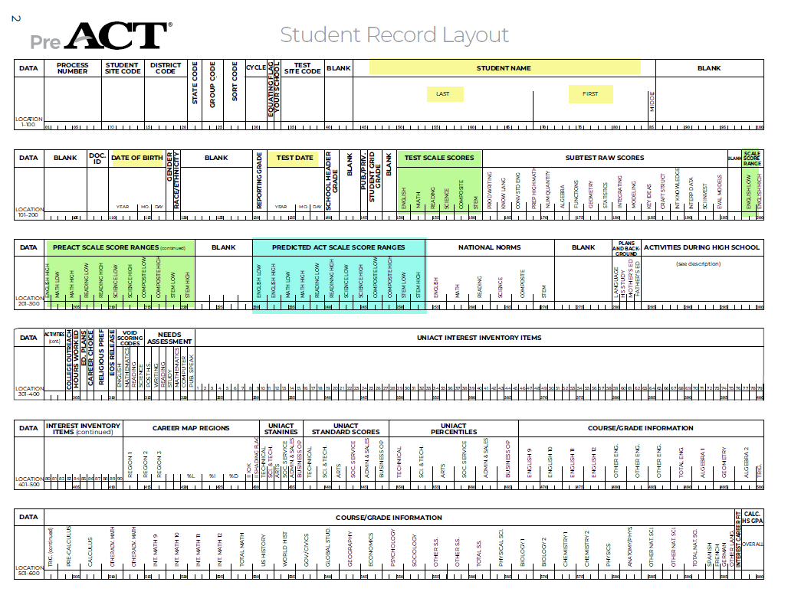
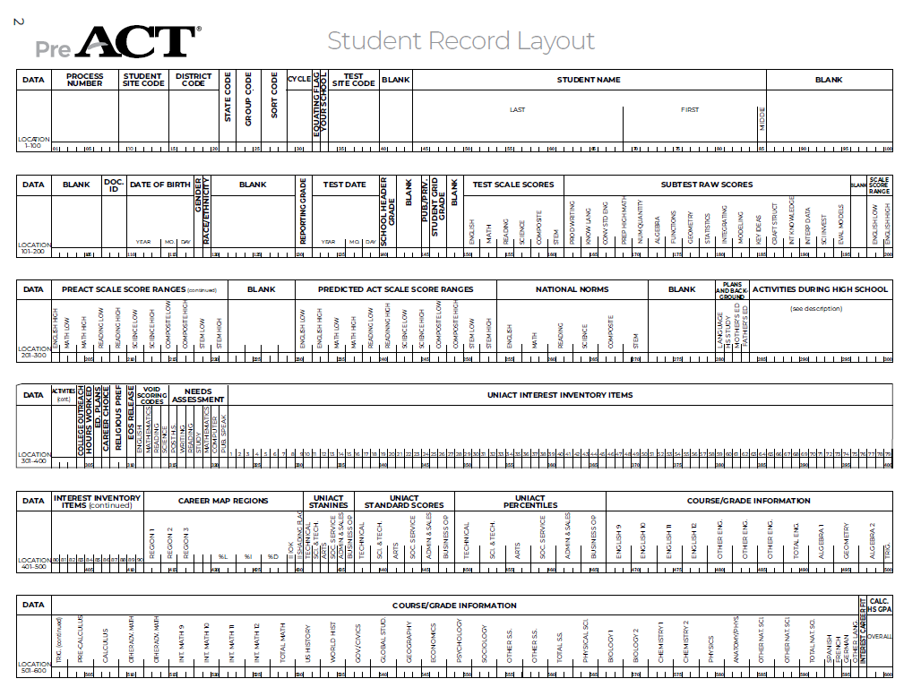
Notes:
Notice in the blue, the Predicted ACT Scale Score ranges.

Slide 36
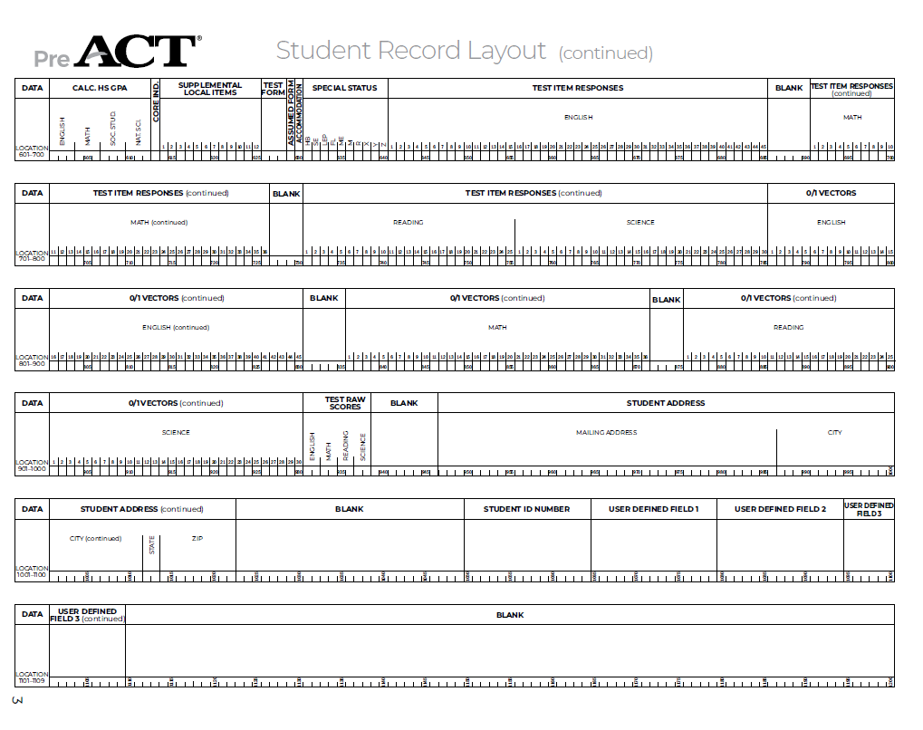
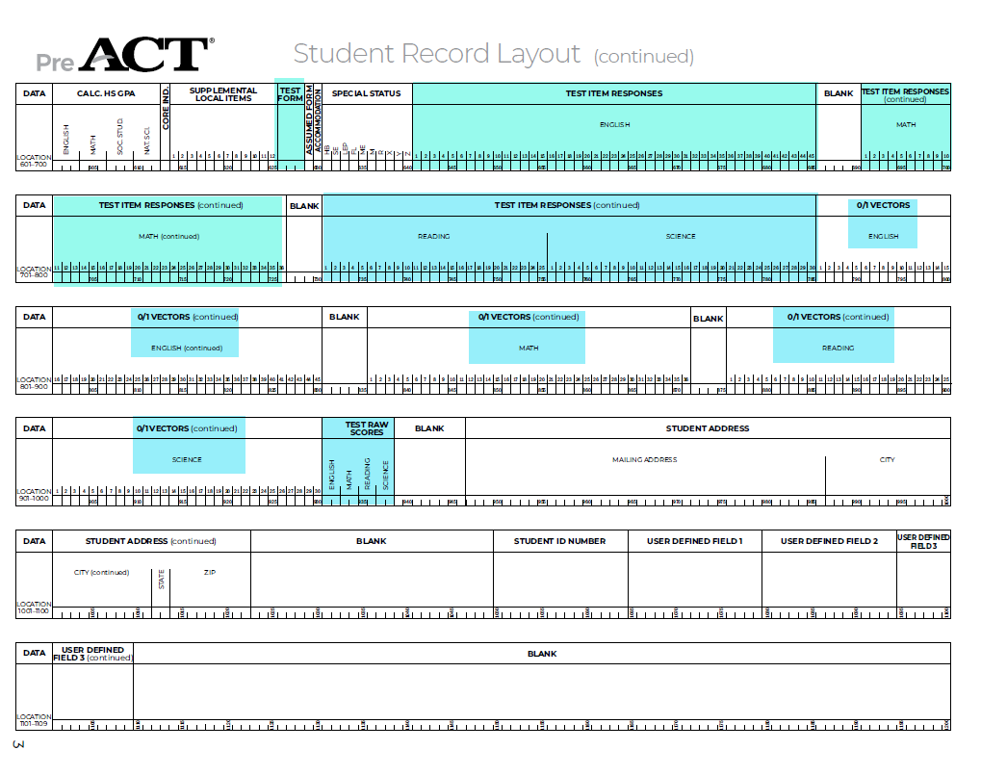

Slide 37
PreACT Online Reporting
Agenda
Multiple Resources
Accessing Online Reporting (video)
PreACT Online Reporting User Guide
PreACT Online Reporting Crosswalk
Available Data
Individual Student (Actual and Predictive)
School
District
School and District
Composite
Content
NCRC
Item Analysis
Download Data Hub
School (Actual and Predictive)
- Interested?
Notes:
Review – did we cover what we said we were going to do?

Slide 38
Did you know about the ACT State Testing Webpage?
Notes:
There are some great supports available to you. Knowing about these supports is the first step. Using these supports depends on you and your needs.
The link to this wealth of information is in the Resource widget.
<click> On the page, the ACT products available to North Carolina schools is listed across the top of the page.
<Click> Today’s webinar will focus on the PreACT and the data your school or district receives from your taking the PreACT.

Slide 39
Notes:
Supports are provided on the ACT – North Carolina webpage

Slide 40

Contact Information
Marchelle.Horner@act.org
Bryan.Williams@act.org
All recipients of ACT data and student information are reminded that they are responsible for protecting the confidentiality of that information in accordance with applicable laws and institutional policies. Score recipients assume responsibility for protecting the confidentiality of ACT data reported to them.

