Slide 1
Getting Ready for the PreACT
Use this deck to share with your staff details about:
Understanding PreACT
Getting Ready for PreACT
Administrator Presentation
Notes:
Thank you for choosing PreACT. Administrators, use this PowerPoint deck to educate your staff on the PreACT assessment and reports, and to help set the stage for next steps as you prepare to administer PreACT in your school. Some additional information is provided via the notes section on several slides for sharing with your staff during your presentation.

Slide 2
Getting Ready for the PreACT

Slide 3
Agenda
PreACT overview
English Learner supports
PreACT reports
Key benefits of PreACT

Slide 4

PreACT:
Easy, flexible, and affordable administration
Fast, robust reporting
Early indication of progress to help guide action plans
Notes:
PreACT encompasses paper-based, multiple-choice tests in English, math, reading, and science. PreACT administration time is less than that for the ACT, and it is an affordable way to give students high-stakes practice in a low-stakes environment.
Reports are ready quickly, so teachers and students can get to work turning PreACT insights into action. Reports include information about student interests that counselors can use to advise students in thinking about college majors and careers.
PreACT predicts student performance on the ACT and can be used as an indicator of college and career readiness. Reports include data to help teachers and counselor target interventions, inform classroom instruction and guide students in course selection.

Slide 5
PreACT Overview
Half-day Administration (3 hours, 15 minutes)
60 minutes for non-test sections
2 hours, 10 minutes for 4 subject tests
4 Subject Tests
English (45 questions)
Math (36 questions)
Reading (3 passages, 25 questions)
Science (30 questions)
Interest Inventory
Notes:
PreACT is available for administration September through May each year. It has been designed to be administered within a half day during school-supervised sessions. Procedures and materials have been designed to allow schools the option of dividing the administration over two or more days. Non-test sections (student plans and background information, Interest Inventory, and course/grade information) may be administered in a nonsecure, supervised school setting on or before the test day. The four subject tests must be administered in a single session on the designated test day.
PreACT contains four subject tests—English, math, reading, and science. These tests are designed to measure students’ curriculum-related knowledge and the complex cognitive skills important for future education and careers.
The ACT Interest Inventory helps students explore personally relevant career options. The inventory is intended for people in the early stages of career planning where the primary purpose of interest assessment is to simulate and facilitate exploration of self in relation to careers and provide a focus to career exploration.

Slide 6
English Learner Supports
Accommodations Available to English Learners
Beginning fall of 2017-2018 school year
Additional time on test (not to exceed time-and-a-half)
Use of an approved word-to-word bilingual dictionary (containing no word definitions)
Test instruction provided in the student’s native language (including Spanish and a limited number of other languages initially)
Testing in a non-distraction environment (i.e. in a separate room)
Notes:
You are able to provide PreACT EL supports at your discretion. ACT will not review/approve PreACT supports as is done for the ACT.

Slide 7
PreACT Overview - Reporting
PreACT scores and predicted ACT score ranges for Composite and subject test on ACT 1-36 scale
PreACT reporting category scores
Student’s college and career planning results, including their results on Interest-Career Fit
STEM and text complexity scores
Student level item response and correct answers

Slide 8
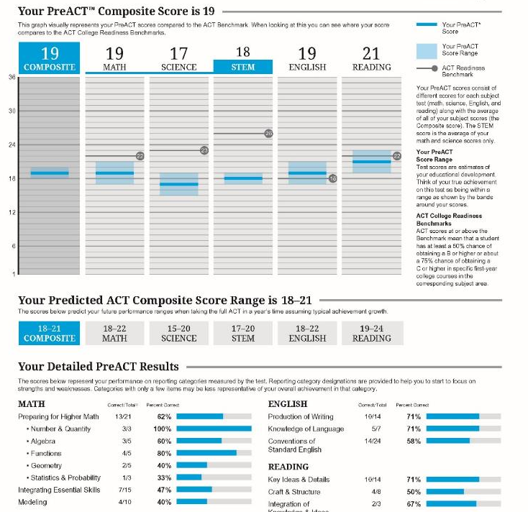
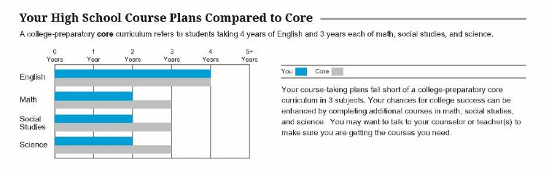
PreACT Student Report Insights
Composite Scores
Composite scores and subject test scores tell you and your students which subjects need more focus before graduation.
Predicted ACT Scores
PreACT scores can be used to predict how well students are likely to perform on the ACT test. These can help determine if there are subject areas requiring more focus to improve skills and scores.
Detailed Results
This score shows the percent and number of points earned out of the total number of points possible on the skills tested within each subject.
Course Plan
Compares student academic plans with the recommended minimum set of college preparatory courses.

Slide 9
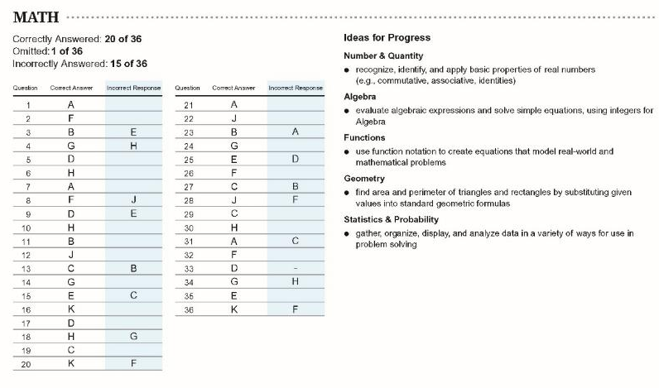
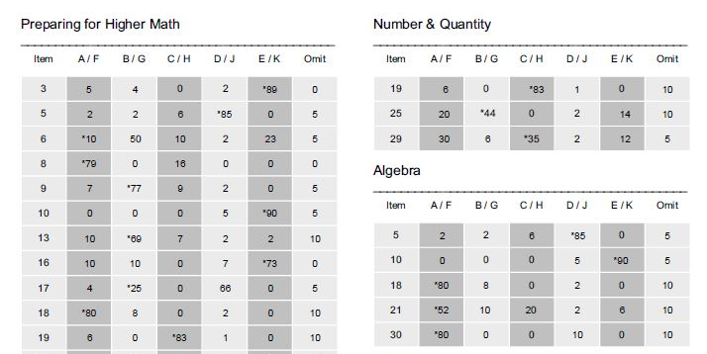
PreACT Student Report Insights
Item responses and how to make progress
Students receive an item analysis report. Here they can view each question, know the correct answer, and identify which items they answered incorrectly. The report also gives them ideas for progress to improve scores.
Educator Item response summary
Identify how your students answered each item: right, wrong, or did not answer
Which specific areas can my students improve?
Based on certain items, understand the content areas where you can improve curriculum before the ACT test to boost students’ college readiness

Slide 10
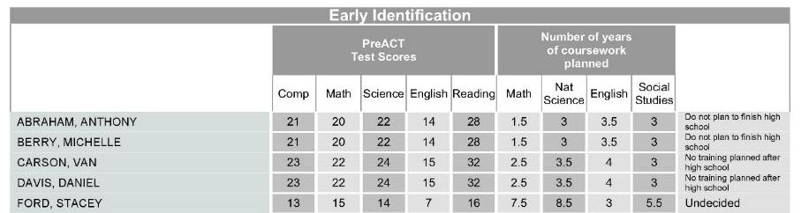
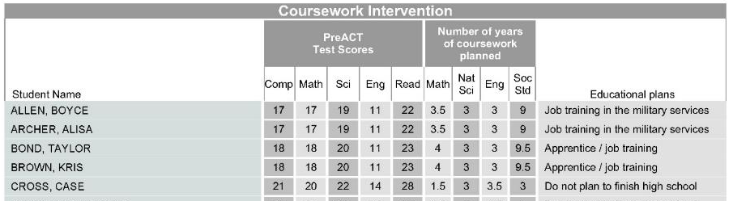
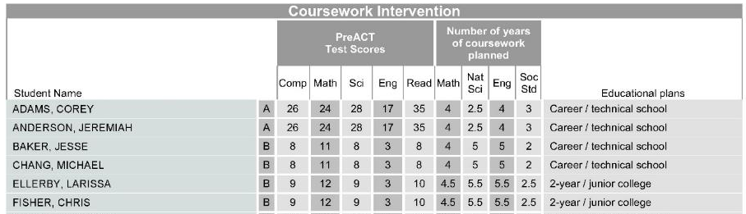
PreACT Report Insights
Early Identification
Shows which students reported they do not plan to finish high school or have no plans for after high school.
College Ready
Shows which students earned a PreACT Composite score of 16 or higher but do not plan to attend college.
Coursework Intervention
Shows which students plan to attend college, but earned a Composite score of 15 or below, or do not plan to take college core coursework

Slide 11
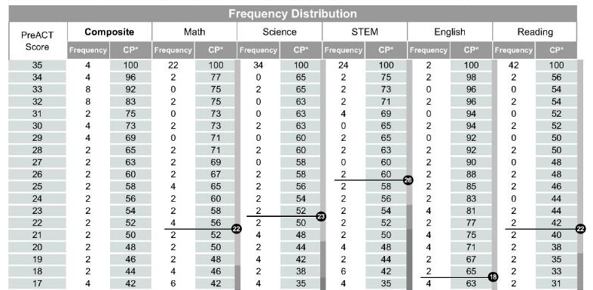
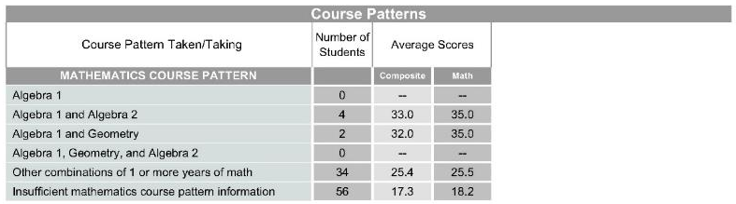
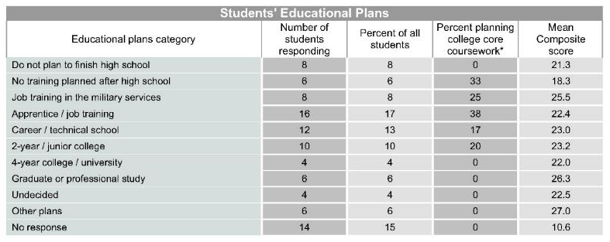
PreACT Report Insights
Frequency Distribution
The frequency distribution chart shows the number of students achieving each score level in each subject and the cumulative percentage of students at or below that score in comparison to the ACT College Readiness Benchmarks.
Course Patterns
Provides average PreACT scale scores by students who have indicated they have taken or are currently taking particular courses.
Students’ educational plans?
Understand how your students’ PreACT Composite scores, and coursework plans, relate to their plans for after high school

Slide 12
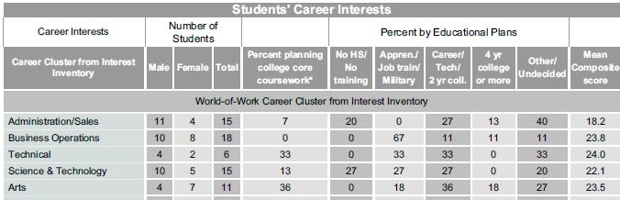
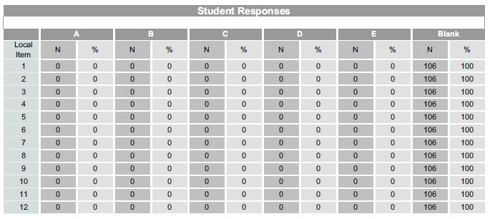
PreACT Report Insights
What are my students’ educational plans?
Understand how your students’ PreACT Composite scores, coursework plans, and educational plans relate to their career interests
Do my students feel safe?
Add your own items to PreACT and understand the environment or climate within your district

Slide 13
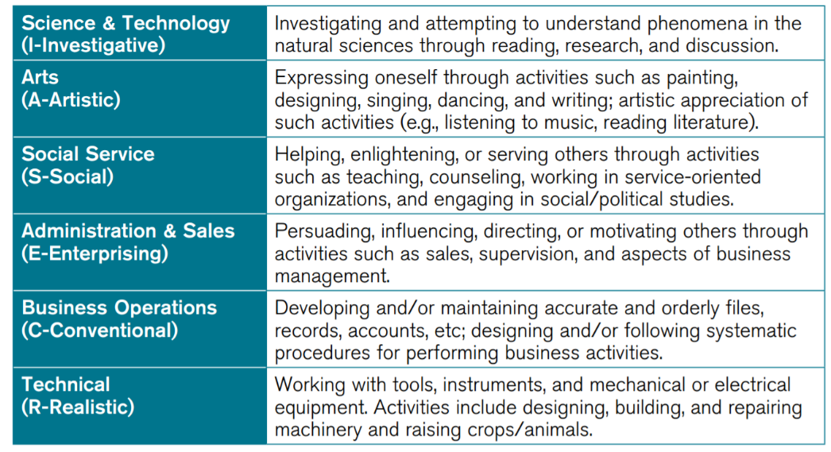
Interest Inventory
Scales
Notes:
The ACT Interest Inventory was designed to help people see the connections between the world of work and the everyday things they like to do. Results can help students identify personally relevant career options.
Students complete the Interest Inventory during registration for the ACT test and PreACT. Items on the Interest Inventory emphasize everyday work-relevant activities that are familiar to people and tap the intended interest constructs, without revealing job titles or specific work activities.
Results are reported on the Individual Student Reports as well as educator reports. Reports include:
Standard Scores – One for each of the six scales shown here
Career Map Regions
Career Areas
Career Connector
Interest-Major Fit

Slide 14
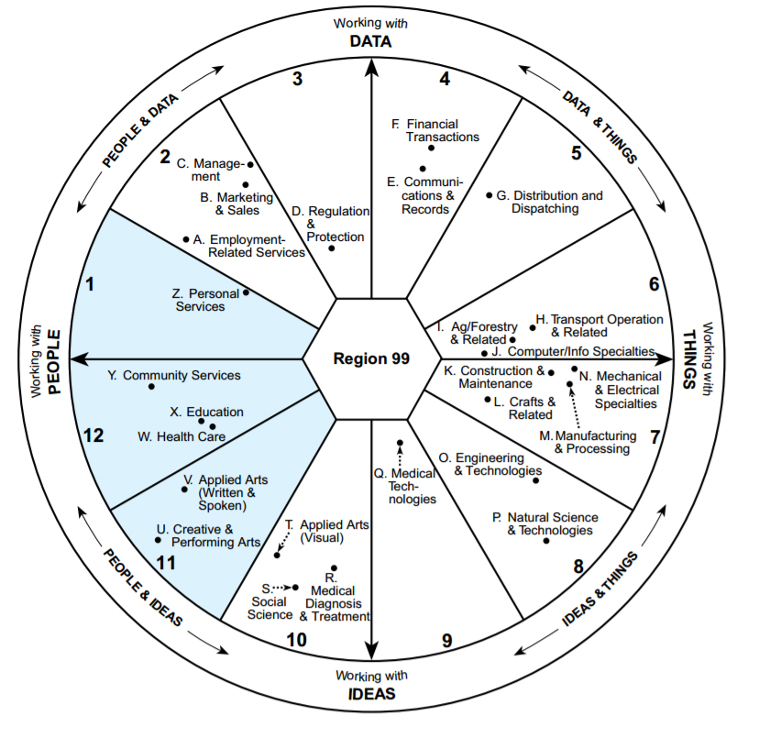
PreACT Career Interest Indicators
Page XX
Notes:
The PreACT score report includes 2 indicators of career and interest measurement:
Education and Career Journey, which helps students identify their career-related interests and encourages follow up with career exploration activities. In addition, this section reports information that can help students evaluate whether they are on track to meet their self-reported educational goals.
Interest-Career Fit, which displays the level of agreement between the student’s interests and the career area they selected. For example, high fit means that the student’s measured interests are in agreement with the kinds of occupations they prefer.

Slide 15
Help students practice for the ACT, discover new opportunities, and start planning for the future with PreACT.

Slide 16

PreACT Key Benefits for Students
Early practice for taking the ACT test
Provides PreACT score and predicted ACT score ranges on the ACT 1-36 scale
Students may opt to share their information with colleges and scholarship agencies
Results of the ACT Interest Inventory provides students a personalized view of interests with college and career alignment

Slide 17

PreACT Key Benefits for Parents
Understand student’s potential performance on the ACT
Understand general academic strengths and weaknesses as well as specific areas of need for academic intervention
Understand if student’s interests and career goals are aligned with their academic performance
Assist in early postsecondary planning and career investigation
Helps inform conversations about academic, interests, college, and career choices

Slide 18

PreACT Key Benefits for Educators
Flexible administration (Sept 1-June 1)
Provides Technical Guides for curriculum planning
Provides a snapshot of how students are performing across academic standards
Reporting categories provides insights to inform classroom and educator intervention
Enables counselors to have college and career planning conversations
Quick access to individual student data and patterns of performance

Slide 19

Why [School/District] Choose PreACT
Early practice for the ACT test with flexible test administration dates – test on your schedule
PreACT score and predicted ACT score ranges align to the ACT 1–36 scale
Students may opt to share their information with colleges and scholarship agencies
ACT Interest Inventory results provide students with a personalized view of interests with college and career alignment
Valuable results provide actionable insights to help educators, parents and students make important decisions for the future
Rapid reporting turnaround within 5-10 days of receipt of answer documents allows for early and effective college and career planning

Slide 20
Next Steps
Administer assessment
Submit online for scoring
Receive and analyze reports
Report distribution
Implement intervention strategies

Slide 21
Other Available Resources
User guides/administration manual
Training sessions
Planning tools

Slide 22
Questions?

