Slide 1
April 5, 2016
Welcome to the Tennessee Test Administration Training and Q&A Session
Please Call: (800) 230-1059
Access Code: 10:00 - 388894
2:00 - 388895
Notes:
Welcome to the Test Administration Training and Q&A session for Tennessee State Testing. My name is Annie Dailey and I will be your presenter. Also in the room with me today is Missy Schintler from the ACT accommodations department.
Please wait to ask questions over the phone until we have finished the training portion of the session. You may chat questions at anytime during the session, however they will only be answered during the Q&A portion at the end. Let’s get started…

Slide 2
ACT Test Days – Spring 2016
Audio Connection: (800) 230-1059
Access Code: 10:00 – 388894
2:00 - 388895
Initial Test Date | Accommodations Testing Window | Makeup Test Date
April 19 | April 19 – May 3 weekdays | May 3
ACT recommends testing begin by 9 a.m. on the initial and makeup test dates. Late Starts must be approved by ACT.
Notes:
11th graders in Tennessee will be taking the ACT (no writing) assessment in mid April.
The initial test date for the ACT test will be on Tuesday, April 19th and makeup testing will occur on Tuesday, May 3rd. Students testing with either ACT-approved or non-college reportable accommodations may test within the two week testing window from April 19th – May 3rd and testing should occur on weekdays only.
ACT recommends testing begin by 9:00am on the initial and makeup test dates. Please contact ACT if you have a situation which requires a late start.

Slide 3
Test Times
Audio Connection: (800) 230-1059
Access Code: 10:00 – 388894
2:00 - 388895
The ACT Subject Area | Time
1. English | 45 minutes
2. Mathematics | 60 minutes
Break | 15 minutes
3. Reading | 35 minutes
4. Science | 35 minutes
Notes:
The chart shown here outlines the order in which the assessments must be administered and the timing for each. The order and timing for each test has not changed from previous years.

Slide 4
Completing the Non-Test Portions
Audio Connection: (800) 230-1059
Access Code: 10:00 – 388894
2:00 - 388895
Non-test Information: complete before test day
State Student ID: grid Block U (if there is no barcode label)
Reporting High School Code: grid Block K for students that do not attend your school
Notes:
For the ACT test, examinees must complete the non-test portions on the answer document before test day. The non-test portions include basic identifying information, high school course & grade information, and the ACT interest inventory. Instructions are included in the test administration manual for completing this information.
At a minimum, identifying information must be completed in order for score reports to be produced. If an examinee chooses not to complete any of the other non-test sections, remind them that the score report that ACT sends to colleges will be partially blank.
For students who did not receive a barcode label, testing staff need to make sure that the State Student ID is gridded in block U of the answer folder.
In some cases, examinees may test at a school in which they are not officially enrolled. In this case, the high school code must be indicated in block K of the answer document so that reporting is sent to the correct school. It is the responsibility of testing staff to ensure this information is correctly completed, if necessary.

Slide 5
Cell Phone and Electronic Device Policy
Audio Connection: (800) 230-1059
Access Code: 10:00 – 388894
2:00 - 388895
Cell phones and electronic devices are considered a prohibited item and ACT discourages the presence of electronic devices in the testing room. However, if a student brings a cell phone or electronic device into the room, the beginning verbal instructions give direction for anyone in possession of such a device to power it off and place it on the floor underneath their seat.
Notes:
Cell phones and electronic devices are considered a prohibited item and ACT discourages the presence of electronic devices in the testing room. However, if a student brings a cell phone or electronic device into the room, the beginning verbal instructions give direction for anyone in possession of such a device to power it off and place it on the floor beneath their seat.
In summary, an examinee may be in possession of a cell phone or electronic device, but if they are seen using a cell phone or electronic device during testing or during the break, that is grounds to void their test. This is a policy change from previous years.

Slide 6
Timing the Test
Audio Connection: (800) 230-1059
Access Code: 10:00 – 388894
2:00 - 388895
Use multiple timepieces
Record start and stop times on Time Verification Form (standard time) and Administration Report Form (accommodations) during testing
Announce a 5-minute warning
Accommodations
  Mixed timing codes cannot test in the same room
  This will result in test invalidations
Notes:
Accurate timing of the test is very important to ensure that students scores are valid and not canceled.
ACT asks that multiple timepieces be used to ensure accurate timing of the test, and that start and stop times for each test are recorded on the Time Verification and Administration Report forms and sent back to ACT.
For students with accommodations, a specific timing code may be assigned for testing. Only students with identical timing codes may test in a room together. If students with different timing codes are tested in the same room, scores will be voided. In addition some types of accommodations require an individual test administration. Please review the Special Testing manual carefully for how to test students with various accommodations and timing codes.

Slide 7
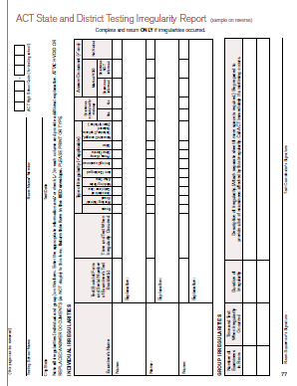
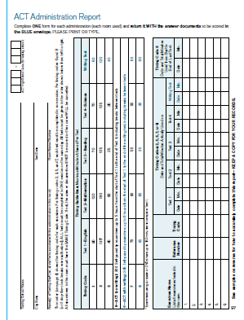
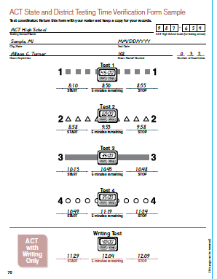
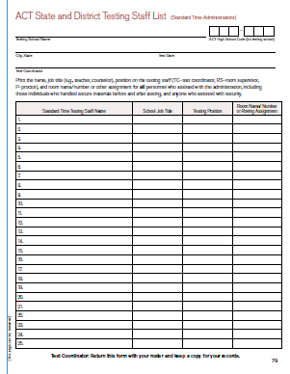
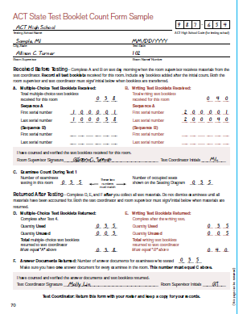
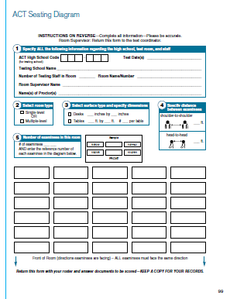
Returning Testing Materials
Audio Connection: (800) 230-1059
Access Code: 10:00 – 388894
2:00 - 388895
Notes:
It is important to follow the instructions provided in the administration manual for returning testing materials. Be sure to keep and reuse the original boxes that the materials arrived in. Make sure to use the pre-paid polymailer to return answer documents and testing forms. If the polymailer is placed inside the box, your scoring may be delayed. Make sure to return all necessary test administration forms, found in the back of the administration manual. Neglecting to return these forms or returning them incomplete may also delay the scoring of answer documents.
ACT preschedules a FedEx pickup for your school. Your pickup date for both the initial and makeup test are noted on your Schedule of Events.
The deadline for ACT to receive answer documents from schools is May 13, 2016. Answer documents received after this date will not be scored.

Slide 8
Question and Answer Session
Audio Connection: (800) 230-1059
Access Code: 10:00 – 388894
2:00 - 388895
We will now take questions over the phone, or through the private chat feature. If you chat a question, we will not chat a response. Instead, we will read these out loud and respond to them.
Notes:
At this time, we will open it up for questions. The AT&T operator will give instructions now for how to ask a question over the phone. You may also chat in a question, but it will be answered over the phone so everyone can benefit from the information.

Slide 9
Resources
Audio Connection: (800) 230-1059
Access Code: 10:00 – 388894
2:00 - 388895
Tennessee ACT State Testing webpage:
http://www.act.org/aap/tennessee/act.html
Contact us at 800.553.6244
  standard time ext. 2800
  accommodations ext. 1788
  or email – statetesting@act.org

