Slide 1
Welcome to the Wisconsin
Test Administration Q&A Session for the ACT© Test with Writing
Spring 2018
Administration, Transportation, and Interpretation
For Audio Please Call: 800.260.0718
Participant Code: 442860
Notes:
Good Afternoon! I want to start by welcoming everyone to this webinar, and thanking you all for attending today. I know time is a very precious resource, and appreciate you taking the time today to learn more about having a successful administration of the ACT and WorkKeys tests.

Slide 2
Test Dates - ACT
February 27 – Initial Standard Time
February 27-March 13 – Accommodations Test Window
March 20 – Makeup Standard Time
March 20-26 – Makeup Accommodations Window
April 3 – Emergency Makeup Standard Time
April 3-9 – Emergency Makeup Accommodations Window

Slide 3
Test Administration Webinar #1
Orientation, Configuration, Verification and Preparation
https://www.act.org/content/dam/act/unsecured/documents/RecordedWebinarWI-TestAdminQandA.pdf
Testing facilities
Type and Size
Seating Arrangement
Testing Staff
Who can serve
Conflict of Interest Policy
Responsibilities
Test Security
Pre-test Session
Notes:
The first webinar was on Nov 30th, and the recording is available on the Wisconsin State Testing website, at the web addres shown above. That session covered pre-testing activiites, such as test facility requirements and setup, seating arrangements, staff selection and responsibilities, test security and the pre-test session. If you were not able to attend, it is recommended you review the webinar recording or the PowerPoint slides before testing.

Slide 4
ACT Contact Information
Wisconsin ACT Testing Website: www.act.org/stateanddistrict/wisconsin
Department | Phone | Email
Test Administration | 800-553-6244 ext 2800 | www.act.org/stateanddistrict/contactus
Accommodations and Supports | 800-553-6244 ext 1788 | ACTStateAccoms@act.org

Slide 5
Briefing Session
Designate arrival time for room supervisors and proctors at least 30 mins prior to examinee check-in.
Make staffing adjustments, if needed
Review procedures
Answer questions
Announce any last-minute changes
Remind staff about authorized personnel and introduce observers, if applicable
Distribute materials to room supervisors after briefing session
Notes:
On test day, you will want to hold a briefing session about a half hour before examinees are expected to arrive. This time allows you to make any staff adjustments, review procedures, announce any observers and answer any last minute questions. This is also a great time to remind staff that administering the test is their ONLY job on test day-they should not be grading papers, reading a book, or doing anything other than supervising the examinees. After all questions are answered and staff are ready to go, you will distribute each rooms’ testing materials-these must remain secure at all times, so remind staff to be diligent in supervising materials.

Slide 6
Authorized Observers
Only authorized personnel may enter the testing area:
Trained staff (includes locally trained staff)
ACT, State, or District observers
Must have ACT authorization letter or ACT, State, or District identification
Test coordinator must call ACT to verify the individual is authorized to observe
Check and verify
Unauthorized observers include parents/guardians, children, school board members, or members of the media. Under no circumstances are cameras allowed in the testing room(s).
Notes:
You need to limit people involved in and observing testing. There may be personnel from ACT, the department of public instruction, or your district that come to observe your administration. There are strict rules about who you can allow in, and you must verify they are authorized to be there. The observer must present adequate identification, and the school test coordinator needs to call ACT to verify the observer is authorized to be there.
Examples of unauthorized observers would be parents, children, school board members, or members of the media. Having unauthorized people in the facility during testing can be distracting to examinees and increase an already stressful situation for them. Under NO circumstances are camera of any type allowed in the testing rooms.

Slide 7
Completing Required Forms
Complete the following forms for each testing room, as applicable:
Test Administration Forms Folder
Timing Report
Seating Diagram
Test Room Report
Testing Roster
Administration Report (accommodations)
Testing Staff List
Irregularity Report (if applicable)
Reader/Interpreter/Scribe Agreement (if applicable)
Notes:
For ease of use, the four main forms you need to complete for each room have been combined into a Test Administration Forms Folder; this folder will no longer be in the back of the manual, but a separate packet which needs to be completed for each room where students test (standard time as well as accommodation/supports).
Test day paperwork-I cannot emphasize enough how important it is to ensure each room completes all the test day documentation fully and accurately. In spring 2017 more than 1/3 of scores that were voided were for missing test times and/or forms. This is the easiest step you can take to help us score as many examinees as possible. Each room needs to complete a seating diagram, test room report (formally test booklet count form), testing roster, and timing report/administration report (accommodations). In addition, the test coordinator will include a staff list, and if applicable, signed reader/interpreter agreements and irregularities.

Slide 8
Standard Time: Test Room Report
Test Coordinator completes “Before Testing” portion of form.
Test Coordinator hands materials to the room supervisor.
Room supervisor counts test booklets, verifies serial numbers.
Any discrepancies must be resolved.
Room supervisor signs form.
Test Coordinator initials next to room supervisor’s signature.
Notes:
The test room report verifies the hand-off of test booklets-it serves as a double check to ensure all test booklets are accounted for at all times. The test coordinator will complete the form, and after verifying the amount and serial number of the books they receive, the room supervisor signs the form. Once the TC initials the form the booklets are the responsibility of the room supervisor to keep secure and return those same books after testing.

Slide 9
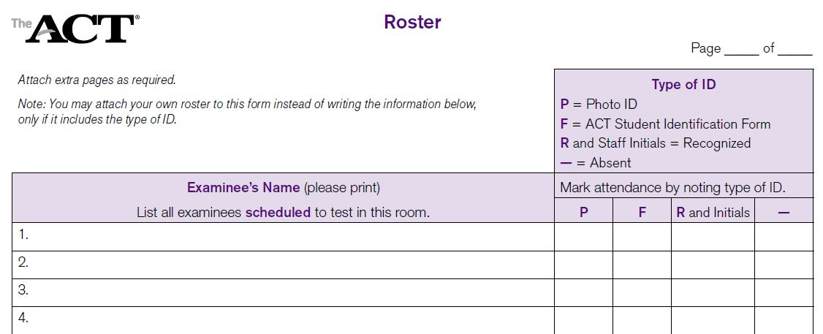
Room Rosters
Room rosters are prepared by the Test Coordinator in advance.
Use your room roster to mark attendance.
Notes:
Rosters should be complete and ready to go before test day. These lists are used to verify who is testing in which room, and to indicate attendance on test day. You will need to mark the type of identification you used to admit each student; a photo ID, ACT identification letter (should be rare), or staff recognition of examinee (most common). You will also need to keep accurate account of who is absent on test day by indication this on the form as well; absent students will be eligible for makeup testing.

Slide 10
Identifying and Admitting Examinees
Secure materials before admitting examinees into room.
Personal recognition or ID required
Verify examinee identification at the door and mark roster.
Mark absent examinees with a dash.
Check for cell phones or other electronic devices.
Check for or provide calculator.
Direct examinees to assigned seats (students do not pick their seat).
No late arrivals—once test booklets are distributed, examinees may no longer be admitted.
Notes:
When admitting students into the test room be sure the test materials are secure and no examinees have access to them-DO NOT have them sitting on the desks already. You will record attendance and identification on the room roster, check for any cell phones/electronic devices, check calculators, then direct examinees to their assigned seat. STUDENTS DO NOT PICK THEIR SEAT!!! Seating arrangements made ahead of time should be designed to minimize possible prohibited behavior. Important: once the test books have been distributed to students, no one else is to be admitted to the room. Late arrivals can either test in a separate room (if staffing allows) or be scheduled for makeup testing. –good time for proctors and RS to work together,

Slide 11
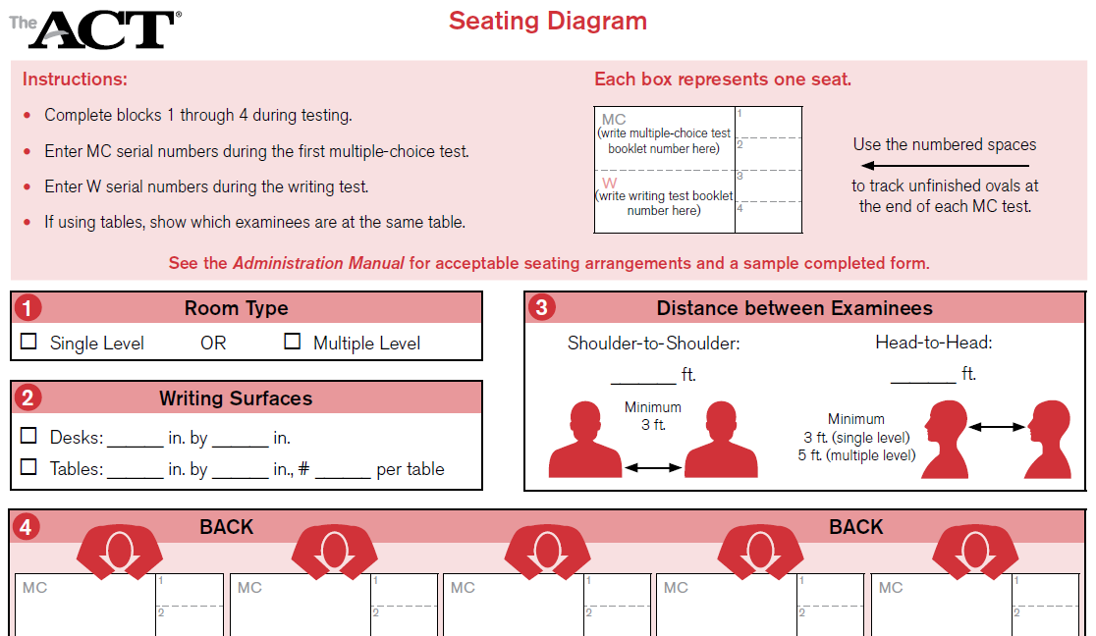
Filling out the Seating Diagram
Notes:
The seating diagram should be completed during test #1, with each examinees test book serial # written in their corresponding spot on the diagram (both multiple choice and writing booklet numbers).
The 4 smaller boxes on the right are used to track those that do not finish a test when time is called. This is a tool to help ensure examinees do not go back and fill in ovals after time on previous tests.

Slide 12
Timing Report
Standard Time
Notes:
This is a portion of the timing report for standard time testing. A few things to note here:
The symbols next to each test correlate to the symbols in the test books-when walking around the room it should help you notice if someone is working on the wrong test.
You are expected to record the exact hour and minute when instructed to in the directions. This is true for the start time, 5-minute warning, and end time.

Slide 13
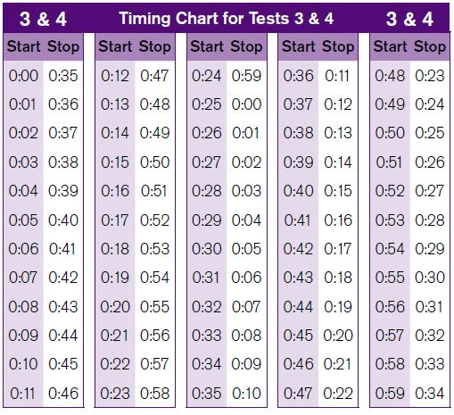
Test Timing Chart
Standard Time
Notes:
We have included this chart for each test to aid you in calculating when the stop time should be, given what time you started. For example, for Test 1 (which is 45 minutes long), if you started at 9:07, you would need to end at 9:52. You can use this calculate when the 5 minute warning should be given as well. For tests 3&4, where the time allowed is 35 minutes each, if you start at 11:22, then you would end at 11:57 (and so on). You do not have to use this chart, it is simply provided as a tool to assist you in accurate timing.

Slide 14
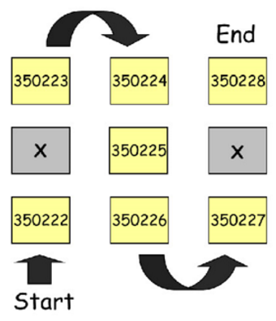
Distribution of Test Booklets
Standard Time
After examinees are seated
Only when prompted by verbal instructions
In sequential, serial number order
Notes:
Distribute the test booklets after examinees are seated, only when prompted by the verbal instructions in the administration manual. Distribute test books one-by-one, in sequential, serial number order, only to present examinees.
Do not place a test booklet on an empty desk.
Following these instructions will maintain the security of the test booklets, and will assist the room supervisor when creating a seating diagram, which is required for each room.

Slide 15
Administering the Tests
The ACT

Slide 16
Sequence of Tests
The ACT with Writing
English | 45 minutes
Math | 60 minutes
Break | 15 minutes
Reading | 35 minutes
Science | 35 minutes
Break | 5 minutes
Writing Test | 40 minutes
Tests must be administered in order or answer documents will not be scored
Notes:
True for standard time and accommodations, even if testing over multiple days.

Slide 17
Scheduled Break
Standard Testing
15 minute break between Test 2 and Test 3
Read the verbal instructions which explain break policies
Room must be attended at all times by testing staff.
Examinees must not access cell phones or electronic devices
Snack and drink outside of room
Remind examinees to be respectful of other testing rooms
Resume testing after 15 minutes even if all examinees do not return on time.
Late examinees may be admitted but can’t make up lost time.
Note any issues on an Irregularity Report.
Notes:
Unauthorized breaks are not allowed, and are cause for cancelling scores or voiding tests. There is 1 scheduled break between tests 2 & 3, and it should last no more than 15 minutes. This break is not included as a time for students to eat lunch; rather it is a short break to use the restroom, get up and stretch, and clear their minds for a few minutes. If you wish, you are allowed to provide drinks and snacks in another room during the break (NOT in the test room). Examinees are NOT ALLOWED ACCESS TO THEIR PHONES DURING THE BREAK! This is hard for students, and roving proctors or hall monitors need to supervise students during the break. If the room supervisor needs to leave the room during the break, they need to be sure all examinees have left the room, and secure the materials (preferably by locking the room)-although try to avoid this situation if possible. After the allowed 15 minutes are over, begin reading the verbal instructions for test #3-Reading. Students are allowed back into the room if they are late, but they do not get to make-up any possible lost time. If there are any issues or concerns during the break, complete an irregularity report. If a student is found to have a phone during break, you MUST tell them that their test will be voided and dismiss them for the rest of testing.

Slide 18
Break before the Writing Test
Per new ACT policy, your school may decide to break for lunch after multiple choice sections for up to 45 minutes
During the break all examinees must be constantly monitored by school personnel for examinee conversations and any other means of sharing test content, including cell phone usage.
Test booklet and answer document must be collected and securely stored during the break. Under no circumstances can these materials be left unattended or stored in the same location as the examinees during the break.

Slide 19
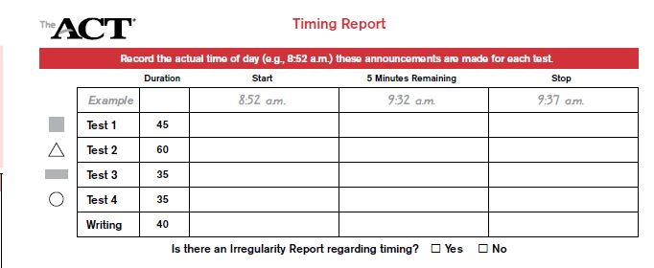
Timing the Tests
Notes:
When recording testing times, you want to note the exact time, down to the minute, on the timing form. Be sure to write the actual start, 5-minute warning, and stop times, even if there is a timing irregularity-should that happen, complete an irregularity report with the necessary information.

Slide 20
Exact Timing
Use more than one timepiece (not cell phone)
Time each room individually (no “central” timing)
Record times during testing:
Testing Report (Standard Time)
ACT Administration Report (ACT-Approved Accommodations/Supports)
Notes:
In order to provide and document the exact correct timing of each test, use more than one timepiece. This could be a wall clock and a stop watch (no beeps or indicators of time over), a timer, a wrist watch (again, no sounds); however DO NOT USE A CELL PHONE as a timer. Examinees and testing staff are not to have phones out or visible at any time during testing. Each room will need to monitor and record their own timing. While each room may begin at the same time, given variables such as pace of reading verbal instructions and examinee questions, it is not possible for an entire school to have exactly the same times for each room. This is a red flag for compliance review. There is no ‘central timing’ or even reading of instructions-these tasks are unique to each room.
Be sure to accurately record the precise timing in your test room. These times need to be documented on the Testing report for standard time, or the ACT administration report for accommodations/supports.

Slide 21
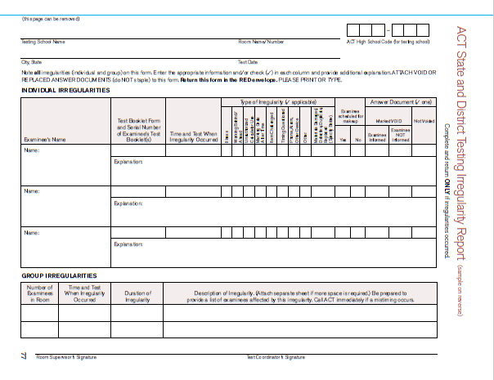
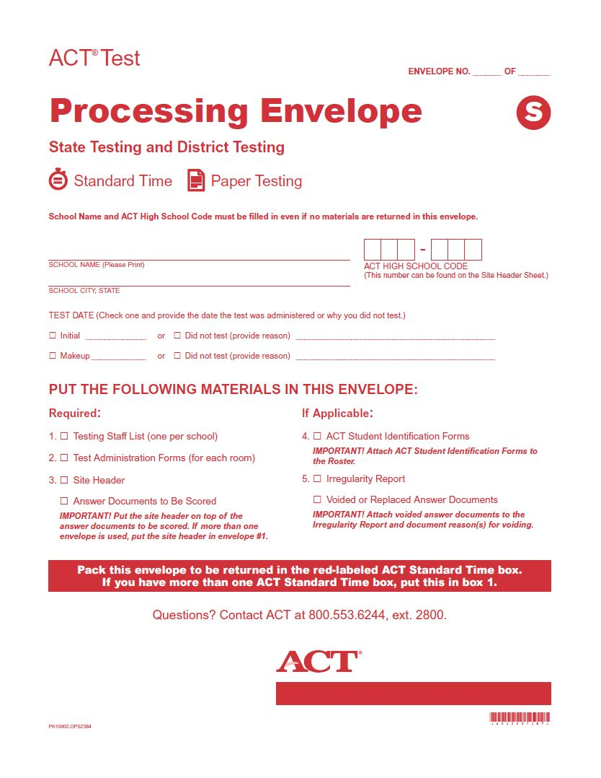
Irregularities
Notes:
Should you have any irregularities at your school, you will return them in the Processing envelope with other test day documentation and answer documents. The irregularity form can be found in the back of the administration manual. If there are no testing irregularities at your site, you do not need to return an irregularity form.

Slide 22
Completing an Irregularity Report
Testing irregularities: interruptions and distractions which affect testing
Group Irregularities
Individual Irregularities
Prohibited behaviors: actions which result in examinee dismissal and voiding answer document
Complete an Irregularity Report to inform ACT of situations which impact testing.
Refer to manual for form and detailed information.
Notes:
There two types of testing irregularities, group or individual. A group irregularity effects the entire room testing, sometimes even the entire school. Examples of group irregularities are an alarm goes off (either a students or the schools), loud noises outside the testing room, poor lighting, fire, raccoons falling from the ceilings, etc. An individual irregularity effects one or a few students. Examples would be if a student questions a test item, a student becomes ill during testing, defective test materials, or prohibited behavior. Prohibited behaviors are explained in the verbal instructions, so examinees are aware of the consequences of these actions. The most common PBs are cell phone, working ahead or behind (ie working on any test other than the one they are supposed to be), filling in responses after time has been called, looking at another examinees test, or having an alarm of some sort go off (such as a timer on a watch when trying to pace themselves).

Slide 23
Completing an Irregularity Report
Provide as much detail as possible.
You must inform the student if voiding the answer document.
Indicate if student will be scheduled for makeup testing.
If in doubt, call ACT for guidance.
Notes:
When completing an irregularity, try to provide as much useful detail as possible. Having reviewed these, I have seen everything from Student cheated (not enough information), to a detailed description of the proctor loudly blowing his nose-it included how many tissues he used and how many times he walked to the waste basket, a bit more information that necessary. Remember that these forms are at times used to decide is a test is valid, so more information is better. If you are voiding a student’s test, you MUST inform them of this! You will also need to indicate if a student is schedule to test makeup (for situations like left early due to illness)-if a student is voided for a PB, they are not allowed to test makeup. If you have any questions or uncertainty if something should be recorded on an irregularity report, please call ACT for guidance.

Slide 24
Prohibited Behavior
Prohibited behavior does not need to be observed if you are certain it occurred
Dismiss examinees and inform them their answer documents will not be scored
Notes:
Prohibited behavior does not need to be observed if you are certain it occurred: for example, if you are certain that a student had 5 un-answered questions from test #1, but when you walk by during a later test and see all bubbles filled in, that is a PB, even though you didn’t watch the student fill-in those bubbles.
If you are just suspicious that a prohibited behavior occurred, give the examinee a warning and monitor their further activity; you can also move a student if you suspect cheating of some sort. Document any seat changes on the seating diagram and complete an irregularity with suspicions and actions taken.

Slide 25
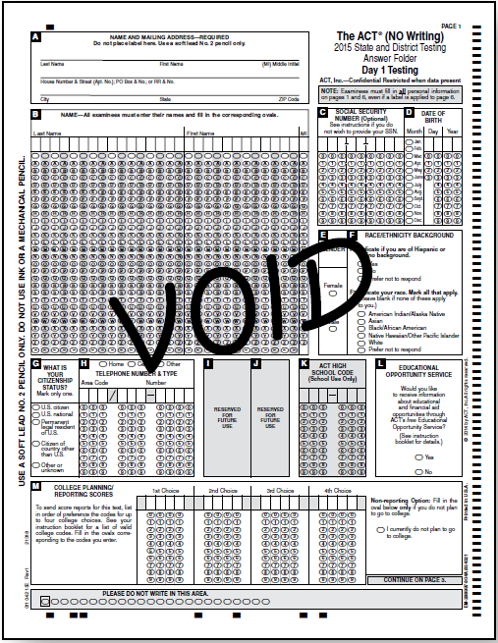
Voiding Answer Documents
Only if:
The examinee exhibited prohibited behavior and was informed scores would be void
An examinee was scheduled for makeup testing
Notes:
If in doubt as to whether you should void and answer document, call ACT first! There may be times you think an answer document would need to be voided, but ACT can actually score it.
Complete an IR with reasoning for voiding answer documents
Write VOID on the first page of the answer document and attach it to the IR. If the student will be testing on the makeup test day, you should keep the voided answer document as the student can transfer their non-test answers to a new answer document before the makeup test date. You would then return this voided answer document and irregularity with makeup paperwork and test materials. Reminder: if testing on makeup test day, the student must complete all tests again - they are not allowed to transfer any test responses from the initial test day.

Slide 26
Test Day Documentation
Room Supervisor Responsibilities
Before dismissing examinees:
Account for all test materials
Must have a test booklet and answer document for each examinee who tested
Verify the following:
Answer documents and booklets are signed
Booklet number and form number are gridded
Barcode label matches examinee name and signature
After dismissing examinees:
Organize materials for return to test coordinator
Review all administrative forms for completeness and accuracy
Administration forms are used as the source of truth- scoring decisions are based off of these forms.
Notes:
Room supervisors will need to count all test booklets and answer documents, and check test booklet serial numbers against the seating diagram, prior to dismissing examinees; there must be a test booklet and answer document for each examinee who tested.
Ensure that each answer document and each test booklet has the examinee's signature. It is important to verify that each answer document has a Test Booklet Number and Test Form number gridded. Check to see that the examinee's first and last names match the barcode label on the back of the answer document. Resolve any issues before dismissing examinees.
After the examinees are dismissed, we recommend the room supervisor organize materials to return to the test coordinator as follows:
Place test booklets back into serial number order.
Stack answer documents so that page one is facing up and review all administration forms for completeness and accuracy.
Investigations and scoring decisions are based off of these forms, so it’s important that they’re correct.

Slide 27
Test Coordinator Procedures
Immediately after testing, the TC must:
Verify materials
Order makeup materials if needed
Pack materials for return
Ensure FedEx retrieves materials
Check Documentation
Notes:
The test coordinator will count and verify that all of the test booklets given to the room supervisor are returned, and ensure the administrative forms are complete and accurate.
ACT will also check each form during our compliance review and will use these forms as the source of truth if questions arise; accuracy of test day documentation may determine whether examinees receive score reports.
Make a copy of each form to keep on file. We recommend you keep these forms for six months.
The TC will receive an email on test day with instructions on how to order makeup materials, if needed. These will be ordered using PANext, and can be entered in the system from Feb 27-March 2. After March 2nd you will need to complete an additional order for any makeup students that enter your school and will be testing on makeup test day; additional orders can be placed in PANext until March 14th for makeup testing.

Slide 28
Makeup Testing
The ACT

Slide 29
Eligibility for Makeup Testing
Situation: | Can student test on Makeup?
Student completed pre-test portion of answer document, but did not test on initial test day. | Yes
Student attempted to test on initial test day, but had to leave early (illness, for example). | Yes-void first answer document and have student transfer non-test responses to new answer document before makeup test day.
Student dismissed for Prohibited Behavior. | No
Student completed the test on initial test day (paper or online). | No
Notes:
When deciding who can test on the makeup test day, refer to the chart above. If your student doesn’t fit into one of these situations and you are unsure whether they student can/should test makeup, please contact ACT for further guidance.

Slide 30
Ordering Makeup Materials
Email sent to TC with instructions on ordering materials
Place order in PearsonAccess^{next}
Contact ACT State and District Testing at 800.553.6244, ext. 2800, if an email is not received
Contact ACT Accommodations at 800.553.6244, ext. 1788 if needing to utilize the accommodations makeup window
If you do not need makeup materials, no further action is required
Notes:
The TC will receive an email on the initial test date with instructions on ordering makeup testing materials.
If you do not need makeup materials, you do not need to contact ACT, simply disregard the email instructions; you do not need to inform ACT that you are not testing makeup. If you need to use the accommodations makeup window, you will need to contact the accommodations department directly to request new materials; you can not use the same materials from the initial accommodations window. Reminder: the makeup Accoms window is only 5 days, running from March 20-March 26.

Slide 31
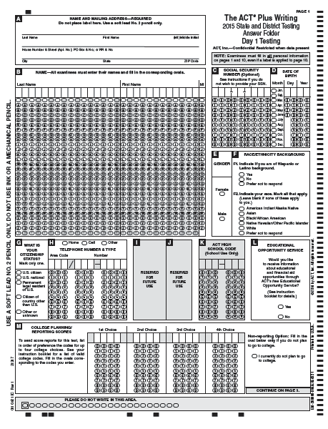
Materials ACT Sends to You for Makeup Testing
Notes:
ACT will send different test books to be used for makeup testing; if test booklets other than those sent in the makeup testing shipment are used, answer documents may not be scored. You will also receive 2 additional blank answer documents, and will need to place an additional order if you will need more that that. You will also receive additional administration manuals, test forms and other necessary materials for testing.

Slide 32
State Use Questions – Did Not Test Codes
The TC is responsible for ensuring all students who do not test are correctly marked in PANext for ACT and/or WorkKeys
Codes can be entered per individual student, or though an upload if there are a large number
The Administration Supplement contains details on how to enter these
ACT supplement is Green, WorkKeys supplement is Gold
If a student doesn’t test/leaves your school, DO NOT remove them from PAN
Notes:
After testing is complete the TC will need to enter did not test codes under the State Use Questions section in PAN. The admin supplements have detailed instructions on how to complete this task. These codes need to be entered in PANext no later than April 13th. These codes need to be entered for students who do not test ACT and/or WorkKeys; you need to be careful to complete these codes under the correct product for reporting and accountability purposes.

Slide 33
Collecting, Packing, and Returning Materials
The ACT
Notes:
There were some changes made to the return process this year, with the intent of standardizing this process across different materials and products. You will now pack and return your standard time ACT materials the same way you ship back your accommodation/support materials, and your WorkKeys materials.

Slide 34
If You Did Not Test
Complete the outside of the Processing Envelope and mark “Did Not Test”
Discard the unused Site Header
Place envelope in box
Prepare other materials for return
Notes:
If your school did not test on the initial test day, please pack up your materials as indicated here, as well as sending an email to statetesting@act.org to inform us you did not test. This email will help us in checking in your boxes when they arrive, as well as minimizing the chance that we contact you concerned for ‘missing’ answer documents. There is a section on the processing envelope specifically for schools that did not test, and this provides us all the information we need to check in your materials. If needed, you will then place an order for makeup testing in PANext per the instructions you received via email.

Slide 35
Packing Materials After Testing
After Testing, pack:
All multiple-choice test books—both used and unused
Packing List
All used manuals
Complete answer documents
Reverse the carton flaps so the outbound shipping label is visible.
Number the cartons in the following manner:
1 of ___, 2 of ___, etc.
Notes:
Materials to be included in the boxes/cartons include ALL test booklets (used and unused), the original packing list, used admin manuals, and if testing online, any student authorization tickets and used scratch paper. You pack these into the original boxes, ‘flip the flaps’, and number the boxes (1 of 6, 2 of 6, etc). The processing envelope should be placed on the top of box #1.

Slide 36
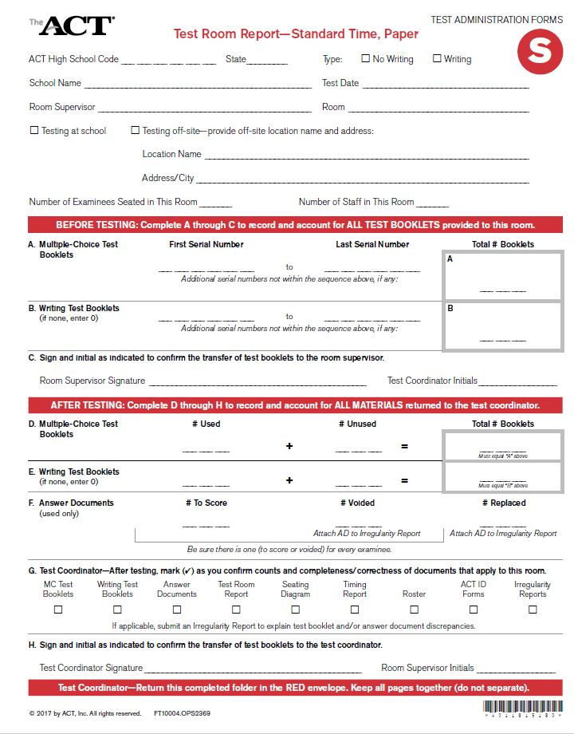
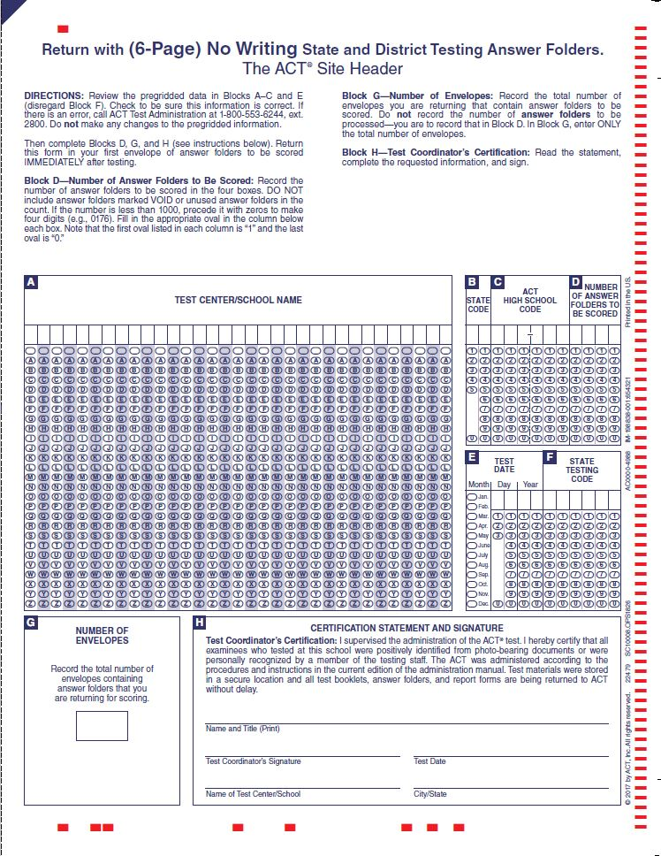
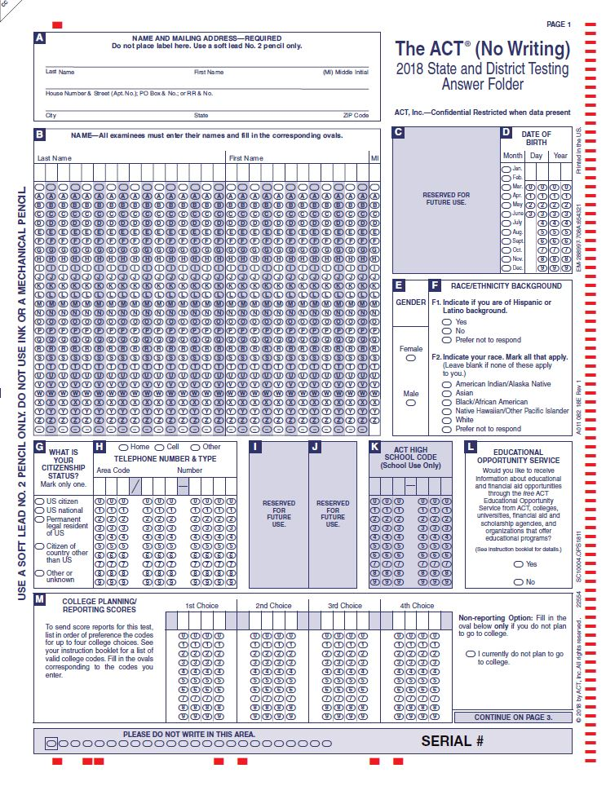
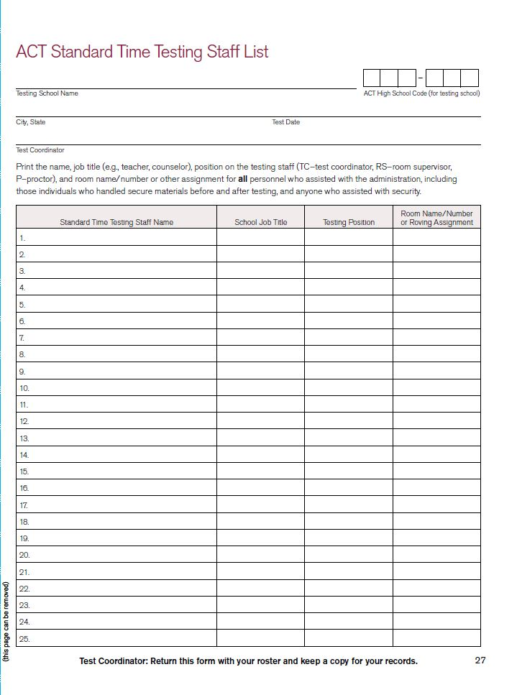
Packing the Processing Envelope
Test Admin Forms
Site Header
Irregularity Reports
Answer Documents
Staffing List
Notes:
Administration forms, irregularity reports, and void or replaced answer documents should be clipped together by room and placed into envelope
Turn answer documents to be scored the same way, with page 1 facing you (place up to 100 answer documents per processing envelope)
Recheck “Booklet Number” and “Test Form” blocks on answer documents, filling them in if needed
Locate and complete the Site Header specific to your administration and place on top of the answer documents
Mark the processing envelope containing the Site Header as #1 and number any remaining envelopes
Place envelope(s) into box(es) for return to ACT

Slide 37
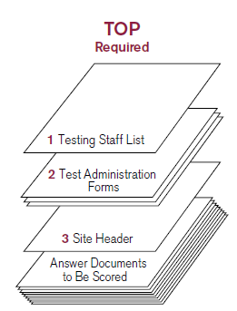
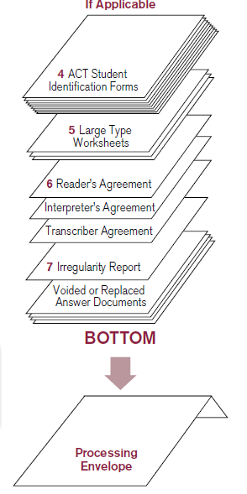
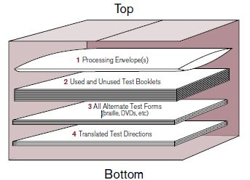
Packing the Cartons
Notes:
The processing envelope(s) should be in the top of box #1, with ALL test booklets below it. If applicable, include any alternate test forms and other testing materials.
Make sure your six-digit ACT High School Code, institution name, and return address label are on the outside of the cartons
Reverse the flaps of the carton and number them 1 of X, etc.
Seal the cartons with the shipping label visible

Slide 38
Materials Pickup
Refer to Schedule of Events for pickup dates.
Carrier pickup is pre-scheduled-if there are any problems call ACT, not FedEx.
Call ACT if carrier does not pick up test materials by the Monday after the scheduled pickup date (March 5, March 26, April 9)
Keep materials secure until pickup.
Notes:
There is a pre-scheduled FedEx pickup for each test day (initial, makeup, emergency and accommodations). As you see, the schedule of events now shows the day the test coordinator needs to have materials ready for pickup (day after testing), but you shouldn’t call ACT with concerns unless FedEx doesn’t show by the second date listed. You have to keep the materials secure until FedEx picks them up-they cannot sit out in your loading area or where FedEx usually picks up. You need to keep materials in the locked storage until you physically give them to FedEx.

Slide 39
Reporting
The ACT

Slide 40
Reporting Schedule
Document | Recipient | Timeline | Description
Student Report | Student | 3-8 weeks | Paper report
Student Online Scores | Student | 1 week after student receives score report | Online account
H.S. Checklist Report | School | 3-8 weeks | List of Examinees
H.S Report | School | 3-8 weeks | List of C.R. Scores
Student Score Labels | School | 3-8 weeks | Record Labels
Student College Report | College | 3-8 weeks | C.R. Scores
Profile Report – H.S. | District | June 12, 2018 | Averages per H.S.
Profile Report - District | District | June 12, 2018 | Averages for District
Student Level Data File - District | District | June 12, 2018 | All scores for all examinees
Notes:
Reports will be mailed as well as posted in PAN for easy access/ reprinting if needed.

Slide 41
Test Dates - ACT
February 27 – Initial Standard Time
February 27-March 13 – Accommodations Test Window
March 20 – Makeup Standard Time
March 20-26 – Makeup Accommodations Window
April 3 – Emergency Makeup Standard Time
April 3-9 – Emergency Makeup Accommodations Window
Notes:
The state testing website has many great resources and training information available. A recording of this webinar, along with the powerpoint will be posted on the website next week. We can now take some questions via the phone.

