Slide 1
Understanding and Using WorkKeys Scores
High School Students
Notes:
Welcome to the “Understanding and Using WorkKeys Scores” webinar. This webinar is designed to help you and your students understand WorkKeys scores and learn about the ways your students can use their scores.

Slide 2
Webinar Objectives
Introduction
Provide an overview of WorkKeys assessments
Explain how WorkKeys scores are calculated and what they mean
Explain the difference between Level Scores and Scale Scores
Demonstrate how students can use their WorkKeys scores
Provide you and your students with additional resources
Notes:
The objectives of today’s webinar are as follows:
I’m first going to provide an overview of the WorkKeys assessments.
Then I’ll talk about how WorkKeys scores are calculated, what the scores mean, and what the difference is between Level Scores and Scale Scores.
After you have an understanding of WorkKeys scores, we’ll look at the many ways these scores can be used by your students.
Finally, I’ll present you with a number of additional resources that you and your students should find helpful.

Slide 3

WorkKeys Assessments
Notes:
Before I actually talk about the WorkKeys assessments, I want to give you some information about the Work Readiness System and where WorkKeys fits into it.

Slide 4



Work Readiness System
Job Analysis
Define Your Workforce
Assessments
Assess Your Workforce
Training & Curriculum
Develop Your Workforce
Certification
Certify Your Workforce
Research & Analytics
Understand Your Workforce
Notes:
The Work Readiness System includes five components:
Job analysis helps employers identify the skills employees need to be successful on the job. It addresses the question: What skills and skill levels are needed in today’s jobs or occupations? Employers may choose to have a job profiled so that they can use the assigned skill levels as hiring criteria.
Next are the assessments. There are 9 Foundational Skills assessments, which include the measurement of cognitive abilities such as reading, math, and locating information. Taking these tests enables students to document the work skills and skill levels they currently have.
We also have 3 Soft Skills assessments: Fit, Performance, and Talent. Students are presented with statements, and they indicate their responses using a Likert scale.
Another key component is Training, in which KeyTrain can be used to address skills gaps. I’ll talk more about that later on in today’s presentation.
Certification is documented through the use of the National Career Readiness Certificate. This is also something I’ll address in more detail shortly.
Finally, we also conduct research to better define the workforce and its needs.

Slide 5
Assessments
Foundational
Applied Mathematics (NCRC)
Locating Information (NCRC)
Reading for Information (NCRC)
Applied Technology
Business Writing
Listening for Understanding (WKIV only)
Workplace Observation (WKIV only)
Teamwork (Paper-and-Pencil only)
Writing (Paper-and-Pencil only)
Notes:
Here are the 9 foundational skills assessments.
Five of these are available in both WorkKeys Internet Version and paper-and-pencil formats: Applied Mathematics, Locating Information, Reading for Information, Applied Technology, and Business Writing.
Each format also includes 2 additional tests. Students can take Listening for Understanding and Workplace Observation using WorkKeys Internet Version, and they can take Teamwork and Writing via paper-and-pencil.
The first three listed, Applied Mathematics, Locating Information, and Reading for Information, are the tests that comprise the National Career Readiness Certificate – or the NCRC.

Slide 6
Assessments
Soft Skills
Fit
Performance
Talent (NCRC Plus)
Notes:
There are three soft skills assessments that are also available via WorkKeys Internet Version. If students take the Talent assessment along with Applied Mathematics, Locating Information, and Reading for Information, they could qualify for the NCRC Plus.
The Fit assessment measures an individual’s interests and values, which help determine how well the person matches up with occupations within an organization.
The Performance assessment is a prescreening integrity test that flags a tendency toward unsafe work behaviors and attitudes toward work. It can be administered to job applicants as part of the preselection and hiring process.
The Talent assessment is a selection and employee-development tool that measures a candidate’s work-related attitudes and behaviors.

Slide 7

NCRC Assessments
Applied Mathematics
Locating Information
Reading for Information
80% of profiled jobs utilize all of these skills
Numbers are based on analysis of 5,130 jobs profiled from 2007 to 2011 in the ACT JobPro database.
Notes:
As I mentioned a moment ago, Applied Mathematics, Locating Information, and Reading for Information are the three tests that comprise the National Career Readiness Certificate. Out of more than 5,000 jobs profiled in the JobPro database, 80 percent of those jobs utilize these three skills.

Slide 8

Understanding WorkKeys Scores
Notes:
Now let’s take a look at WorkKeys scores.

Slide 9
How WorkKeys Scores Are Calculated
Determined by the total number of items answered correctly on the entire assessment
No penalty for guessing
Notes:
For multiple-choice WorkKeys tests – which include Applied Mathematics, Locating Information, and Reading for Information – a WorkKeys score is determined by the number of questions answered correctly. Since there’s no penalty for guessing, students should answer every question, even if they don’t know the answer.

Slide 10
Level Scores
Level Scores indicate the skill level
Each level includes a broad range of skills; link to skill level descriptions at: www.act.org/workkeys/assess/understanding.html
Each test has 4 or 5 levels
There’s a range of raw (number correct) scores assigned to each level
WorkKeys tests are not “pass” or “fail”
Notes:
Level Scores indicate a student’s skill level, and each level includes a broad range of skills. There are four or five skill levels in each test, and there’s a range of raw (number correct) scores assigned to each level.
It’s estimated that a person who scores at a given skill level on a specific WorkKeys test will be able to correctly answer at least 80 percent of all the WorkKeys items possible for that level in the item pool. Each WorkKeys test contains only a sample of all the items that could be written to assess that skill.
Please note that students don’t “pass” or “fail” a WorkKeys test. Their score indicates their skill level. For example, if a student scores below a level 3 in Applied Mathematics, it doesn’t mean that they’ve failed the WorkKeys Applied Mathematics test. Instead, it means that their score on the test indicates that their skill level is below the minimum level measured for that particular test.
Level Scores can be used for selection, promotion, or other individual high-stakes purposes. The scores are designed to be used with a job profiling process for employee selection and promotion decisions.

Slide 11
Scale Scores
Level Scores broken into smaller units
Shows smaller increments of change over time
Generally used to identify changes in scores from one testing time to another
Scale Score Interpretation Guide: www.act.org/workkeys/pdf/scale_score_interp_guide.pdf
Notes:
Each Level Score can be broken into many smaller units, called Scale Scores, which can show smaller increments of change over time. In other words, although a student’s Level Score may remain the same if they take the test another time, their Scale Score may improve. Scale Scores are generally used by educational institutions to identify changes in scores from one testing time to another.
For a closer look at Scale Scores, go to the Scale Score Interpretation Guide located at the link shown on this slide.

Slide 12
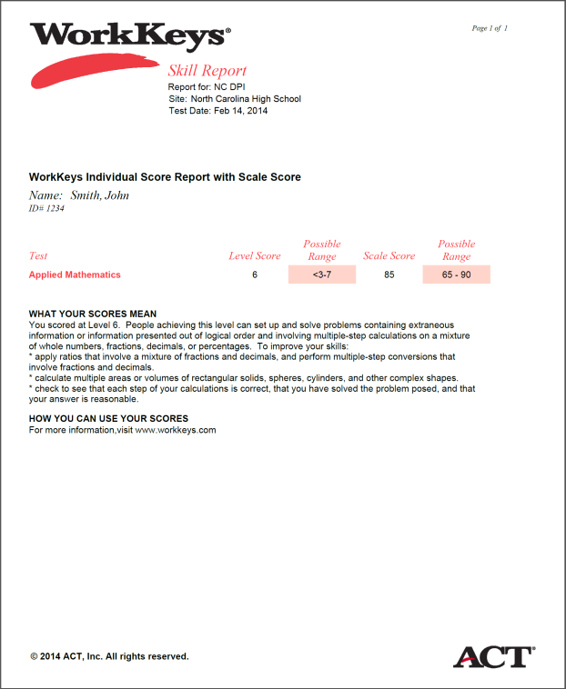
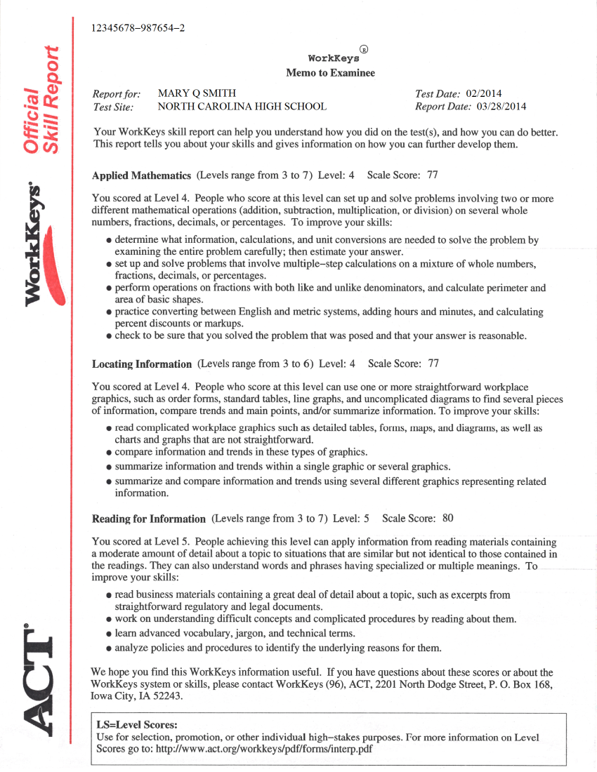
Score Reports
Notes:
So, where do these scores appear?
For students taking the WorkKeys Internet Version tests, they’ll receive an “Individual Score Report.”
For those taking the WorkKeys assessments in paper-and-pencil format, they’ll receive a “Memo to Examinee.”
Both documents include the skill level for each assessment taken, describe the tasks associated with each skill level, and suggest general strategies for improvement.

Slide 13

WorkKeys Internet Version Score Report
Name of test
Level Score
Level Score Range
Scale Score
Scale Score Range
What Your Scores Mean
How to Improve Skills
Notes:
Here’s a color-coded breakdown of the WorkKeys Internet Version Score Report. Let’s take a closer look on the next slide.

Slide 14
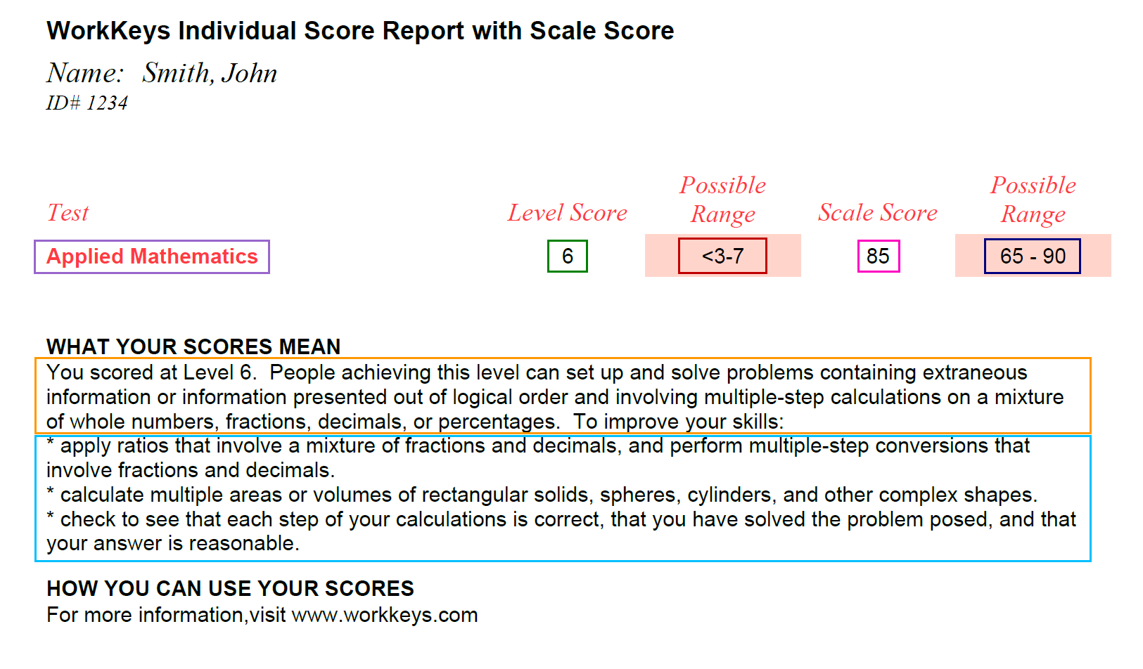
WorkKeys Internet Version Score Report
Notes:
Test is the name of the WorkKeys test the student took; in this example, it’s Applied Mathematics.
Level Score tells the student what score they earned on this test; in this example, the student earned a Level 6.
Scale Score is used primarily to track changes from one testing time to another; in this example, the student earned an 85.
Possible Range tells the student the lowest and highest possible Level Score and Scale Score for an assessment, so the student can see how well they did compared to the minimum and maximum possible scores on this test. In this example, the Level Score range is from Level 3 through Level 7, and the Scale Score range is 65 through 90.
In the section titled “What Your Scores Mean,” students will find information about the skills they demonstrated on this test. This example points out that the student likely can solve problems that may require multiple steps and have unrelated information.
The bullets listed under “To Improve Your Skills” tells how students can work to increase their Level Score. In this example, it states that the student should practice converting decimals to fractions; work on taking measurements in a variety of formats, such as inches, feet, and meters, and use them to calculate formulas requiring more than one step; and verify their answers.

Slide 15
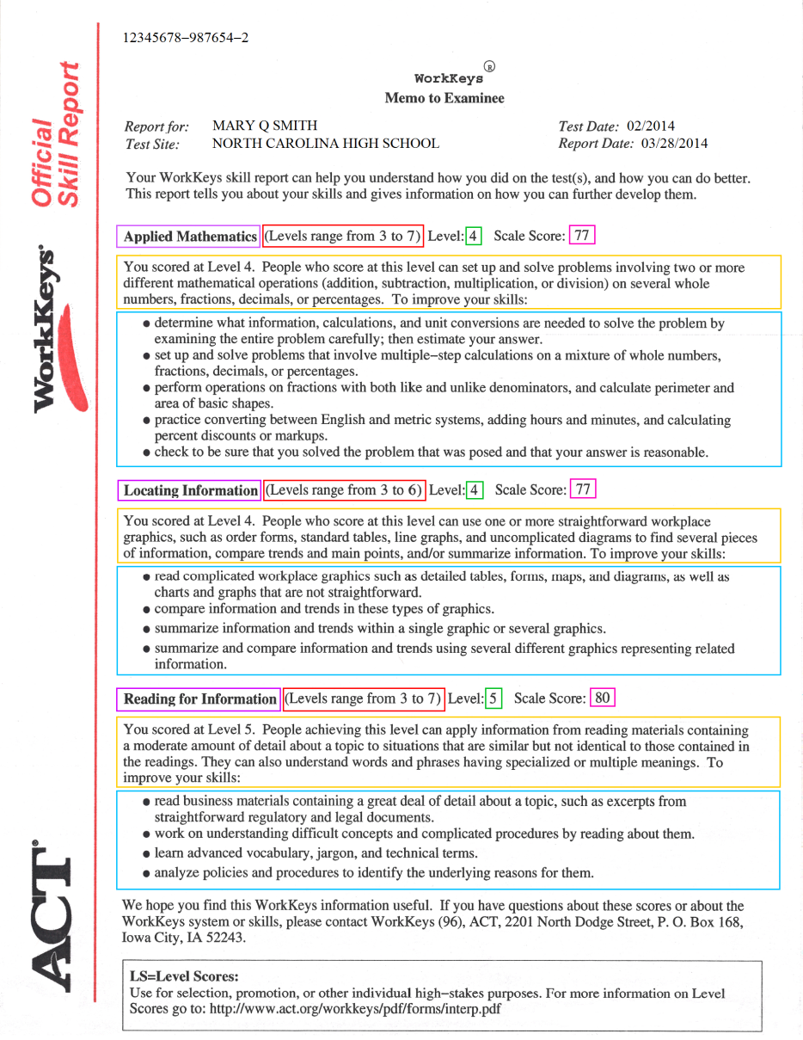
Paper-and-Pencil Score Report
Memo to Examinee
Name of test
Level Score
Level Score Range
Scale Score
What Your Scores Mean
How to Improve Skills
Notes:
Here’s the color-coded breakdown of the paper-and-pencil score report, which is called the “Memo to Examinee.”
In this particular example, all three NCRC tests are reported on one score report. When there are three tests on one report, most of the information appears on page 1, but students will find some additional information on page 2.
Let’s get a better look on the next slide.

Slide 16
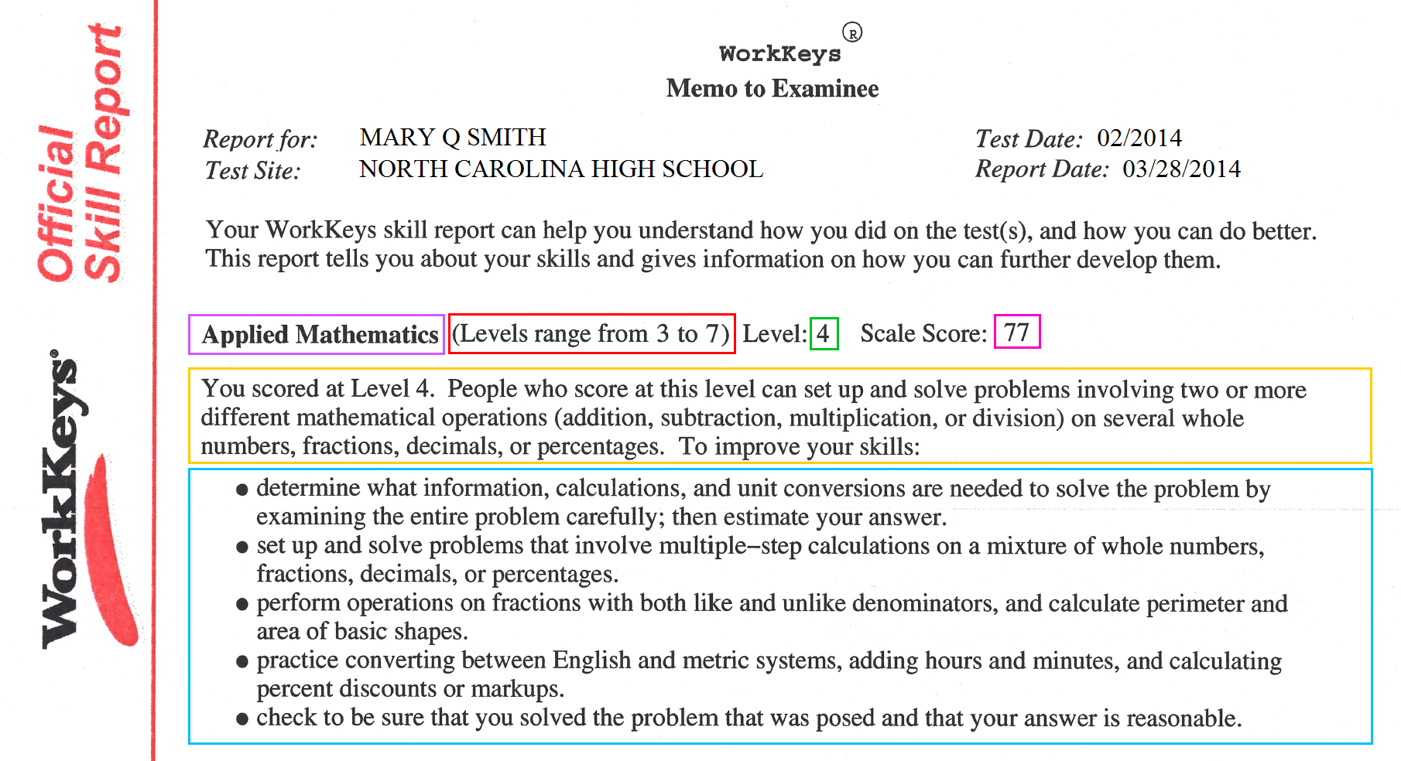
Paper-and-Pencil Score Report
Memo to Examinee
Notes:
Just as with the WorkKeys Internet Version score report, you’ll find the name of the test; the Level Score and the Level Score range; the Scale Score; and sections on what the scores mean and how students can improve their skills.

Slide 17
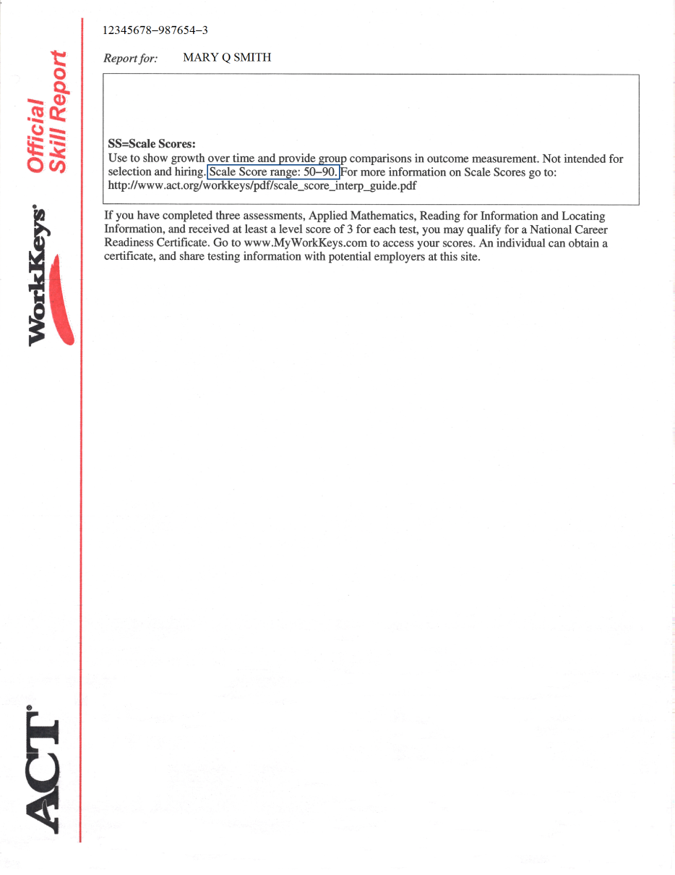
Paper-and-Pencil Score Report
Memo to Examinee
Scale Score Range
Notes:
In this example, the Scale Score information is found on page 2.
Let’s get a close-up view on the next slide.

Slide 18
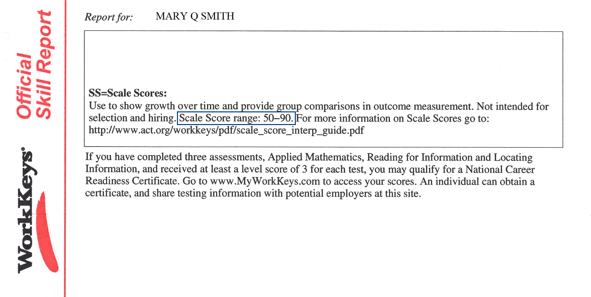
Paper-and-Pencil Score Report
Memo to Examinee
www.act.org/workkeys/pdf/scale_score_interp_guide.pdf
Notes:
As you can see, the Scale Score range is given in the narrative section at the end of the report. For more information, the student should look at the Scale Score Interpretation Guide, which is located on the website listed on this page.

Slide 19

Using WorkKeys Scores
Notes:
Now that we’ve covered what scores are, let’s take a look at the ways students can use their WorkKeys scores.

Slide 20
How Students Can Use Their WorkKeys Scores
Qualify for an NCRC
Career exploration
Employment
Entrance to/exit from community college programs
College credit
Notes:
As you can see from this list, there are quite a few uses for WorkKeys scores. The NCRC is a big part of most of these, but just knowing what their skill levels are can help students in so many ways.
I’ll talk more about each of these as we go through the next set of slides.

Slide 21
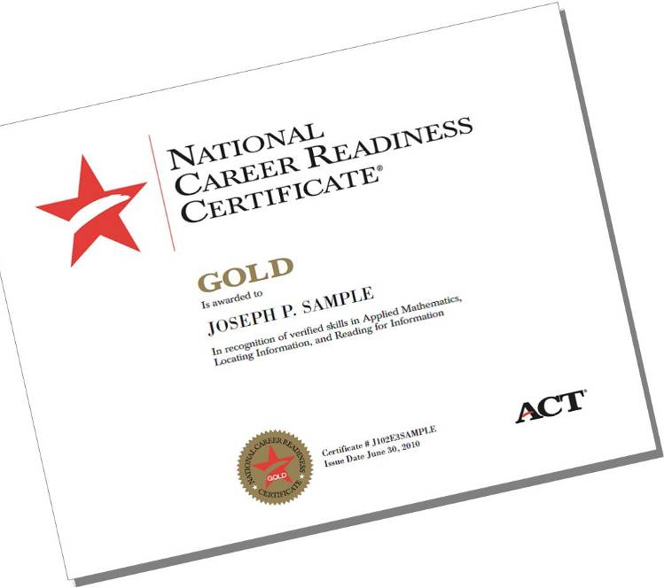
National Career Readiness Certificate (NCRC)
The NCRC™ is a credential that is:
Evidence-based
Industry-recognized
Portable
Used to document essential skills linked to workplace success
Awarded at four levels: Bronze, Silver, Gold, and Platinum
Notes:
Let’s talk first about the National Career Readiness Certificate, which is an evidence-based, industry-recognized, and portable credential.

Slide 22
Level Score Requirements
Certificate Level | Level Score Requirements
Platinum | Minimum score of 6 on each of the three tests
Gold | Minimum score of 5 on each of the three tests
Silver | Minimum score of 4 on each of the three tests
Bronze | Minimum score of 3 on each of the three tests
The three tests to be taken for the NCRC are: Applied Mathematics, Locating Information, and Reading for Information.
Notes:
As I mentioned earlier, students take the Applied Mathematics, Locating Information, and Reading for Information assessments to qualify for the NCRC.
They can earn a Bronze, Silver, Gold, or Platinum certificate. (Kentucky students will not receive certificates at the Bronze level.)
Qualification for a certificate is based on a minimum score on each of the three assessments. In order to qualify for a Bronze certificate, the student must achieve a minimum level score of 3 on each of the three assessments.
For a Silver certificate, a minimum level score of 4 is needed; for a Gold certificate, a minimum level score of 5, and for a Platinum certificate, a minimum level score of 6 is necessary on all three tests.
So, for example, let’s say a student earns a 5 in Applied Mathematics, a 5 in Reading for Information, and a 4 in Locating Information. He or she would qualify for a Silver certificate, which requires a minimum level score of 4 across all three tests.

Slide 23
Job Qualification of Certificate Holders
Job Qualification of Certificate Holders (Essential Foundational Skills)
Platinum NCRC | Gold NCRC | Silver NCRC | Bronze NCRC
99% | 93% | 69% | 17%
Source: ACT JobPro Data 2007-2011
Notes:
What this slide shows is the percentage of jobs included in the JobPro database that an individual would qualify for based on the certificate they’ve earned.
Students earning a Bronze certificate have the essential foundational skills, which are math, reading, and locating information, needed for 17% of the jobs in the JobPro database.
Students earning a Silver certificate have the essential foundational skills needed for 69% of the jobs.
Students earning a Gold certificate have those same skills needed for 93% of the jobs.
And, students earning a Platinum certificate have those skills needed for nearly all of the jobs in the JobPro database.
Demonstrating higher job skills means you have access to higher-paying jobs.

Slide 24
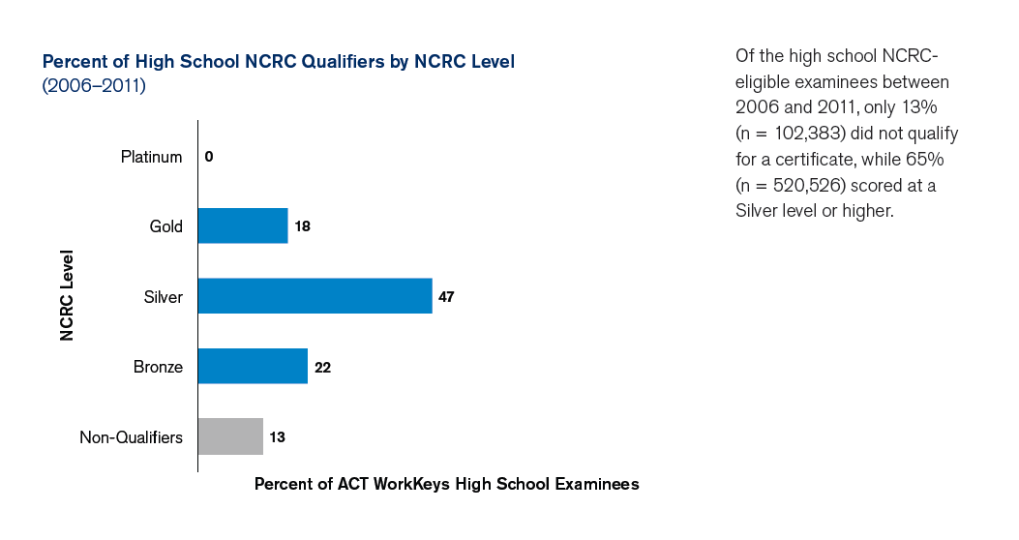
Percent of High School NCRC Qualifiers by NCRC Level
Notes:
This slide shows the percent of high school students who qualified for the NCRC and at what level.
Between 2006 and 2011, the majority of students earned at least a Silver certificate or higher, while only 13 percent did not qualify at all.
This is right in line with the statistics for all WorkKeys NCRC qualifiers – not just students – with 12 percent not qualifying, 21 percent earning a Bronze certificate, 49 percent earning a Silver, 19 percent a Gold, and 1 percent earning a Platinum certificate.

Slide 25
Career Exploration
Review the WorkKeys skills needed for different careers
Search for jobs by skill levels
profiles.keytrain.com/profile_search/
For detailed information, attend the “Using the Occupational Profile Database” webinar: student.gototraining.com/1yx78/catalog/4912135621342396416
Notes:
One of the best ways students can use their WorkKeys scores is to see what jobs they qualify for based on the Level Scores they earned, and ACT has a website just for that. Students can access the Occupational Profile Database, look at jobs they’re interested in, then see which WorkKeys tests and what skill levels are needed to qualify for the job. They can search by job title, job cluster, or job description.
They can also search for jobs by specific skill levels. To generate a list of jobs they’re qualified for, students should enter the Level Scores that they earned.
Let’s take a quick look at the website so you can see what I mean.
_____________________________________
For a more in-depth exploration, please attend the “Using the Occupational Profile Database” webinar, which is usually offered once a month by my colleague, Rick Harris. To find upcoming webinar dates, click on the link shown at the bottom of this slide.

Slide 26
Employment – New Jobs
The student should:
Include NCRC information and WorkKeys scores on résumés and job applications
Take this same information to job interviews
Employers can see if a student possesses the skills needed for the job
Notes:
Students should also consider including their NCRC information and WorkKeys scores on their résumé or on job applications because sometimes this information can be the difference between getting or not getting a job interview.
It’s also useful for students to take their National Career Readiness Certificate or their WorkKeys score report to an interview. This is an excellent way for them to show the employer that they have the skills needed to do the job.

Slide 27
Employment – Current Job
Skills may align better with another job
May have the skills needed for an advanced job
A happier worker?
Notes:
Some students already have jobs and want to continue in their current jobs after high school.
In this case, it may be beneficial for the students to share their NCRC or WorkKeys scores with their employer. Their scores may indicate that their skills may align better with another job. Or, they may find that they have the skills needed for an advanced job, which will likely mean higher pay.
Could this lead to a happier worker? Quite possibly. We all know that we enjoy our jobs better when we feel that they align with the skills we possess.

Slide 28
Entrance to/Exit from Community College Programs
Community colleges may require an NCRC prior to accepting students into a program
Some require the NCRC prior to awarding a certificate/diploma
Notes:
For those students who say the WorkKeys tests don’t have any benefit for them because they’re not going into the workforce, but to a community college instead, you may want to tell them that they should check the admission and exit requirements for any programs they may be interested in. Some community colleges require the NCRC prior to admitting a student into certain programs. For example, prior to admittance into the Electric Line Construction Academy at Nash Community College in Rocky Mount, North Carolina, students must earn at least a Bronze certificate.
At Durham Technical Community College, students may find that the NCRC is a prerequisite for a Continuing Education program that they’re interested in.
And, at Dyersburg State Community College in Tennessee, students pursuing the Associate of Applied Science degree in 5 different programs are required to earn an NCRC prior to receiving their degree.

Slide 29
College Credit – ACE and the NCRC
Recommendation for College Credit
Include WorkKeys scores with college application
The American Council of Education (ACE) has recommended the National Career Readiness Certificate for college credit:
Silver: 3 semester hours in applied critical thinking for vocational certificate programs
Gold or Platinum: 3 semester hours in applied critical thinking for lower-division baccalaureate or associate degree programs
Notes:
In addition, students may find that their WorkKeys scores qualify them for college credit. The American Council on Education’s College Credit Recommendation Service (or CREDIT) recommends that the Silver, Gold, and Platinum NCRCs qualify as college credit.
The Silver level certificate is recommended to count as 3 semester hours in applied critical thinking in the vocational certificate category.
The Gold and Platinum level certificates are also recommended to count as 3 semester hours in applied critical thinking, but in the lower-division baccalaureate or associate degree category.
Currently, almost 1,400 colleges and universities are in the ACE CREDIT College and University Network.

Slide 30
College Credit – ACE and the NCRC
What This Means to Students
According to studies conducted by the University of Michigan, 3 credit hours equates to between a 135- and 180-hour commitment by the individual
The average community college credit hour costs in the vicinity of $150. The average cost of a credit hour at an in-state university is $350.
This places the value of the NCRC and ACE’s endorsement between $450 and $1,050.
Notes:
As you can see from this slide, 3 credit hours equates to a student committing between 135 and 180 hours of their time. When you look at the cost at community colleges, which averages around $150 per credit hour, and the average cost at an in-state university, which is more than twice that, it’s very apparent that this can add up to a lot of time and money for those 3 credits.

Slide 31
College Credit – ACE and the NCRC
Informational Websites
The ACE College Credit Recommendation Service (CREDIT): www.acenet.edu/news-room/Pages/College-Credit-Recommendation-Service-CREDIT.aspx
The ACE National Guide to College Credit for Workforce Training: www2.acenet.edu/credit/?fuseaction=browse.main
ACE CREDIT – NCRC: www2.acenet.edu/credit/?fuseaction=browse.getOrganizationDetail&FICE=800047
Notes:
Here are a few websites where you can find more information about the ACE CREDIT program.

Slide 32

Additional Resources
Notes:
So, we’ve covered what WorkKeys scores are and what they mean, and we’ve also taken a look at the various uses for those scores. Now I want to give you some information about additional resources that will benefit you and your students.

Slide 33
MyWorkKeys.com
Make scores and NCRC available to employers
Keep track of their WorkKeys scores
MyWorkKeys.com
For more information, go to: www.act.org/certificate/order.html
Notes:
The first thing I want to talk about is MyWorkKeys.com. Students can view their scores and make their certificates available to employers by accessing a pre-created account at this website. Login information to their MyWorkKeys account will be printed on the back of their NCRC.
If a student doesn’t earn an NCRC but would like to set up an account, they should go to MyWorkKeys.com, then click on the link that says “The Certificate Account Quick Start Guide” before creating their account.
Once they access their MyWorkKeys account, they can allow their scores to be made “public,” but only in the sense that they could provide access to whomever they’d like – primarily, employers. These employers would then log in at the same website – but go in through a different portal – to see the student’s certificate.
For more information, you and your students can go to the website shown on the bottom of this page.

Slide 34
How Can You Help?
KeyTrain
Look at Scale Scores
Focus on areas of improvement
Notes:
You may be asking, “How can I help my students improve their WorkKeys scores?”
One way is through the use of KeyTrain, and I’ll talk more about that in just a moment.
If you don’t currently have access to KeyTrain, you can review each student’s scores, both Level and Scale, to determine areas of improvement. With WorkKeys Internet Version, Test Supervisors can download group reports that will include student scores for completed tests.
Once you have the scores, you can determine the areas that may need more attention and improvement.

Slide 35
KeyTrain
KeyTrain website: www.keytrain.com
Webinars: student.gototraining.com/1yx78/catalog/4912135621342396416
Contact information:
800.WORKKEY (967.5539)
info@keytrain.com
Notes:
As I just mentioned, KeyTrain is one way to help students improve their scores, as it’s the training system for ACT WorkKeys. It’s a targeted curriculum and learning tool designed specifically to help individuals master the applied workplace skills.
If you’d like to learn more about KeyTrain, please access the KeyTrain website at keytrain.com. You can also attend one or more of the webinars about KeyTrain. The link to the catalog of public webinars is shown on this slide. You may also get more KeyTrain information by calling 800.WORKKEY or e-mailing KeyTrain at info@keytrain.com.

Slide 36
Additional Websites
For Students and Educators
ACT WorkKeys Information: www.act.org/workkeys
Understanding WorkKeys Scores: www.act.org/workkeys/assess/understanding.html
Using Your WorkKeys Scores: www.act.org/workkeys/careerseekers/scores.html
Occupational Profile Database (Search Jobs by Skills): profiles.keytrain.com/profile_search/
Notes:
Here are some additional links to websites that you and your students may find useful.
The first link is to the ACT WorkKeys public website. From there, you can link to numerous pages with lots of information about WorkKeys.
A couple of sites that I wanted to specifically highlight are the “Understanding WorkKeys Scores” and the “Using Your WorkKeys Scores” web pages, so I’ve included the links for you.
Also, the link to the Occupational Profile Database where students can search for jobs by skills is included again on this page. As I mentioned earlier, this is a fantastic resource for your students. There are so many ways to explore the various jobs that they may be interested in or those in which they exhibit the required skills.

Slide 37
Additional Websites
For Educators
ACT Research Reports on Work Readiness: www.act.org/workreadiness/
ACT WorkKeys Key Facts Information Briefs: www.act.org/workkeys/briefs/
Ready for College and Ready for Work: Same or Different?: www.act.org/research/policymakers/pdf/ReadinessBrief.pdf
Notes:
Here are some links to sites that are geared more towards educators and policy makers.
The first is a web page that includes ACT Research Reports on Work Readiness. One of the newest reports is “The Condition of Work Readiness in the Unites States,” which I believe you’ll find very interesting.
The second link connects to a web page that includes ACT WorkKeys Key Facts Information Briefs. They really are brief, yet very informational.
Finally, I’ve included the link to a study that looks at whether getting ready for college and getting ready for work require the same level of readiness in math and reading.

Slide 38
Webinar Objectives
Review
Provide an overview of WorkKeys assessments
Explain how WorkKeys scores are calculated and what they mean
Explain the difference between Level Scores and Scale Scores
Demonstrate how students can use their WorkKeys scores
Provide you and your students with additional resources
Notes:
Why don’t we take a quick look back at what we’ve covered in today’s webinar:
First, we learned a bit about the WorkKeys assessments.
Then we talked about how WorkKeys scores are calculated, what the scores mean, and what the difference is between Level Scores and Scale Scores.
After that, we addressed the many ways these scores can be used by your students, including career exploration; employment; entrance to or exit from community college programs; and college credit.
And just a moment ago, I pointed out a number of additional resources that you and your students should find helpful.

Slide 39
For Information or Help…
WorkKeys Contact Center
800.WORKKEY (800.967.5539)
workkeys@act.org
Hours:
Monday-Friday (except holidays): 8:00 a.m. – 8:00 p.m. (Eastern time)
Saturday (except holiday weekends): 9:00 a.m. – 3:00 p.m. (Eastern time)
Notes:
If you have any questions about WorkKeys, KeyTrain, or any topic we’ve covered in this presentation, please call or e-mail the WorkKeys Contact Center.
Thank you!

