Slide 1

Math Warm-Up
[Class Name] [Teacher name]
Featuring a real ACT question!

Slide 2













Math Warm-Up
A.
Rewrite the left side of the equation.
49
B.
98
C.
99
D.
101
Notes:
The correct answer is D.
* Encourage students to think about how they can rewrite terms using the exponents rules to help them solve this equation.

Slide 3

Key Takeaways
Math Warm-Up
Apply Exponent Rules: Simplify terms while solving.
Identify Common Bases: For example, recognize 49 as 7 squared to simplify expressions.
Factor Out Smallest Powers: This will help clean up the math.

Slide 4
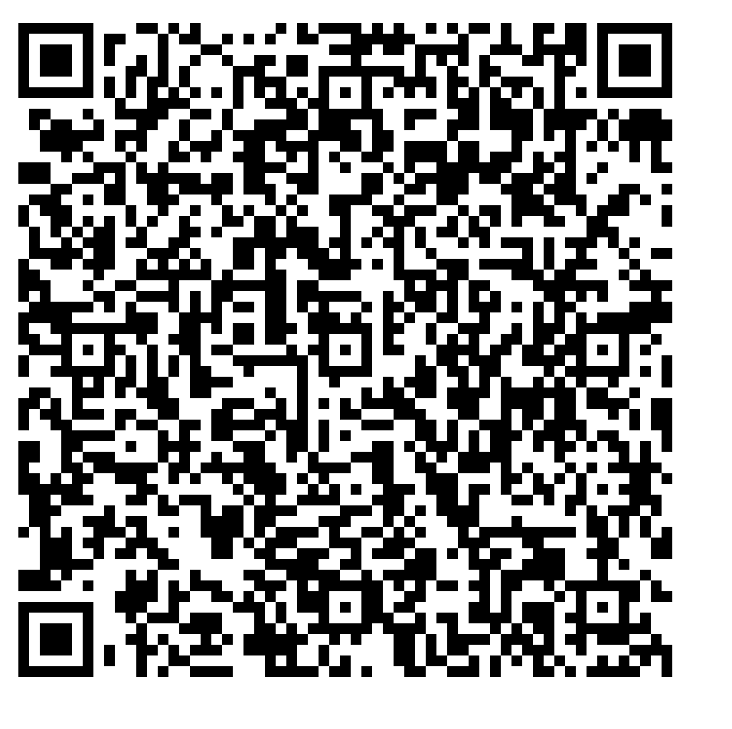
For more real ACT practice, visit act.org

