Slide 1

Reading Warm-Up
[Class Name] [Teacher name]
Featuring a real ACT question!

Slide 2
Reading Warm-Up: Passage
INFORMATIONAL: This passage is adapted from the article “The Tease of Memory” by David Glenn (©2004 by The Chronicle of Higher Education, Inc.).
In 1856, American author Nathaniel Hawthorne visited a decaying English manor house known as Stanton Harcourt. He was struck by the vast kitchen, which occupied the bottom of a 70-foot tower.
Hawthorne wrote that as he stood in that kitchen, he was seized by an uncanny feeling: “I was haunted and perplexed by an idea that somewhere or other I had seen just this strange spectacle before. The height, the blackness, the dismal void, before my eyes, seemed as familiar as the decorous neatness of my grandmother’s kitchen.” He was certain that he had never actually seen this room or anything like it. And yet for a moment he was caught in what he described as “that odd state of mind wherein we fitfully and teasingly remember some previous scene or incident, of which the one now passing appears to be but the echo and reduplication.”
P1: H’s experience at manor
Notes:
* Approach this first blurb and paragraph as follows:
Unpack the blurb together; discuss what the title “The Tease of Memory” might indicate about the topic (something deceptive about memory).
Give students 30-45 seconds to read the first two paragraphs.
Ask students what kind of note they would make for the first two paragraphs.
Emphasize that students need not get bogged down in the details, which they can look up later if needed, but should make a note that summarizes the content.

Slide 3
Reading Warm-Up: Passage
When Hawthorne wrote that passage there was no common term for such an experience. But by the end of the 19th century, after discarding “false recognition,” “paramnesia,” and “promnesia,” scholars had settled on a French candidate: “déjà vu,” or “already seen.”
The fleeting melancholy and euphoria associated with déjà vu have attracted the interest of poets and novelists of many stripes. Most academic psychologists, however, have ignored the topic. Déjà vu is difficult to study because it produces no measurable external behaviors. Researchers must trust their subjects’ personal descriptions of what is going on inside their minds. Psychology has generally filed déjà vu away in a drawer marked “Interesting but Insoluble.”
During the past two decades, however, a few hardy souls have reopened the scientific study of déjà vu. Alan S. Brown, a professor of psychology at Southern Methodist University, surveys the fledgling subfield. “What we can try to do is zero in on it from a variety of different angles,” he says.
P2: decided on term-
déjà vu (dv)
P3: why dv’s not studied academically
P4: Brown surveyed study of dv
Notes:
* Approach this first blurb and paragraph as follows:
Unpack the blurb together; discuss what the title “The Tease of Memory” might indicate about the topic (something deceptive about memory).
Give students 30-45 seconds to read the first two paragraphs.
Ask students what kind of note they would make for the first two paragraphs.
Emphasize that students need not get bogged down in the details, which they can look up later if needed, but should make a note that summarizes the content.

Slide 4
Reading Warm-Up: Passage
In Brown’s account, scientific theories of déjà vu fall into four broad categories. In the first category are theories of “dual processing.” The late neuropsychiatrist Pierre Gloor conducted experiments in the 1990s strongly suggesting that memory involves distinct systems of “retrieval” and “familiarity.” In a 1997 paper, he speculated that déjà vu occurs at rare moments when our familiarity system is activated but our retrieval system is not.
In the second category are more purely neurological explanations. One such theory holds that déjà vu experiences are caused by small, brief seizures. Researchers have found that déjà vu can be elicited by electrically stimulating certain regions of the brain.
P5: 4 theories-
1st dual processing (Gloor)
P6: 2nd neurological, seizures
Notes:
* Continue giving students time to read and then eliciting notes.

Slide 5
Reading Warm-Up: Passage
Brown’s third category consists of memory theories. These propose that déjà vu is triggered by something we have actually seen or imagined before, either in waking life, in literature or film, or in a dream. Some of these theories hold that a single element, perhaps familiar from some other context, is enough to spark a déjà vu experience. (Suppose, for example, that the chairs in Stanton Harcourt’s kitchen were identical in color and shape to Hawthorne’s decorously neat grandmother’s, but that he didn’t recognize them in this new context.) At the other end of the scale are theories which suggest that we sometimes falsely recognize a general visual or audio pattern. (Suppose that the Stanton Harcourt kitchen looked similar, in broad visual outline, to a long-forgotten church that Hawthorne had once attended.)
P7: 3rd memory theories
Notes:
* Continue giving students time to read, and then eliciting notes.

Slide 6
Reading Warm-Up: Passage
In the final category are “double perception” theories of déjà vu, which suggest that a brief interruption in our normal process of perception might make something appear falsely familiar. In 1989, in one of the first laboratory studies that tried to induce something like déjà vu, the cognitive psychologists Larry L. Jacoby and Kevin Whitehouse, of Washington University in St. Louis, showed their subjects a long list of words on a screen. The subjects then returned a day or a week later and were shown another long list of words, half of which had also been on the first list. They were asked to identify which words they had seen during the first round.
P8: 4th double perception
Jacoby & Whitehouse experiment
Notes:
* Continue giving students time to read, and then eliciting notes.

Slide 7
Reading Warm-Up: Passage
The experimenters found that if they flashed a word at extremely quick, subliminal speeds (20 milliseconds) shortly before its “official” appearance on the screen during the second round, their subjects were very likely to incorrectly say that it had appeared on the first list. Those results lent at least indirect support to the notion that if we attend to something half-consciously and then give it our full attention, it can appear falsely familiar.
“This will be very slow progress toward a very abstract phenomenon,” Brown says.
P9: experiment results
P10: Brown- understanding dv will take time
Big Picture Summary:
dv not scientifically understood – 4 possible explanations
Notes:
* Continue giving students time to read, and then eliciting notes.
* Elicit a Big Picture Summary; emphasize that students’ summaries should encompass the entire passage. (Hawthorne’s experience is not included in the summary since it is an introduction.)

Slide 8
Reading Warm-Up: Question
Big Picture Summary:
dv not scientifically understood – 4 possible explanations
The main idea of the passage is that:
A.
when Hawthorne wrote about Stanton Harcourt, there was no accepted term for the feeling now called déjà vu.
B.
psychologists agree that déjà vu is difficult to study because it produces no measurable external behaviors.
C.
scientists have learned that the feeling of déjà vu can be triggered by electrically stimulating certain regions of the brain.
D.
the scientific study of déjà vu approaches the phenomenon from various angles in an attempt to understand it.
Notes:
The correct answer is D.
* Show that this question is answered by looking at the big picture thinking at the end of the passage.

Slide 9
Reading Warm-Up
Key Takeaways
Focus on the Big Picture: Use passage summaries to identify the overarching theme rather than getting distracted by details in single paragraphs.
Eliminate Overly Specific Options: Incorrect choices often focus on a single experiment, figure, or sub-theory (like options A, B, and C).
Seek Multi-Angle Synthesis: Choose the option that encompasses the entire scope and connects different elements of the passage (like option D).
Notes:
The correct answer is D.
* Show that this question is answered by looking at the big picture thinking at the end of the passage.

Slide 10
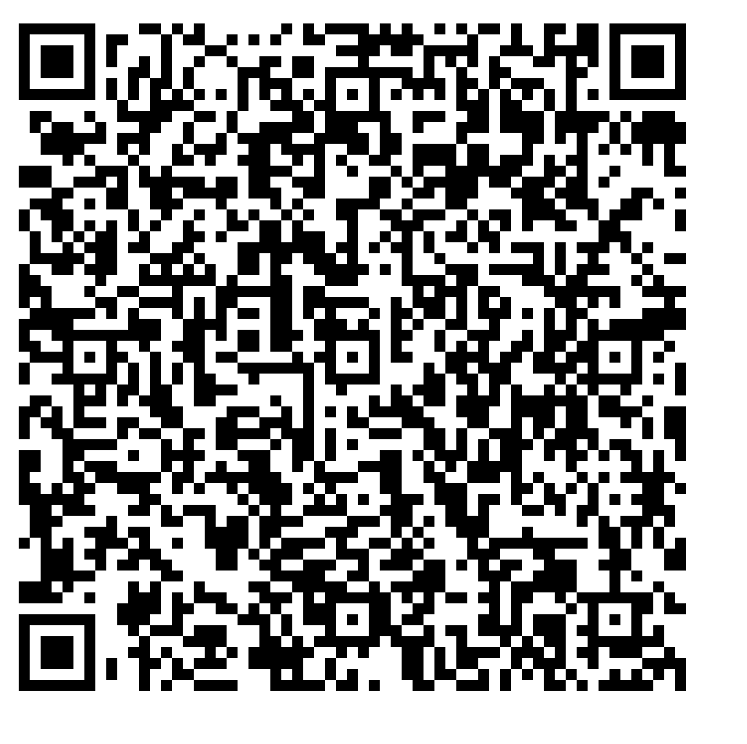
For more real ACT practice, visit act.org

