Slide 1

Science Warm-Up
[Class Name] [Teacher name]
Featuring a real ACT question!

Slide 2
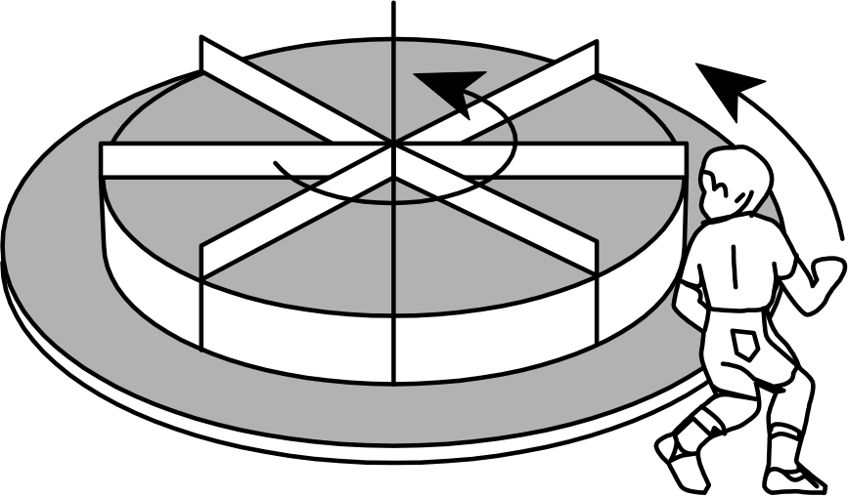
Science Warm-Up: Passage
Students conducted an experiment to see how jumping on a merry-go-round affects how fast it spins. In each case an empty spinning merry-go-round was approached by a student who ran in the direction shown in Figure 1 and then jumped on the edge. Several trials, each consisting of three runs, were performed using students of different masses running at different speeds, and different initial spin rates for the merry-go-round, given in revolutions per minute (rpm). The results are shown in Table 1.
Data Representation
Table 1
Trial | Mass of student (kg) | Speed of student (m/sec) | Initial spin rate (rpm) | Final spin rate (rpm)
1 | 30 | 1.00 | 10 | 9.54
 | 30 | 1.36 | 10 | 10.00
 | 30 | 2.00 | 10 | 10.82
2 | 20 | 1.00 | 10 | 9.67
 | 30 | 1.00 | 10 | 9.54
 | 40 | 1.00 | 10 | 9.42
Figure 1 adapted from Richard Wolfson and Jay M. Pasachoff, Physics: Extended with Modern Physics. ©1989 by Scott, Foresman/Little, Brown Higher Education.
Figure 1
Notes:
Overview
* Elicit passage type (Data Representation)
* Elicit how they can tell it’s Data Representation (because relatively little text/more than 1 figure/no numbered studies)

Slide 3
Science Warm-Up: Passage
Students conducted an experiment to see how jumping on a merry-go-round affects how fast it spins. In each case an empty spinning merry-go-round was approached by a student who ran in the direction shown in Figure 1 and then jumped on the edge. Several trials, each consisting of three runs, were performed using students of different masses running at different speeds, and different initial spin rates for the merry-go-round, given in revolutions per minute (rpm). The results are shown in Table 1.
Figure 1
Figure 1 adapted from Richard Wolfson and Jay M. Pasachoff, Physics: Extended with Modern Physics. ©1989 by Scott, Foresman/Little, Brown Higher Education.
Notes:
So the students can more easily read the text
* Elicit all that’s needed from the text? (Jumping on a merry go round affects speed of the merry-go-round)

Slide 4
Science Warm-Up: Passage
Table 1
Trial | Mass of student (kg) | Speed of student (m/sec) | Initial spin rate (rpm) | Final spin rate (rpm)
1 | 30 | 1.00 | 10 | 9.54
 | 30 | 1.36 | 10 | 10.00
 | 30 | 2.00 | 10 | 10.82
2 | 20 | 1.00 | 10 | 9.67
 | 30 | 1.00 | 10 | 9.54
 | 40 | 1.00 | 10 | 9.42
3 | 20 | 1.36 | 10 | 10.00
 | 30 | 1.36 | 10 | 10.00
 | 40 | 1.36 | 10 | 10.00
4 | 20 | 3.00 | 10 | 11.50
 | 30 | 3.00 | 10 | 12.10
 | 40 | 3.00 | 10 | 12.70
Notes:
* Flip between this and the next slide to show all of the data (otherwise Initial spin rate looks like a constant)
* Give time to allow students to analyze strategically
* Determine Variables, Scales, Labels, etc. (from Step 2 of the method)

Slide 5
Science Warm-Up: Passage
Table 1
Trial | Mass of student (kg) | Speed of student (m/sec) | Initial spin rate (rpm) | Final spin rate (rpm)
5 | 30 | 0.50 | 5 | 4.77
 | 30 | 0.68 | 5 | 5.00
 | 30 | 1.00 | 5 | 5.41
6 | 20 | 0.50 | 5 | 4.84
 | 30 | 0.50 | 5 | 4.77
 | 40 | 0.50 | 5 | 4.70
7 | 20 | 0.68 | 5 | 5.00
 | 30 | 0.68 | 5 | 5.00
 | 40 | 0.68 | 5 | 5.00
8 | 20 | 3.00 | 5 | 7.10
 | 30 | 3.00 | 5 | 7.97
 | 40 | 3.00 | 5 | 8.74
IV:
mass of student (kg),
speed of student (m/sec),
initial spin rate (rpm)
DV:
final spin rate (rpm)
Notes:
* Elicit IV and DV (including the units)
* Different trials test the effect of different independent variables
* Elicit from students what trials are testing the influence of what variables and how they can tell (other IVs constant)

Slide 6
Science Warm-Up: Question
Table 1
Trial | - | Speed of student (m/sec) | - | Final spin rate (rpm)
5 | - | 0.50 | - | 4.77
 | - | 0.68 | - | 5.00
 | - | 1.00 | - | 5.41
6 | - | 0.50 | - | 4.84
 | - | 0.50 | - | 4.77
 | - | 0.50 | - | 4.70
7 | - | 0.68 | - | 5.00
 | - | 0.68 | - | 5.00
 | - | 0.68 | - | 5.00
8 | - | 3.00 | - | 7.10
 | - | 3.00 | - | 7.97
 | - | 3.00 | - | 8.74
In Trial 5, as the students’ speed increased, the final spin rate:
F.
decreased only.
G.
increased only.
H.
increased, then decreased.
J.
remained the same.
Notes:
The correct answer choice is (G)
* Provide time to work through this problem and then review
* Encourage students to isolate only what data they need
* Use the “arrow trick”: Draw arrows in the direction of increase
* This is a direct relationship, but students don’t need to know that/use that vocabulary

Slide 7

Key Takeaways
Science Warm-Up
Identify Variables Quickly: Distinguish independent variables (like speed and mass) from dependent variables (like final spin rate).
Isolate Relevant Trials: Focus only on the requested trial (e.g., Trial 5) to analyze specific trends without getting distracted.
Track Step-by-Step Trends: Observe if values increase or decrease sequentially to determine direct relationships.

Slide 8
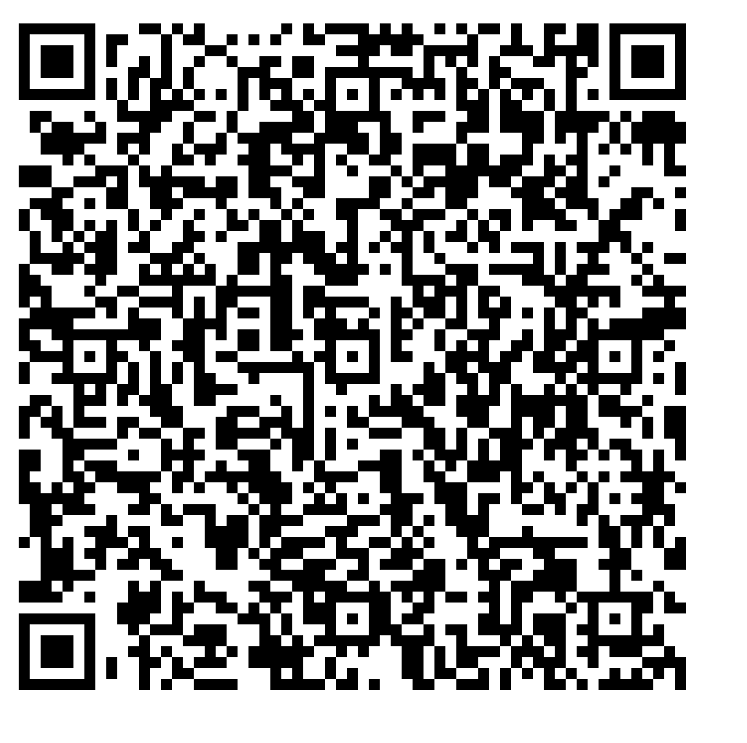
For more real ACT practice, visit act.org

